Slide 1
SPECIAL MEETING OF THE
ARKANSAS HIGHER EDUCATION
COORDINATING BOARD
April 27, 2023

Slide 2

AHECB Meeting
April 27, 2023
Annual Report of
Student Retention and Graduation
Sonia Hazelwood, Assistant Director
Information Systems & Technology Innovation

Slide 3
National Retention Rates
According to the most recent data published in May 2022, from the National Center for Education Statistics (NCES), 82% of the first-time, full-time degree-seeking students who enrolled at 4-year public or private degree-granting institutions in fall 2019 returned in the fall 2020.
At public 4-year institutions overall, the retention rate was also 82%.
The national retention rate was 61% for first-time, full-time, degree-seeking students who enrolled at a public 2-year college in fall 2019 and then returned in fall 2020.

Slide 4
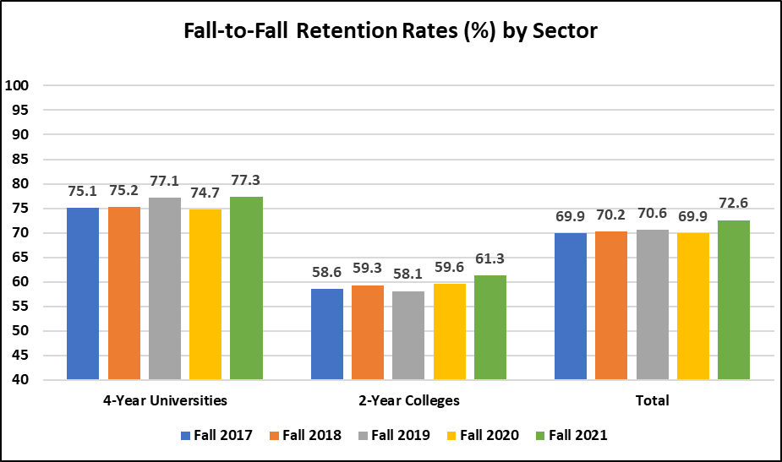
Retention – Public Institutions
The retention calculations are based on fall-to-fall comparisons of students in the IPEDS cohort of first-time entering, full-time, and credential-seeking students from the fall term only.
Retention rates for our 2-year colleges follows the IPEDS model that includes any certificates awarded to the student during the year.

Slide 5
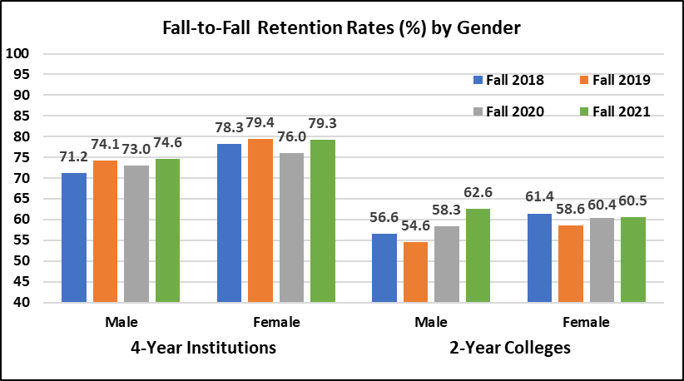
Retention – Public Institutions
Both male and female cohorts showed improved retention rates for our public 4-year institutions. Female students increased their retention rate by 3.3%
For our 2-year colleges, both male and female cohorts reported increases, with the male cohort increasing 4.3%.

Slide 6
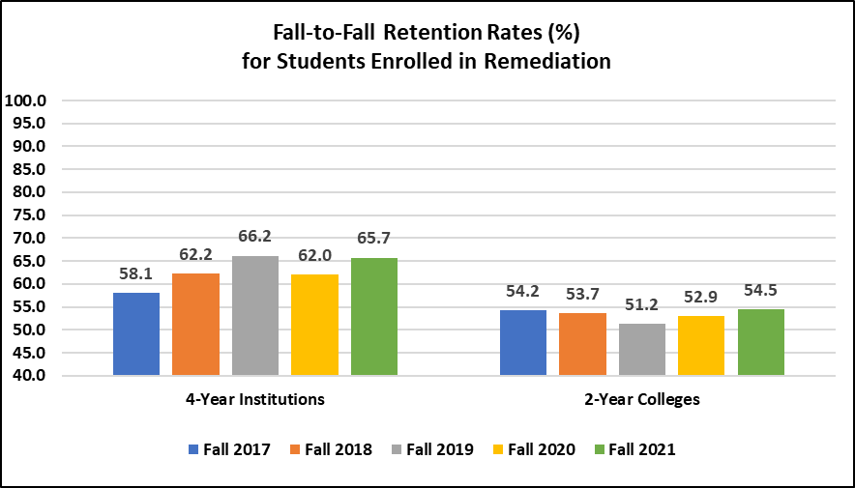
Retention – Public Institutions
Retention rates for students requiring at least one remedial class improved for both our 4-year institutions and 2-year colleges.

Slide 7
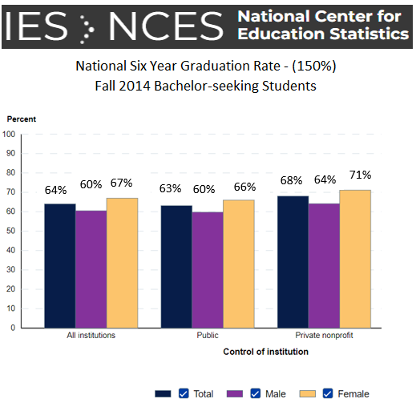
Graduation Rates
https://nces.ed.gov/programs/coe/indicator/ctr
Notes:
NOTE: Data shown represent the 50 states and the District of Columbia. Data are for 4-year degree-granting postsecondary institutions participating in Title IV federal financial aid programs. Graduation rates refer to students receiving bachelor’s degrees from their initial institutions of attendance only.
NOTE: Data shown represent the 50 states and the District of Columbia. Data are for 2-year degree-granting postsecondary institutions participating in Title IV federal financial aid programs. Graduation rates refer to students receiving associate’s degrees or certificates from their initial institutions of attendance only. An example of completing a credential within 150 percent of the normal time is completing a 2-year degree within 3 years

Slide 8
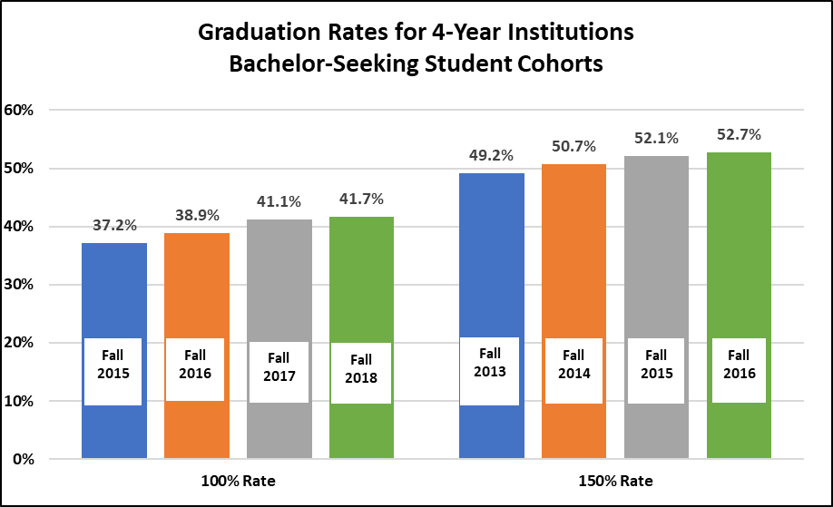
Graduation Rates – Public Institutions
For the 4-Year institutions, there has been slow but steady increases in both the 100% and the 150% graduation rates.

Slide 9
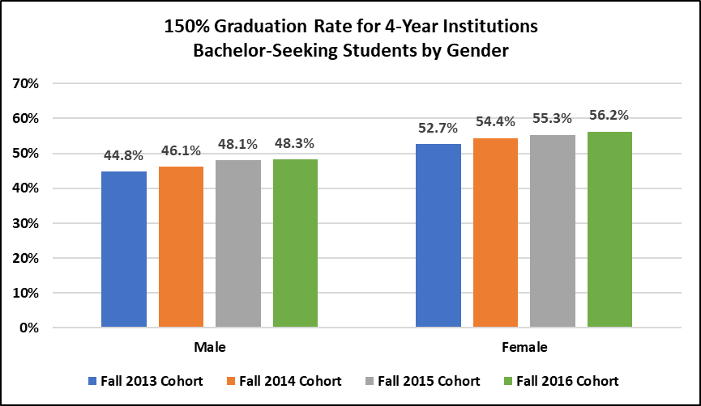
Graduation Rates – Public Institutions
For the 4-Year institutions, there has been slow but steady increases in both the 100% and 150% graduation rates for both male and female students.

Slide 10
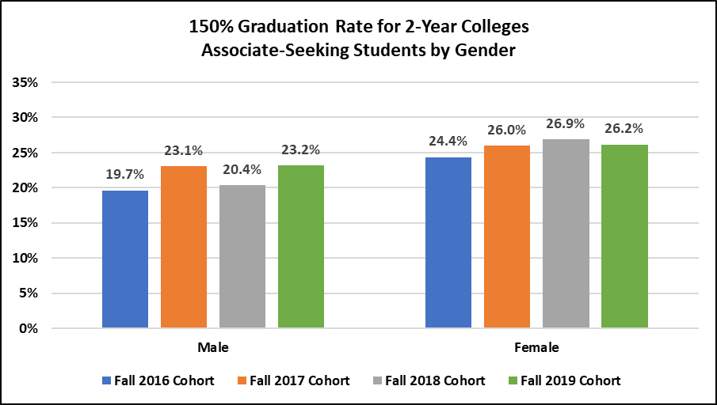
For the 2-year colleges, male students reported a 2.8% increase in their 150% graduation rate, while female students showed a slight decline.

Slide 11
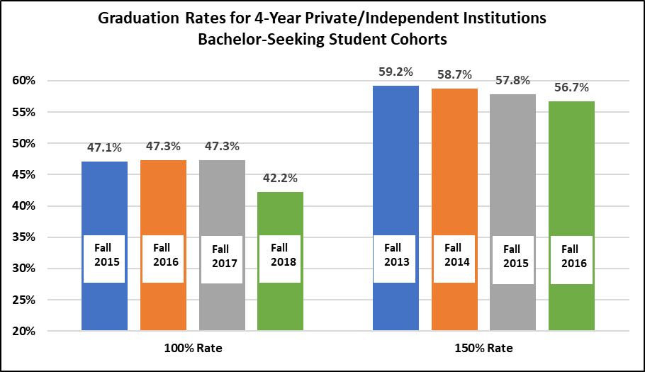
Graduation Rates – Private/Independent
Our private colleges reported a decrease in the 100% rate of 5.1%, and a smaller decrease of 1.1% for the 150% rate.

Slide 12
AHECB Meeting
April 27, 2023
Annual Report of
Retention and Graduation
of Student-Athletes
Sonia Hazelwood, Assistant Director
Information Systems & Technology Innovation

Slide 13
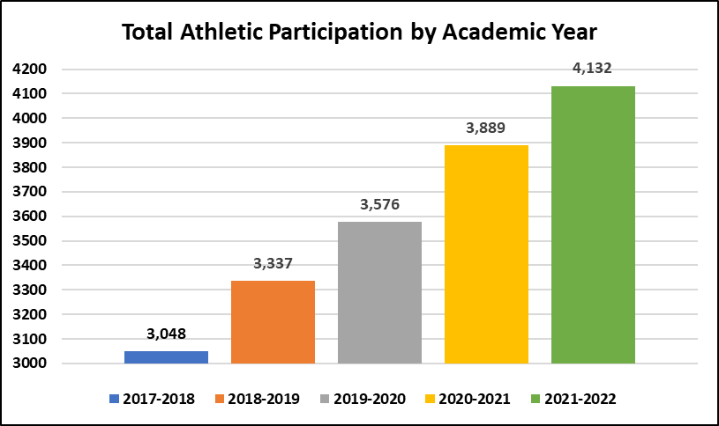
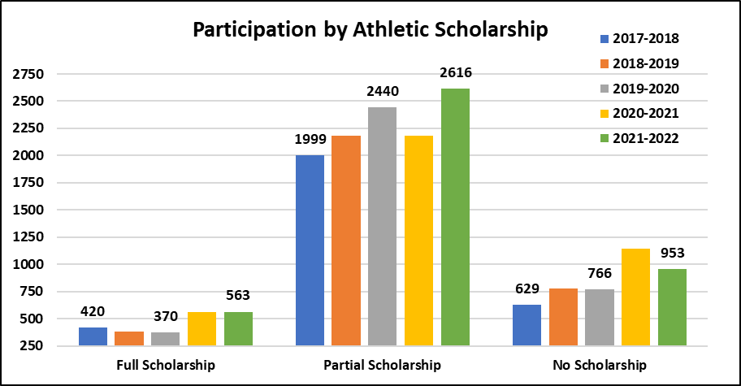
AY 2022 Student-Athlete Overview

Slide 14
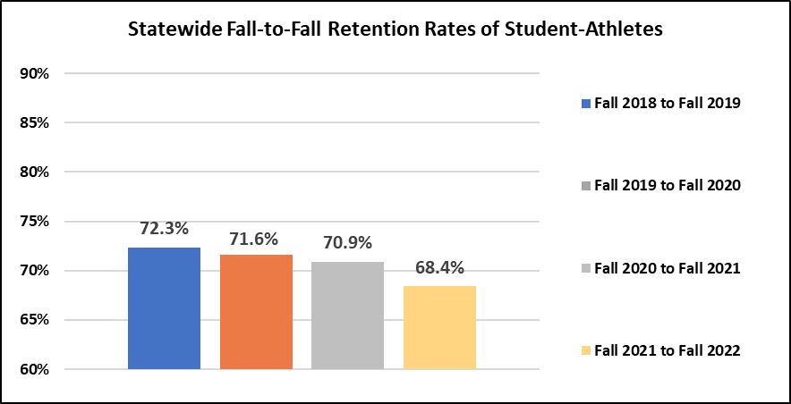
Retention of Student-Athletes

Slide 15
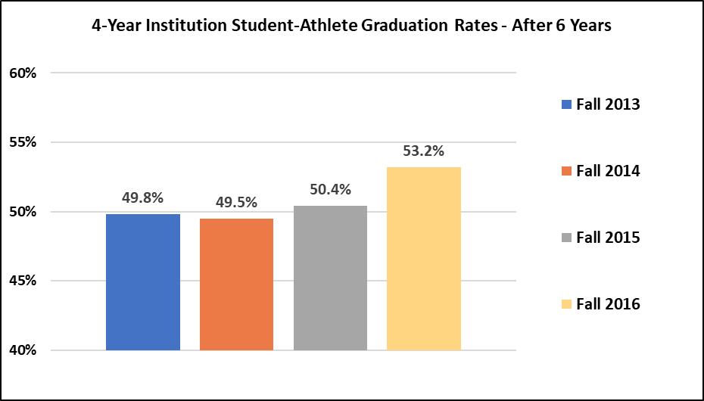
Graduation Rates of Student-Athletes

Slide 16
Any Questions?

Slide 17


AGENDA ITEM NO. 3
ANNUAL REPORT ON FIRST-YEAR STUDENT REMEDIATION
Mason Campbell
Chief Academic Officer

Slide 18
Report on Remediation
In accordance with A.C.A. §6-61-110 and Act 970 of 2009, the Arkansas Division of Higher Education (ADHE) addresses the placement standards necessary for enrollment of students into mathematics, English composition, and reading based on appropriate indicators of potential student success rates.
  Students who required remediation during their first year of enrollment in a public state-supported institution of higher education in this state if the enrollment occurred within two (2) years of graduation from a secondary school in this state.
  Students who require remediation and who graduated with a 3.0 or higher grade point average.
  Attempts it takes a student to pass postsecondary remedial courses.

Slide 19
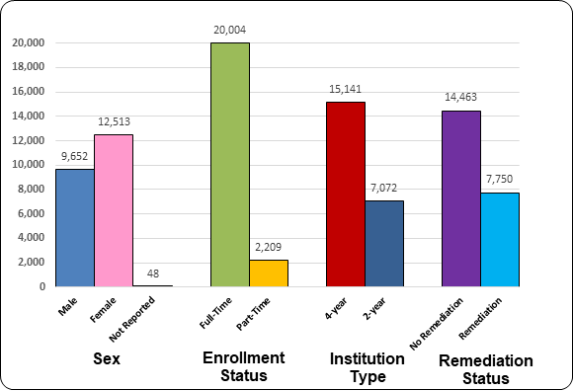
Report on Remediation
First-Time Entering Students – Fall 2022
22,213 Students

Slide 20
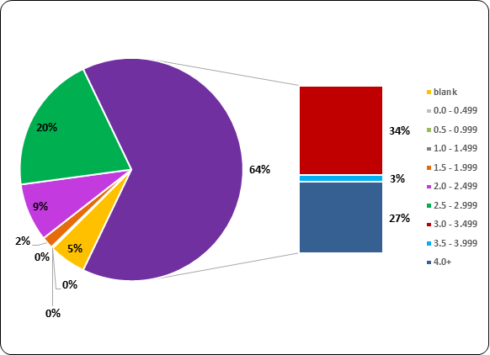
Report on Remediation
High School GPA of Students Requiring Remediation
Fall 2022 – 7,750 Students

Slide 21
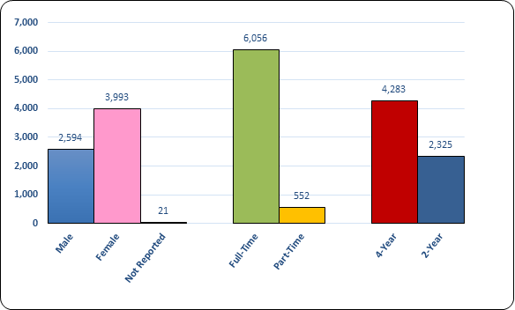
Report on Remediation
First-Year Rate Students Requiring Remediation
Fall 2022 – 6,608 Students

Slide 22
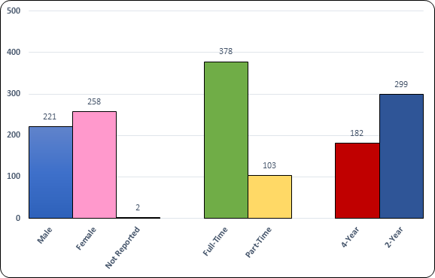
Report on Remediation
Second-Year Rate Students Requiring Remediation
Fall 2022 – 481 Students

Slide 23
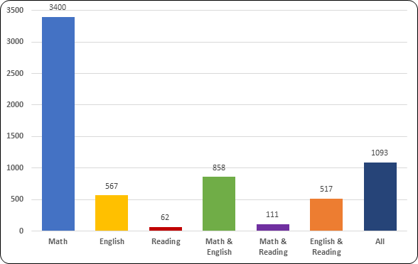
Report on Remediation
First-Year Rate Students Requiring Remediation by Subject Area
Fall 2022 – 6,608 Students

Slide 24
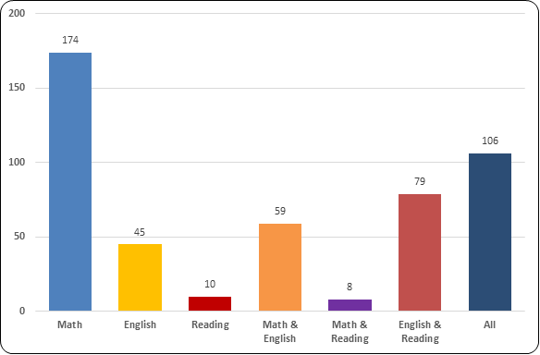
Report on Remediation
Second-Year Rate Students Requiring Remediation by Subject Area
Fall 2022 – 481 Students

Slide 25
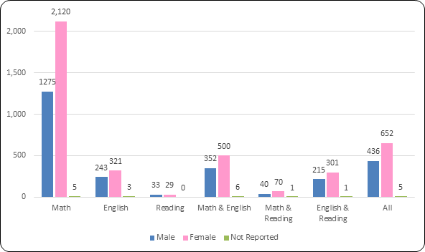
Report on Remediation
First-Year Rate Students Requiring Remediation by Sex
Fall 2022 – 6,608 Students

Slide 26
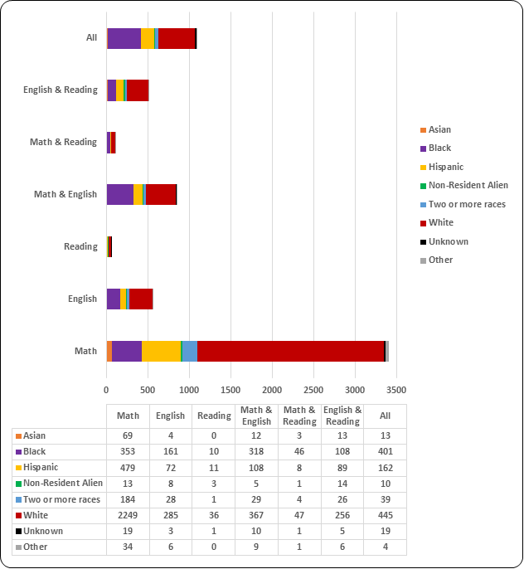

Slide 27
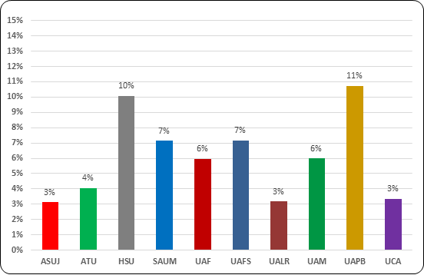
Report on Remediation
Rate of First-Time Entering Students Requiring Remediation
to Total Fall 2022 Term Enrollment

Slide 28
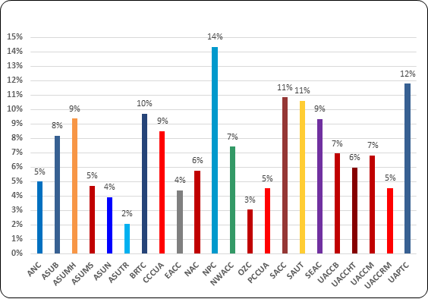
Report on Remediation
Rate of First-Time Entering Students Requiring Remediation
to Total Fall 2022 Term Enrollment

Slide 29
Questions?

Slide 30

AGENDA ITEM NO. 4
PRODUCTIVITY OF RECENTLY APPROVED PROGRAMS
Mason Campbell
Chief Academic Officer

Slide 31
Program Viability Standards
Graduates Required over 3-Year Period
18
12
01 - CERTIFICATES OF PROFICIENCY
02 - TECHNICAL CERTIFICATES
03 - ASSOCIATE DEGREES (AAS ONLY)
05 – BACHELOR’S DEGREES
12
05 – BACHELOR’S DEGREES
(in science, mathematics, engineering, foreign languages, middle school education, and secondary education programs for licensure in science and mathematics)
07 – MASTER’S DEGREES
08 – SPECIALIST DEGREES
19 – DOCTORAL: PROFESSIONAL PRACTICE
18
6
03 - ASSOCIATE DEGREES (AA, AS, AND AAT)
17 – Doctoral: Research/Scholarship

Slide 32
Productivity of Recently
Approved Programs Report
Programs Evaluated
52
20
New Certificates
& Associate Degrees
(Approved in AY2020)
New Bachelor, Graduate & Professional Degrees
(Approved in AY2018)
66%
Of All Recently Approved Programs Are on Track to Meet Standards

Slide 33
Report Similarities:
Productivity of New Programs Report and Program Viability Report
Reporting Standards | Program Viability Standards
Shared Data File
  Productivity Report data is derived from Program Viability data file
Reporting Timeline
  Productivity of New Programs Report
  Program Viability Report

Slide 34
Shared (Program Viability) Standards
AHECB adopted new program viability standards in October 2008.
The 2008 viability standards, based on a 3-year average, are as follows:
  Average of four (4) graduates per year for CTE degrees and certificates
  Average of four (4) graduates per year for bachelor’s degrees in science, mathematics, engineering, foreign languages, and secondary education
  Average of six (6) graduates per year for transfer associate degrees (AA, AS, and AAT) and bachelor’s programs;
  Average of four (4) graduates per year for master’s, specialist and first-professional programs; and,
  Average of two (2) graduates per year for doctoral programs

Slide 35
Productivity of Recently
Approved Programs Report

Slide 36
Program Viability Report
Each year, the Program Viability Report
details “new programs” (highlighted in yellow).

Slide 37
Questions?

Slide 38
PUBLIC COMMENTS/
ANNOUNCEMENTS
Follow-up questions can be sent to: Nichole.Abernathy@adhe.edu
Presentations will be posted on the ADHE website at:
https://www.adhe.edu/about-adhe/coordinating-board/board-presentations

