Slide 1

REGULAR MEETING OF THE
ARKANSAS HIGHER EDUCATION
COORDINATING BOARD
October 27, 2023

Slide 2
AHECB Members
Graycen Bigger, Chair
Dr. Jim Carr, Secretary
Al Brodell
Dr. Jerry Cash
Kelley Erstine
Chad Hooten
Dr. Kyle Miller
Lucas Pointer
Carolyn Rhinehart

Slide 3
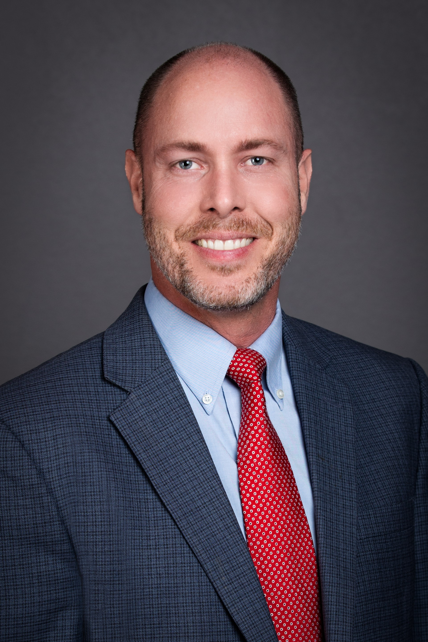

New AHECB Members
Lucas Pointer
Carolyn Rhinehart

Slide 4
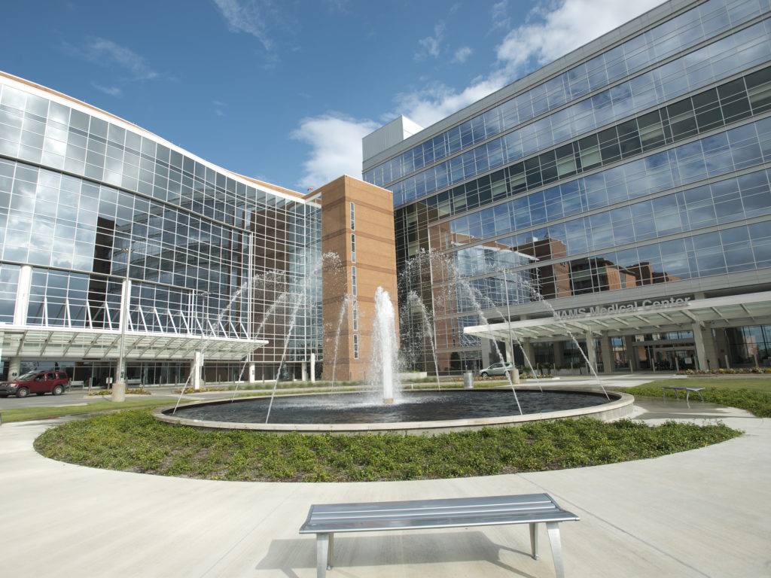

Dr. Cam Patterson, Chancellor
University of Arkansas for Medical Sciences

Slide 5
Dr. Stephanie Gardner, Provost
University of Arkansas for Medical Sciences

Slide 6
FINANCE COMMITTEE

Slide 7
Nick Fuller
Assistant Commissioner
AGENDA ITEM NO. 1:
BOND AND LOAN FEASIBILITY UPDATES

Slide 8
Bond and Loan Feasibility Updates
This update consists of the actual terms for bond and loan issues receiving AHECB approval that occurred from October 2022 through October 2023.
Report includes the actual date of bond/loan issue, amount of bond/loan issue and actual bond/loan terms for bond and loans approved during the reporting period

Slide 9
Nick Fuller
Assistant Commissioner
AGENDA ITEM NO. 2:
REPORT ON INTERCOLLEGIATE ATHLETIC REVENUES & EXPENDITURES 2022-23

Slide 10
Athletic Report
A.C.A. §6-62-106 directs AHECB to develop and establish uniform accounting standards and procedures for reporting revenues and expenditures.
The 2022-23 Athletic actual expenditures for state-supported universities was $242.3 million and $4.3 million for two-year colleges.
This represents an increase of 12.1 percent over 2021-22.

Slide 11
Revenues By Source

Slide 12
% of Athletic Revenues By Source 2022-23

Slide 13
Expenditures By Source

Slide 14
% of Athletic Expenditures By Source 2022-23

Slide 15
ANY QUESTIONS?

Slide 16
Nick Fuller
Assistant Commissioner
AGENDA ITEM NO. 4:
PRODUCTIVITY-BASED FUNDING DISTRIBUTION 2024-25

Slide 17
Productivity Funding Distribution
7th Year of Productivity Funding Model.
Baseline Metrics used data from AY2019-2021 with Comparative metrics based on AY2020-2022.
Overall Productivity Decrease of 0.14% resulting in a recommendation for 0.00% funding increase.
$4,555,985 in “Incentive Funding” from FY2024 recommended to be utilized for Statewide purposes as per Funding Distribution policy.

Slide 18
Productivity Funding Distribution

Slide 19
Productivity Funding Distribution

Slide 20
Productivity Funding Distribution

Slide 21
Productivity Funding Distribution

Slide 22
Productivity Funding Distribution

Slide 23
Productivity Funding Distribution

Slide 24
Productivity Funding Distribution

Slide 25
ANY QUESTIONS?

Slide 26
Nick Fuller
Assistant Commissioner
AGENDA ITEM NO. 3:
OPERATING RECOMMENDATIONS FOR THE 2024-2025 FISCAL YEAR

Slide 27
ADHE Recommendation
Recommendations for State Operating levels are based on Productivity Funding Recommendations as well as current estimates for EETF and WF2000 funding. Non-formula recommendations are based off of 2nd year recommendations approved last year.
ADHE is recommending an additional 2% spending authority increase to the funding recommendations within the productivity model to account for any fluctuations with the forecast for special revenues that are included in the State appropriations.

Slide 28
Operating Recommendations

Slide 29
Operating Recommendations

Slide 30
Operating Recommendations

Slide 31
Operating Recommendations

Slide 32
Operating Recommendations

Slide 33
Operating Recommendations

Slide 34
ANY QUESTIONS?

Slide 35
ACADEMIC COMMITTEE

Slide 36
Mason Campbell
Assistant Commissioner
of Academic Affairs

Slide 37

New Program
Technical Certificate in Practical Nursing
Academic Affairs Agenda Item No. 5

Slide 38
New Administrative Unit and Program
Trails Trade School and Construction Technology
Certificate of Proficiency in Trail Management,
Certificate of Proficiency in Trails Technician,
Technical Certificate in Trails and Community Development, and Technical Certificate in Trails Construction and Maintenance
Academic Affairs Agenda Item No. 6

Slide 39

New Program
Doctor of Musical Arts in Music
Academic Affairs Agenda Item No. 7

Slide 40
New Program
Master of Science and Graduate Certificates
in Environmental Resiliency
Academic Affairs Agenda Item No. 8

Slide 41
Alana Boles
Associate Director of
Private Postsecondary Education

Slide 42
New Programs from Out-of-State Institutions
4 Institutions: 2 Private Institutions, 2 Public Institutions
15 Programs
Academic Affairs Agenda Item No. 9

Slide 43
Tracy Harrell
Chief Program Development Officer
Academic Affairs

Slide 44
Letters of Notification
80 Letters of Notification from 21 Arkansas Public Institutions
received by August 1, 2023
n | Requested Action
12 | Approved Degree Programs List Correction
6 | CIP Change
27 | Curriculum Revision
1 | Delete Option, Emphasis, Concentration, or Minor
5 | Existing Program Offered at Existing Off-Campus Location
4 | Existing Program Offered by Distance Education
8 | New Certificate
5 | New Option, Emphasis, Concentration, or Minor
11 | Program Deletion
12 | Program Inactivation
1 | Program Reactivation
5 | Program Reconfiguration
8 | Title Change
Academic Affairs Agenda Item No. 10

Slide 45
Letters of Intent
8 Letters of Intent from 7 Arkansas Public Institutions
received by October 2, 2023
n | Reason of Intent
1 | New Instruction Center
7 | New Program
Academic Affairs Agenda Item No. 11

Slide 46
REGULAR MEETING OF THE
ARKANSAS HIGHER EDUCATION
COORDINATING BOARD
October 27, 2023

Slide 47
Approval of Minutes
June 29 Special Meeting
July 28 Regular Meeting

Slide 48
Chair Graycen Bigger will appoint members of the Arkansas Higher Education Coordinating Board nominating committee. The nominating committee will recommend Board officers for 2024-25 at the January 27, 2024, meeting.
Al Brodell
Dr. Jim Carr

Slide 49
2024 Coordinating Board Meeting Schedule
January 26, 2024 National Park College, Hot Springs
April 26, 2024 North Arkansas College, Harrison
July 26, 2024 University of Central Arkansas, Conway
October 25, 2024 University of Arkansas Community College, Batesville

Slide 50
Dr. Ken Warden
Commissioner
AGENDA ITEM NO. 15:
COMMISSIONER’S REPORT

Slide 51
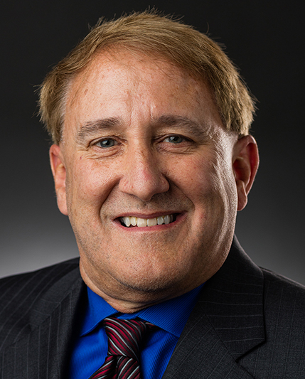

Institutional Changes
Dr. Russell Jones
Acting Interim President
Arkansas Tech University
Dr. Sheila Jacobs
Interim Chancellor
ATU-Ozark

Slide 52


Slide 53
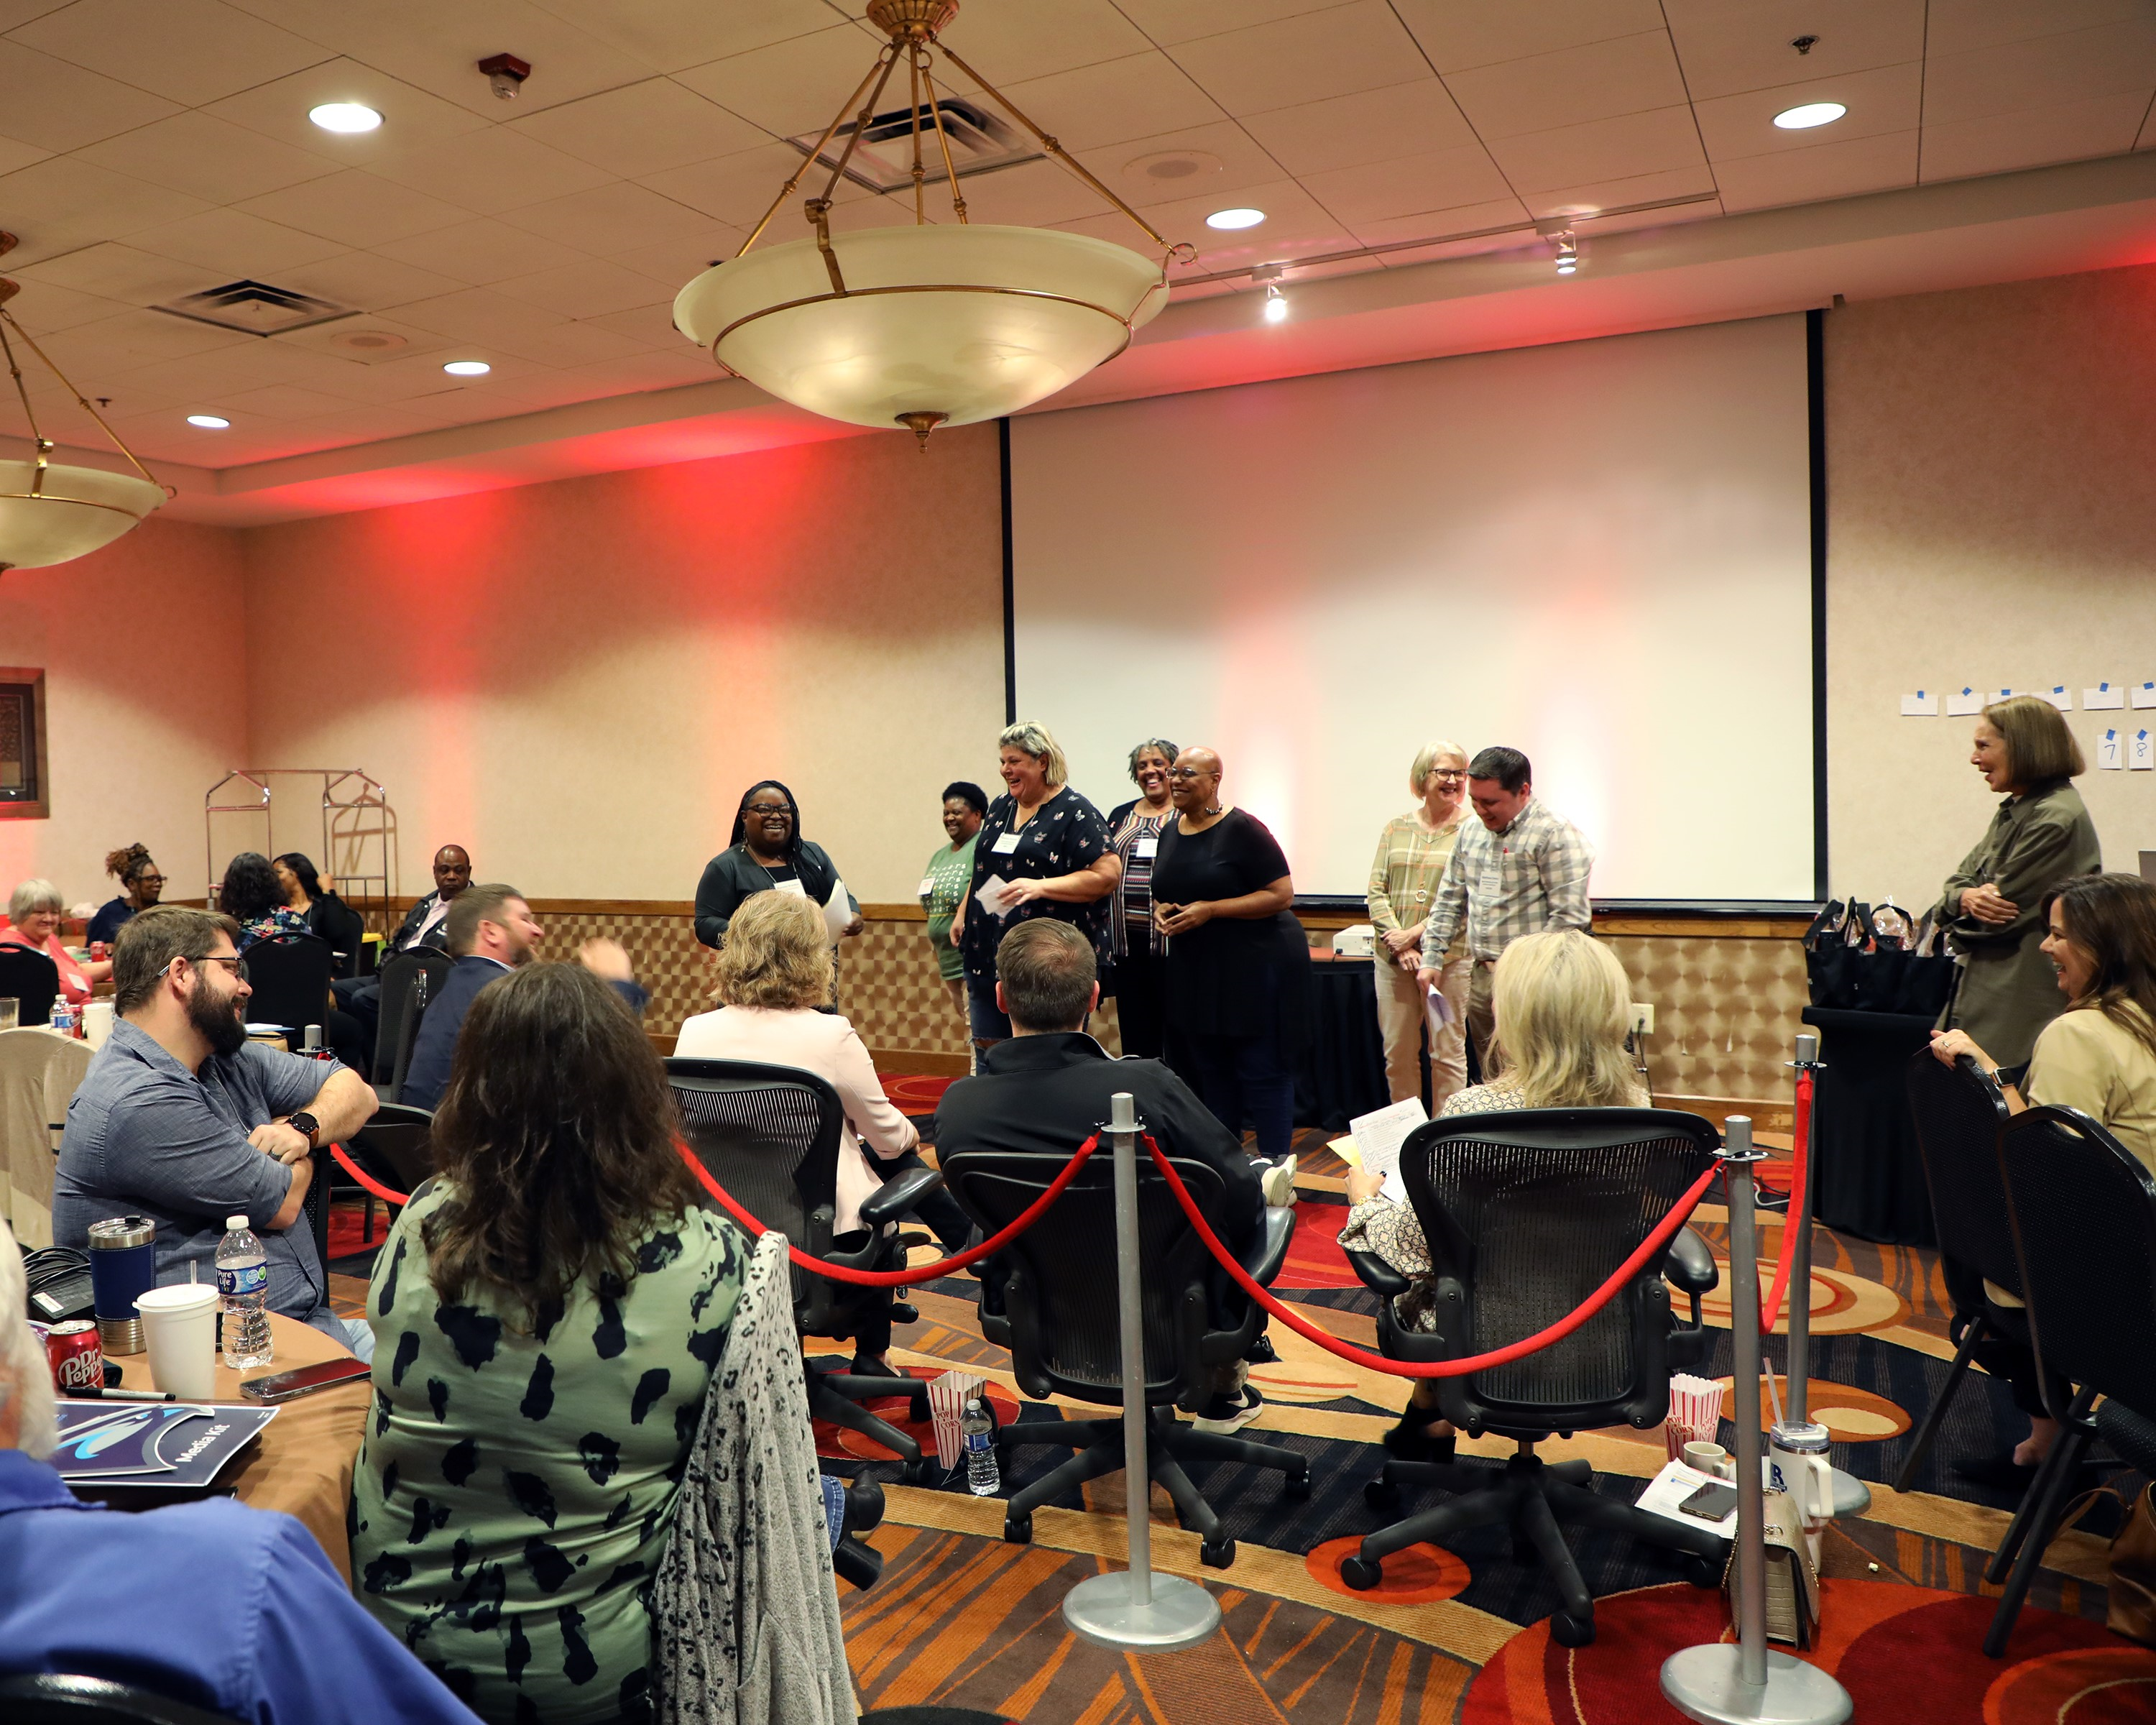

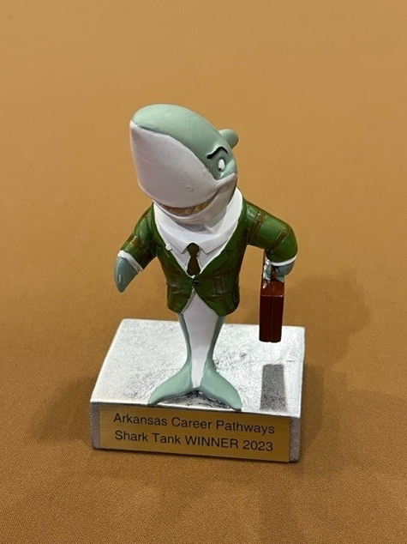

CPI Shark Tank

Slide 54
Update on Institutional
Role and Mission Designations

Slide 55
ANY QUESTIONS?

Slide 56
Annual Report of
Credentials Awarded
AHECB Meeting
October 27, 2023
Sonia Hazelwood
Assistant Commissioner

Slide 57
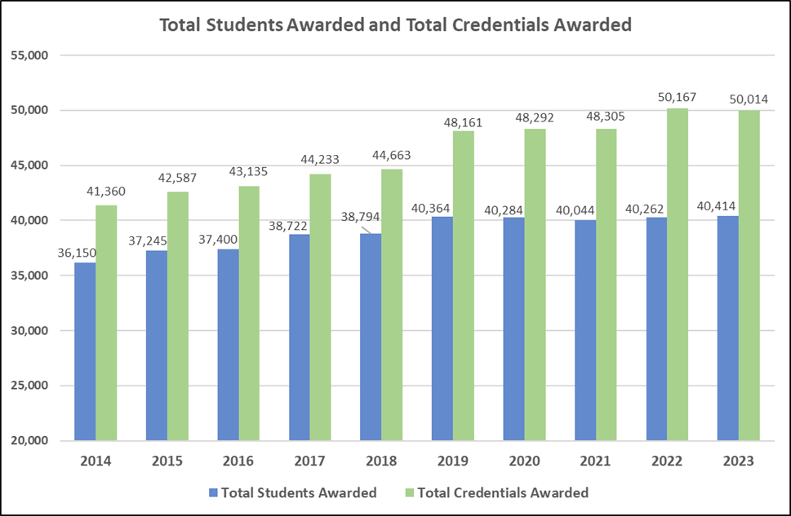
Statewide Trends
In 2014, 36,150 students received 41,360 credentials.
In 2023, 40,414 students received 50,014 credentials.
This is an 11.8% increase in the number of students receiving credentials, but a 20.9% increase in the number of credentials awarded.

Slide 58
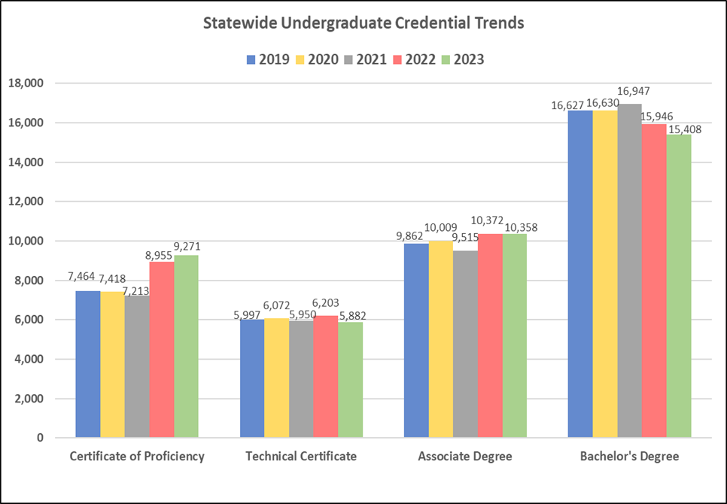
Statewide Trends
The number of Certificates of Proficiency awarded across the state has increased significantly in the past two years, increasing more than 2,000 awards in 2023 over the 2021 Covid affected year.
Technical Certificate awards in 2023 declined more than 5% compared to 2022 and in 2023, 5,882 is the fewest TCs awarded since the 2018 academic year.
For the past five years, Arkansas has awarded approximately 10,000 Associate Degrees each year, except for the 2021 Covid affected year that dropped the number of Associate degree awards to 9,515.
In 2021, 16,947 Bachelor’s Degrees were awarded, which is the most ever, however, serious declines were reported for both 2022 and 2023.
Undergraduate Credentials awarded statewide represent about 82% of total credentials awarded each academic year.

Slide 59
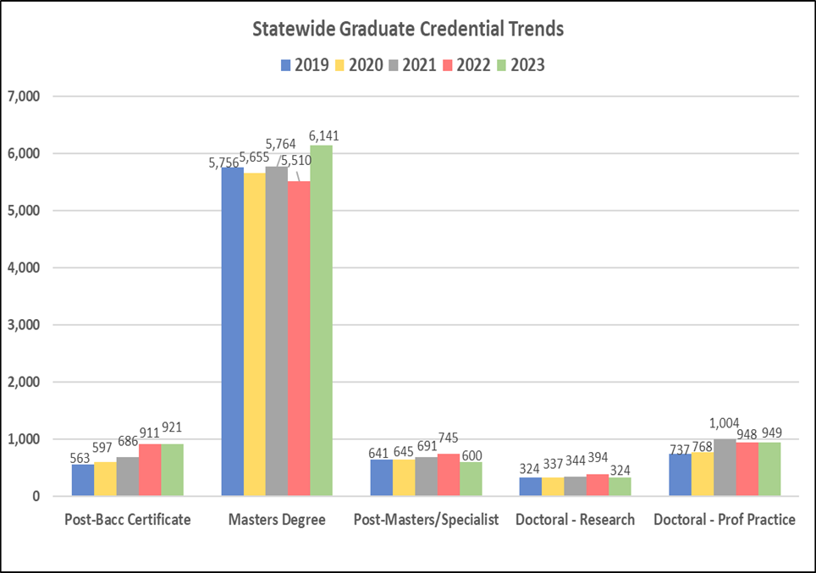
Statewide Trends
The most significant change at the graduate level is in the Masters Degree category that experienced an 11.5% increase in awards from 2022 to 2023.
6,141 Masters Degrees were awarded in 2023, which is the largest number ever and the first time since 2017 to hit over the 6,000 credentials mark.
Both Post-Baccalaureate Certificates and Doctoral – Professional Practice credential award levels remained constant from 2022 to 2023.
Post-Masters/Specialist and Doctoral – Research awards experienced declines from 2022 to 2023.
Graduate Credentials awarded statewide represent about 18% of total credentials awarded each academic year.

Slide 60
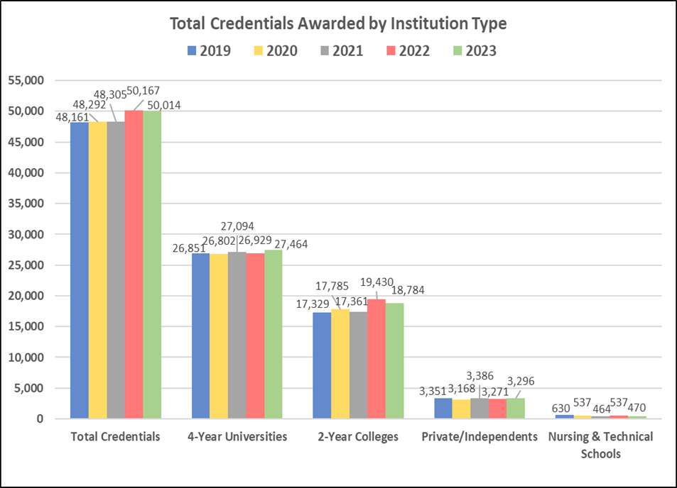
Trends by Institution Type
Public 4-year consistently award 55% of the total statewide credit credentials.
Public 2-year award about 37%.
Private/independent institutions award about 7%.
The two nursing schools and one technical institute award 1% of the statewide total.
Public 4-year universities reported a slight increase of 2% from 2022 to 2023.
Public 2-year colleges reported a 3.3% decrease in total awards from 2022 to 2023.
Private/Independent institutions reported a slight .8% increase in total awards from 2022 to 2023.

Slide 61
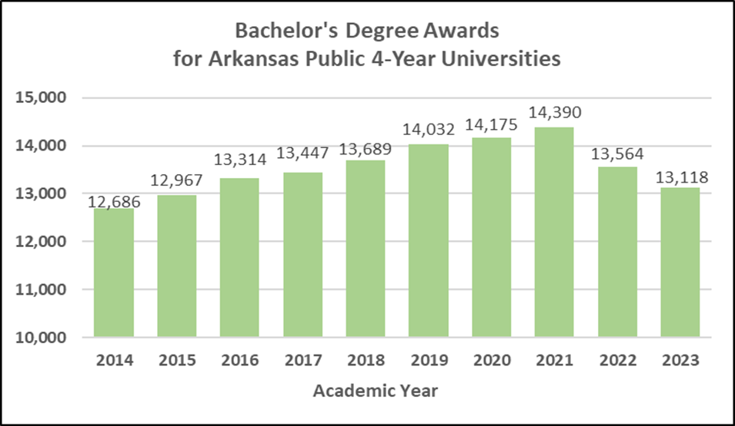
Trends by Institution Type
Public 4-year conferred 13,118 Bachelor’s degrees, which is the lowest total since 2015.
Bachelor’s degrees had been on a steady growth trend until Covid pushed course delivery online, which impacted awards in 2022 and 2023.
38% of Bachelor’s degrees were awarded in Business and Healthcare. Top 3 program areas include:
  Nursing
  Business Administration
  Marketing
Top 5 universities awarding Bachelor’s degrees include:
  UAF – 4,751
  ASU – 1,763
  UCA – 1,584
  ATU – 1,100
  UALR – 1,014

Slide 62
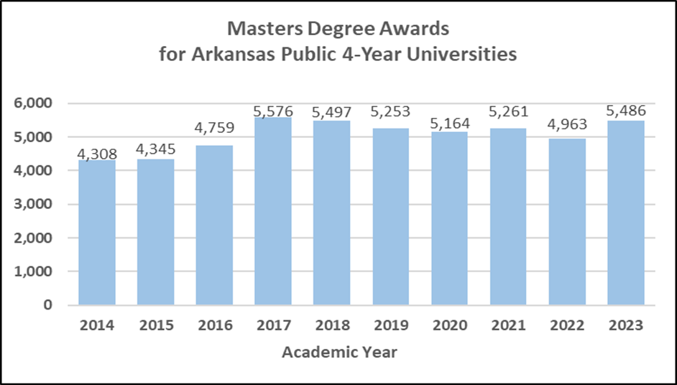
Trends by Institution Type
Public 4-year conferred 5,486 Masters degrees in 2023, which is 500 more than 2022.
36% of Masters degrees were awarded in Education. Top program areas include:
  Education
  Computer Science
  Business Administration
  Healthcare
Top 5 awarding institutions in 2023:
  ASU – 1,672
  UA – 1,203
  SAUM – 834
  UCA – 521
  UALR - 434

Slide 63
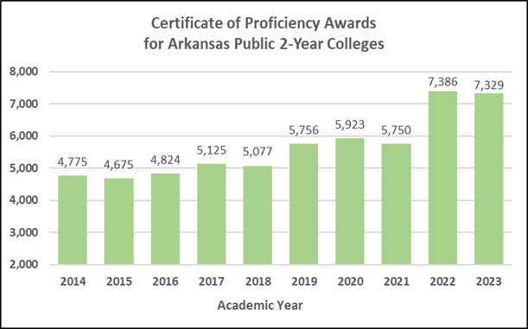
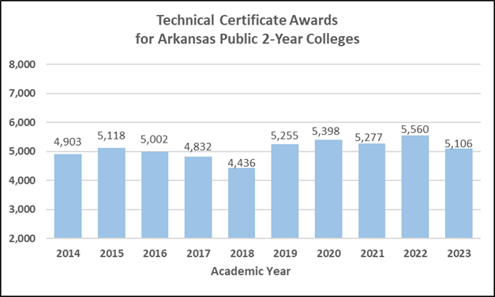
Trends by Institution Type
Public 2-year colleges conferred 7,329 Certificates of Proficiency in 2023, the second largest total ever awarded.
In 2023, 35% of CPs awarded by 2-year colleges are in Healthcare, followed by 15% in Precision Production and 12% in Mechanic and Repair Technologies.
The top 3 awarding colleges in 2023 include:
  BRTC – 951
  UAPTC – 576
  ASUN - 527
Public 2-year conferred 5,106 Technical certificates in 2023, which is the lowest total since 2018.
In 2023, 36% of TCs were awarded in the Healthcare field followed by 32% in Liberal Arts/General Studies. The top 5 awarding colleges in 2023 include:
  UAPTC – 623
  NWACC – 513
  ASUN – 400
  UACCM – 396
  BRTC - 306

Slide 64
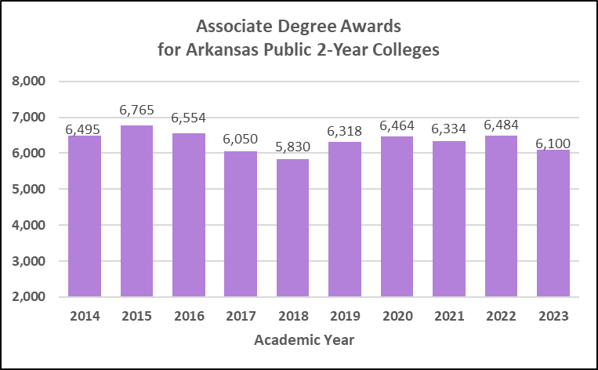
Trends by Institution Type
Public 2-year conferred 6,100 Associate degrees in 2023, which is a decline from 2022.
In 2023, 47% of Associate degrees awarded by 2-year colleges were in Liberal Arts/General Studies, followed by 21% in Healthcare.
Top 5 awarding colleges in 2023 include:
  NWACC – 1,226
  UAPTC – 663
  ASUB – 492
  BRTC – 436
  UCAAM - 416

Slide 65
ANY QUESTIONS?

Slide 66
Mason Campbell
Program Status Report
Agenda Item No. 17
Assistant Commissioner of Academic Affairs

Slide 67
Academic Status Definitions
Status | Status Value | Description
Active | A | Current, active programs offered by an institution.
Active Future | N | Newly created program with a future effective date.
Inactive | I | A program that is placed on “hold” for a maximum of 5 years. Must have 0 enrolled students and be completely inactive at the campus level. Can be reactivated via Letter of Notification within the 5-year timeframe.
Future Inactive | F | A program that has been requested to be inactivated but contains declared or enrolled students. These students must be a part of a required teach-out plan.
Delete* | D | A program that an institution no longer offers. Cannot have any declared or enrolled students.
Phase-Out Delete | P | A program that has been requested to be deleted but contains declared or enrolled students. These students must be a part of a required teach-out plan.
*not included in the Approved Degree Programs list

Slide 68
Academic Program Status Overview
AY2023

Slide 69
Academic Program Status Changes 4-Year Institutions
AY2023

Slide 70
Academic Program Status Changes 2-Year Institutions
AY2023

Slide 71
Academic Program Status Changes by Award Type
AY2023

Slide 72
Academic Program Status Changes by CIP Code
AY2023
CIP Category | Addition | Inactivation/Future Inactivation | Deletion/ Phase-Out | % of Total Status Changes
52 – Business, Management, Marketing, & Related Support Services | 19 | 2 | 21 | 14%
51 – Health Professions and Related Programs | 20 | 6 | 12 | 12%
11 – Computer and Information Sciences and Support Services | 22 | 2 | 8 | 10%
15 – Engineering/Engineering Related Technologies/Technicians | 10 | 8 | 13 | 10%
13 – Education | 23 | - | 4 | 9%
47 – Mechanic and Repair Technologies/Technicians | 12 | 2 | 3 | 6%
43 – Homeland Security, Law Enforcement, Firefighting, Related Protective Services | 8 | 2 | 5 | 5%
50 – Visual and Performing Arts | 7 | - | 4 | 4%
46 – Construction Trades | 7 | 2 | - | 3%
03 – Natural Resources and Conservation | 4 | - | 3 | 2%
09 – Communication, Journalism, and Related Programs | 3 | - | 4 | 2%
12 – Culinary, Entertainment, and Personal Services | 4 | 1 | 1 | 2%
14 – Engineering | 6 | - | - | 2%
44 – Public Administration and Social Service Professions | 4 | - | 2 | 2%
22 – Legal Professions and Studies | 1 | - | 4 | 2%
23 – English Language and Literature/Letters | 3 | - | 2 | 2%
30 – Multi/Interdisciplinary Studies | 5 | - | - | 2%
45 – Social Sciences | - | - | 5 | 2%
All other 2-digit Series CIPs (17 Program-Level CIP Codes) | 18 | 1 | 16 | 11%
Total | 176 | 26 | 107 | 100%

Slide 73
Academic Program Status Overview
AY2019 – AY2023

Slide 74
Academic Program Additions
AY2019 – AY2023

Slide 75
Academic Program Deletions/Phase-Outs
AY2019 – AY2023

Slide 76
Academic Program Inactivations/Future Inactivations
AY2019 – AY2023

Slide 77
Academic Program Status Changes by CIP Code
AY2019 – AY2023
Top 10 CIP Codes With the Most Status Changes
CIP Category | Addition | Inactivation/Future Inactivation | Deletion/Phase-Out | % of Total Status Changes
13 – Education | 119 | 9 | 43 | 14%
51 – Health Professions and Related Programs | 97 | 14 | 55 | 13%
52 – Business, Management, Marketing, & Related Support Services | 86 | 7 | 64 | 13%
47 – Mechanic and Repair Technologies/Technicians | 55 | 17 | 33 | 8%
11 – Computer and Information Sciences and Support Services | 71 | 4 | 23 | 8%
15 – Engineering/Engineering Related Technologies/Technicians | 36 | 15 | 31 | 7%
43 – Homeland Security, Law Enforcement, Firefighting, and Related Protective Services | 34 | 2 | 33 | 5%
09 – Communication, Journalism, and Related Programs | 21 | - | 12 | 3%
12 – Culinary, Entertainment, and Personal Services | 18 | 7 | 8 | 3%
50 – Visual and Performing Arts | 21 | - | 12 | 3%
Full list of Status Changes by CIP Code available in the Board Book.

Slide 78
Active Academic Programs by CIP Code
AY2019 – AY2023
 |  |  |  |  |  | Comparison of AY2019 vs AY2023
CIP Code & Description | AY2019 | AY2020 | AY2021 | AY2022 | AY2023 | Difference | % Change
01 – Agricultural, Animal, Plant, Veterinary Science and Related Fields | 47 | 73 | 75 | 77 | 75 | +28 | 60%
03 – Natural Resources and Conservation | 28 | 28 | 28 | 28 | 24 | -4 | -14%
11 – Computer/Information Sciences & Support Services | 132 | 151 | 166 | 184 | 184 | +52 | 39%
13 – Education | 293 | 307 | 313 | 375 | 403 | +110 | 38%
14 – Engineering | 50 | 48 | 51 | 48 | 54 | +4 | 8%
15 – Engineering, Engineering Related Technologies/Technicians | 135 | 144 | 147 | 158 | 159 | +24 | 18%
30 – Multi/Interdisciplinary Studies | 40 | 44 | 47 | 54 | 55 | +15 | 38%
45 – Social Sciences | 72 | 55 | 54 | 52 | 51 | -21 | -29%
46 – Construction Trades | 28 | 31 | 39 | 39 | 43 | +15 | 54%
49 – Transportation and Material Moving | 20 | 17 | 22 | 26 | 30 | +10 | 50%
51 – Health Professions and Related Programs | 439 | 454 | 464 | 477 | 468 | +29 | 7%
52 – Business, Management, Marketing, and Related Support Services | 307 | 283 | 324 | 344 | 332 | +25 | 8%
Full list of active programs by CIP Code available in the Board Book.

Slide 79
Questions?

Slide 80
Mason Campbell
Concurrent Enrollment
Report
Agenda Item No. 18
Assistant Commissioner of Academic Affairs

Slide 81
AY23 College Enrolled Students by Sector
Private
College Enrolled
Students Total:
181,133
2-Year
Public
Colleges
Source: ADHE Information Systems Technology Innovation
Note: # of enrolled students by sector in AY23 - students may be duplicated if they attended more than one sector.

Slide 82
AY23 Concurrent Enrolled Students by Sector
Private
4-Year
Public
Institutions
Concurrent
Students Total:
22,154
Source: ADHE Information Systems Technology Innovation
Note: # of concurrent students enrolled by sector in AY23 - students may be duplicated if they attended more than one sector.

Slide 83
AY23 Concurrent Credit Grade Distribution
Success Rate: 91.3%
Success Rate: 85.5%
Success Rate: 89.8%
Source: ADHE Information Systems Technology Innovation

Slide 84
Number of Students
Enrolled in High School (9-12)
Source: ADE Data Center

Slide 85
College Enrolled Students by Sector
Source: ADHE Information Systems Technology Innovation
Note: # of concurrent students enrolled by sector in AY23 - students may be duplicated if they attended more than one sector.

Slide 86
Concurrent Enrolled Students by Sector
Source: ADHE Information Systems Technology Innovation
Note: # of concurrent students enrolled by sector in AY23 - students may be duplicated if they attended more than one sector.

Slide 87
Concurrent Credit General Education
Grade Distribution
Success
Rate:
91.3%
Success
Rate:
92.8%
Success
Rate:
91.6%
Success
Rate:
90.8%
Success
Rate:
93.7%
Source: ADHE Information Systems Technology Innovation

Slide 88
Concurrent Credit CTE Grade Distribution
Success
Rate:
85.5%
Success
Rate:
85%
Success
Rate:
84.8%
Success
Rate:
86.8%
Success
Rate:
83.7%
Source: ADHE Information Systems Technology Innovation

Slide 89
Concurrent Credit Graduates Overview
High School Graduation Year | # of years out after HS graduation | College Going Rate |  |  | Fall to Fall Retention
High School Graduation Year | # of years out | % of HS grads who attended the Fall term after graduation | % of students who took concurrent | % of students who did not take concurrent | % of students who took concurrent | % of students who did not take concurrent
2021 | 1 | 42.0% | 51.8% | 48.2% | 79.7% | 64.8%
2020 | 2 | 44.0% | 53.4% | 46.6% | 76.6% | 61.3%
2019 | 3 | 48.0% | 52.6% | 47.4% | 79.6% | 63.9%
2018 | 4 | 49.5% | 51.4% | 48.6% | 79.4% | 65.4%
2017 | 5 | 51.0% | 51.3% | 48.7% | 79.9% | 66.0%
2016 | 6 | 52.4% | 49.2% | 50.8% | 81.0% | 67.4%
Source: ADHE Information Systems Technology Innovation

Slide 90
Concurrent Credit Completion Comparisons
High School Graduation Year | Time to Degree Completion (150% = 6 years) | Students Who Finished Any Type of Credential |  | Students Who Finished Bachelor Degree or Higher Credential
High School Graduation Year | # of years out after HS graduation | % of students who finished any credential who took concurrent | % of students who finished any credential who did not take concurrent | % of students who finished Bachelor or higher, of the % who took concurrent | % of students who finished Bachelor or higher, of the % who did not take concurrent
2016 | 6 | 59.3% | 40.7% | 66.5% | 59.2%
2015 | 6 | 57.3% | 42.7% | 65.7% | 59.8%
2014 | 6 | 54.2% | 45.7% | 65.6% | 60.1%
Source: ADHE Information Systems Technology Innovation

Slide 91
Questions?

Slide 92
Mason Campbell
Sexual Assault
Prevention
Agenda Item No. 19
Assistant Commissioner of Academic Affairs

Slide 93
Sexual Assault on Campus
ANNUAL STATUS REPORT FOR SEXUAL ASSAULT
PREVENTION ON CAMPUS (ACT 563 OF 2017)
Under Act 563 of 2017, the Higher Education Coordinating Board was directed to develop an action plan to address the prevention of sexual assault on College and university campuses. ADHE has collected the annual campus status reports for the 2021–2022 academic year, as required by the legislation. All campuses have submitted reports.
The legislative requirements for the action plan direct Arkansas public colleges and universities:
To incorporate sexual assault prevention into advising and student orientation;
To integrate information into academic courses as appropriate;
To identify opportunities to raise awareness and provide resources for sexual assault prevention across the entire student population;
To identify available grants and partnerships to assist with the work;
To collaborate with sources for access to care; and
To identify other topics or issues relating to the prevention and reduction of sexual assault.

Slide 94
Questions?

Slide 95
Mason Campbell
Unplanned Pregnancy Prevention
Agenda Item No. 20
Assistant Commissioner of Academic Affairs

Slide 96
Unplanned Pregnancy Prevention
Under Act 943 of 2015 the Arkansas Higher Education Coordinating Board (AHECB) was directed to develop an action plan to address unplanned pregnancies on college campuses. ADHE has collected the campus implementation reports for 2021-2022.
The Arkansas Department of Higher Education has collected reports from all 11 public four-year universities in the state and all 22 two-year colleges. The reports show that all campuses are in compliance with Act 943.

Slide 97
Questions?

Slide 98
Chair Graycen Bigger
Agenda item no. 21:
BOARD BY-LAWS

Slide 99
AHECB By-Laws
HIGHLIGHTS
Align wording with current statutes
  Change “department” to “division”
  The Governor appoints the commissioner directly rather than the coordinating board recommends a commissioner to the Governor
  Change the board composition
Redefine quorum
  At all meetings of the Coordinating Board one member more than 50% of the current number of slated members shall constitute a quorum for the transaction of business
  (no longer 7 members needed).

Slide 100
FINANCE COMMITTEE REPORT

Slide 101
ACADEMIC COMMITTEE REPORT

Slide 102
ANY QUESTIONS?

Slide 103
PUBLIC COMMENTS/
ANNOUNCEMENTS
Follow-up questions can be sent to: Nichole.Abernathy@adhe.edu
Presentations will be posted on the ADHE website at:
https://www.adhe.edu/about-adhe/coordinating-board/board-presentations

