Slide 1
SPECIAL MEETING OF THE ARKANSAS HIGHER EDUCATION COORDINATING BOARD
Southern Arkansas University
January 26, 2017

Slide 2
Agenda item no. 1: Enrollment
Dr. Marla Strecker
Senior Associate Director for Research & Academic Affairs

Slide 3
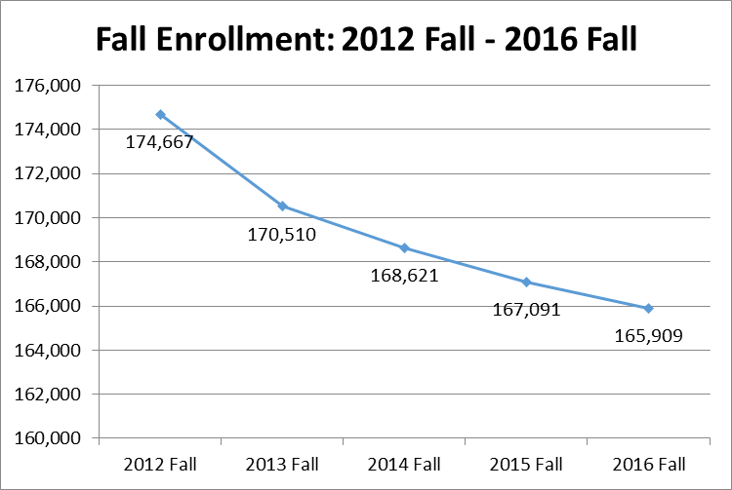
Overall Fall Enrollment Trends
Fall enrollment is down 0.7 percent from the 2015 Fall term to the 2016 Fall term and down 5 percent from the 2012 Fall term to the 2016 Fall term.

Slide 4
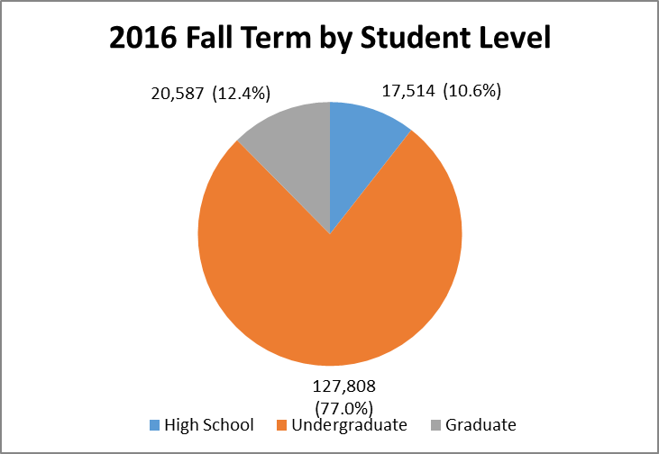
Enrollment by Student Level
Student Level percentages remain relatively the same as Fall 2015, with a slight decrease in the percentage of undergraduates and a slight increase in graduate students.

Slide 5
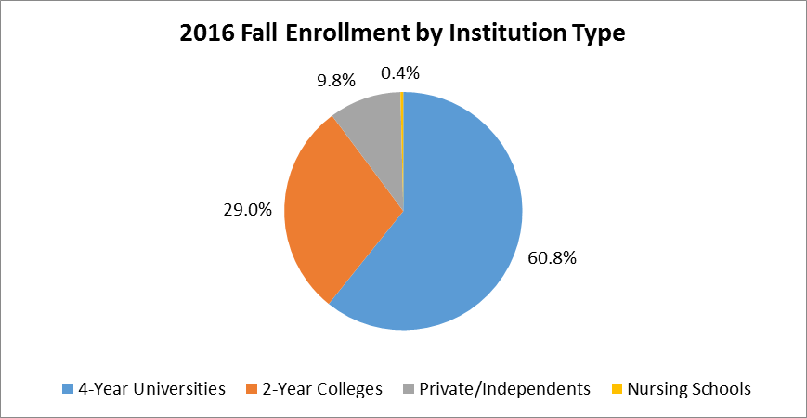
Enrollment by Institution Type
Four Year Public Universities continue to enroll the majority of students, slightly increasing the percentage from Fall 2015.

Slide 6
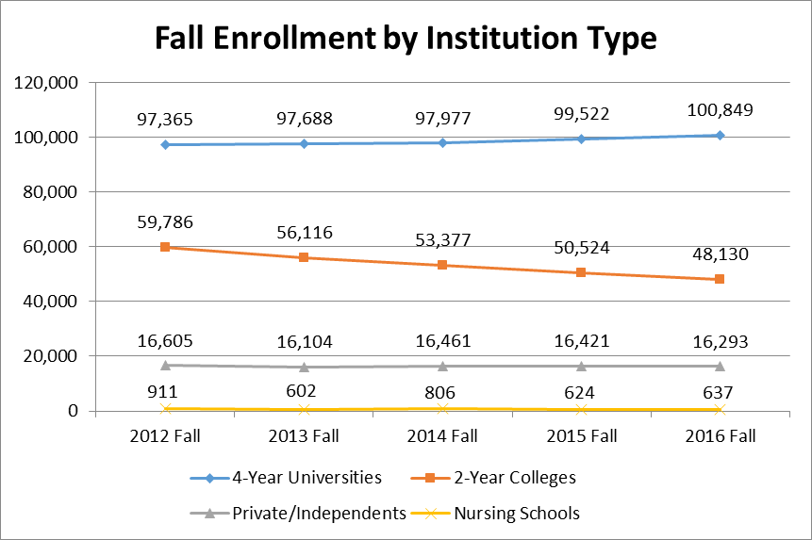
Enrollment History by Institution Type
4-Year Universities continue small enrollment growth while 2-Year Colleges have experienced enrollment decline.

Slide 7
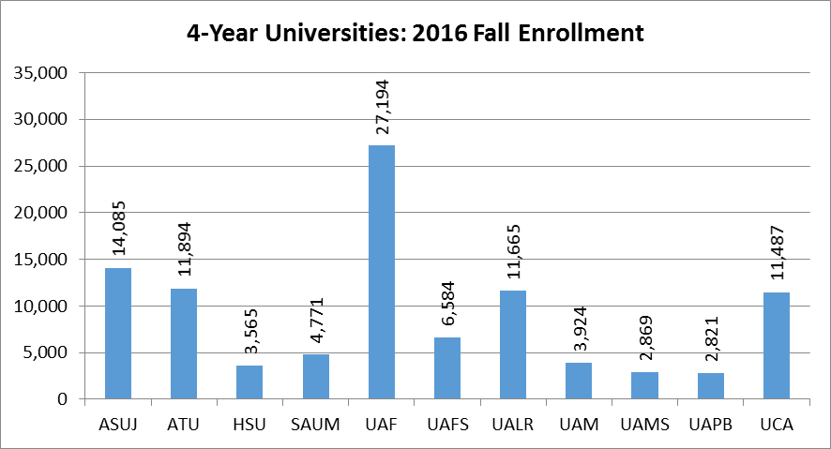
Enrollment by Institution: Universities
Six of the eleven 4-Year Universities experienced positive 5-year growth. The top three were:
Southern Arkansas University –29.0 percent
University of Arkansas Fayetteville – 12.8 percent
Arkansas Tech University – 9.3 percent

Slide 8
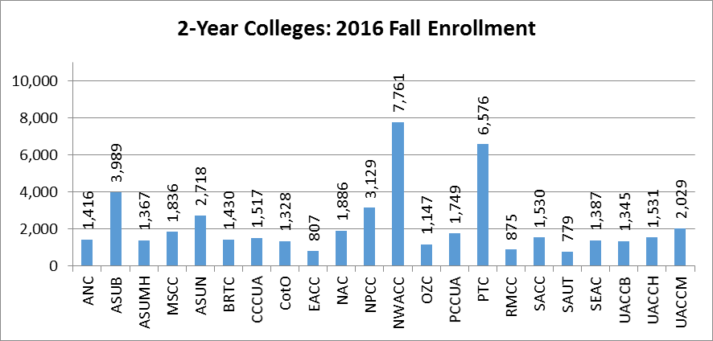
Enrollment by Institution: Colleges
Three of the twenty-two 2-Year Colleges experienced positive 5-year growth. They were:
Arkansas State University Newport – 30.1 percent
Cossatot Community College of the University of Arkansas – 3.2 percent
University of Arkansas Community College at Hope – 2.3 percent

Slide 9
One Year Growth Rates
Growth Rates from 2015 Fall to 2016 Fall
Institution Type | High School Students | Under- graduate Students | Graduate Students | Total
4-Year Universities | 12.1% | -0.6% | 5.9% | 1.3%
2-Year Colleges | -9.1% | -3.6% | - | -4.7%
Private/Independents | -17.7% | 0.5% | -2.6% | -0.6%
Nursing Schools | - | 2.1% | - | 2.1%
Total | -1.5% | -1.4% | 4.9% | -0.7%
Although in overall decline, there has been a definitive increase in Graduate Student Enrollment.

Slide 10
Enrollment by Gender
In Arkansas, Female students outnumber male students by almost 3 to 2. The gender ratio remains relatively unchanged for all institution types.

Slide 11
Enrollment by Race/Ethnicity
There has been a 4 percent decrease in African American enrollment over the last year, while Hispanic enrollment has grown by 14 percent.

Slide 12
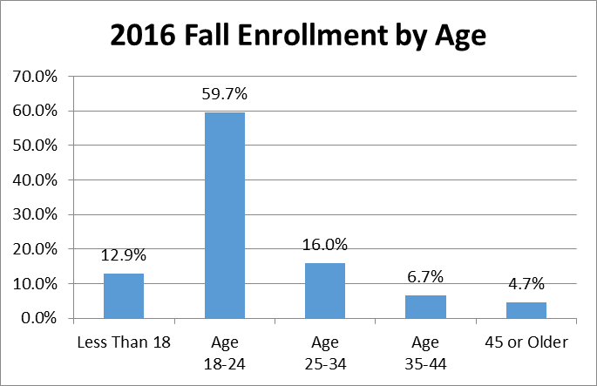
Enrollment by Age
Including Graduate Students, 27% of the student body is over the age of 25.

Slide 13
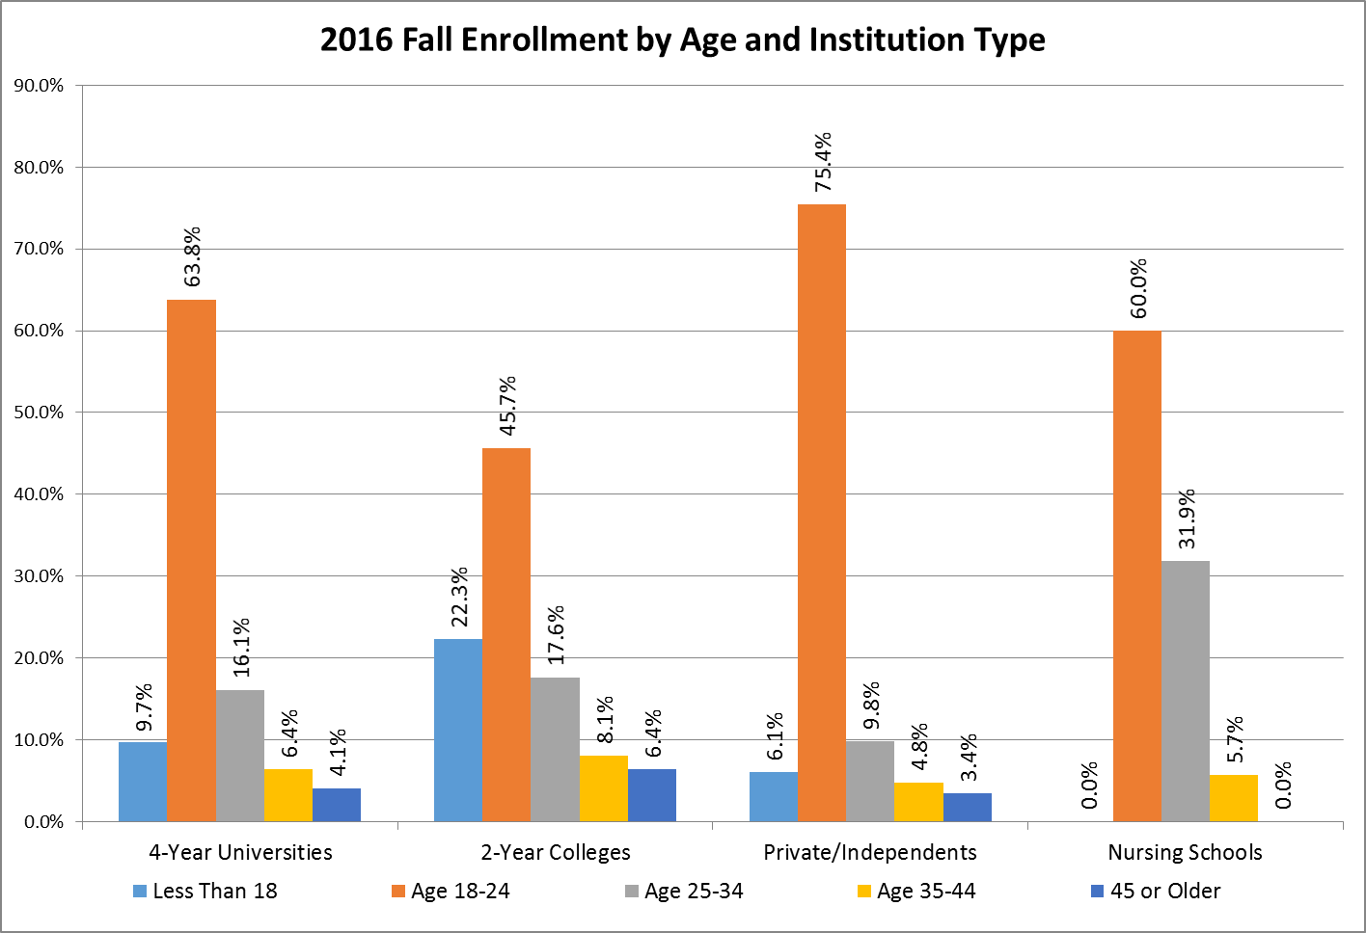
Enrollment by Age
Traditional aged students (18-24) make up the majority of the student body at all institution types.

Slide 14
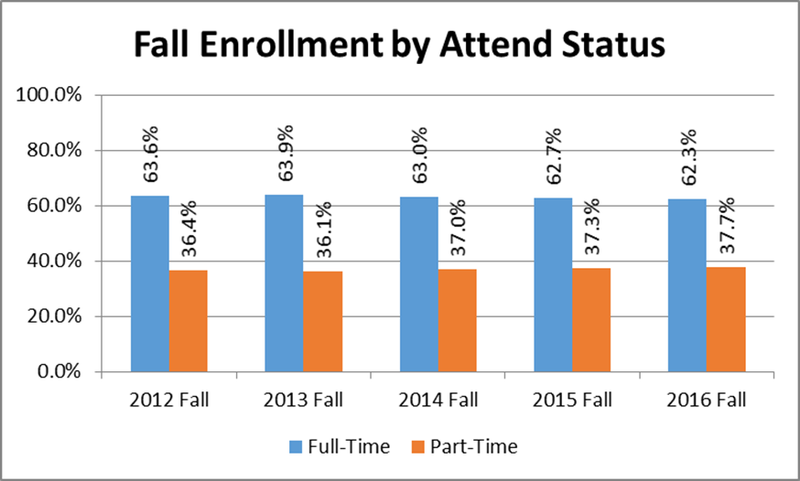
Enrollment by Attend Status
There is a very slight (1.3%) decrease in the number of Full-Time Students enrolled over the last 5 years.

Slide 15
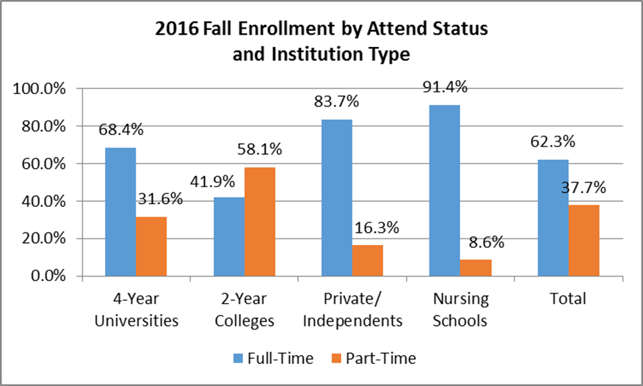
Enrollment by Attend Status
Two-Year Public Colleges have seen a 1.5% increase in the number of part-time students enrolled. Nursing and Private schools have increased full-time enrollment.

Slide 16
Enrollment by Geographic Origin
Among all two-year and four-year institutions, 78.4 percent of the students enrolled in the fall 2016 semester are from Arkansas.
Origin | Count | Percent
Arkansas | 127,088 | 78.4%
Texas | 10,062 | 6.2%
Foreign Country | 6,350 | 3.9%
Missouri | 3,777 | 2.3%
Oklahoma | 2,569 | 1.6%
Tennessee | 2,240 | 1.4%
Louisiana | 1,206 | 0.7%

Slide 17
FTE – Full Time Equivalent Students
Methodology:
In order to calculate the number of Full-Time Equivalent (FTE) students attending a College or University, we divide the number of Student Semester Credit Hours (SSCH) taken at that institution by fifteen (15), which is the number of hours taken by a full-time student in a semester.
SSCH
(Student Semester Credit Hours)
=
FTE
(Full-Time Equivalent Students)
15
(Credits per Full-Time Semester)

Slide 18
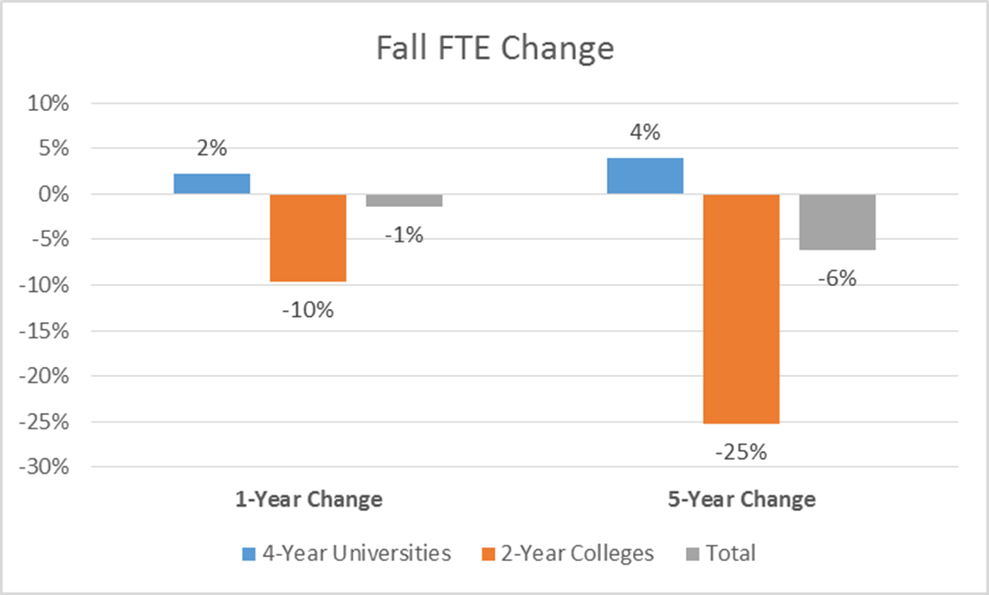
Fall SSCH/FTE Change
SSCH/FTE data is not collected for Private/Independent institutions or Nursing Schools.

Slide 19
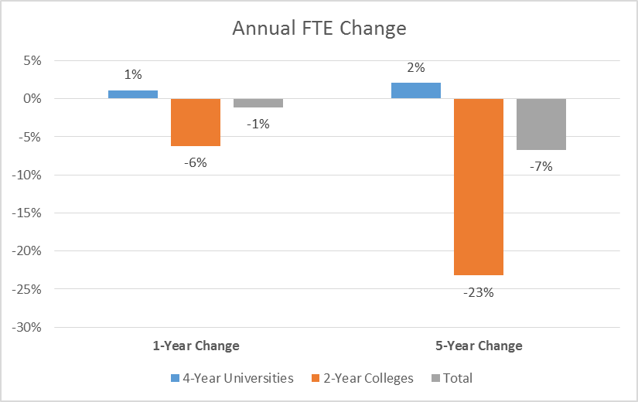
Annual SSCH/FTE Change
SSCH/FTE data is not collected for Private/Independent institutions or Nursing Schools.

Slide 20
Fall FTE by Institution
SSCH/FTE data is not collected for Private/Independent institutions or Nursing Schools.

Slide 21
Fall FTE by Institution
SSCH/FTE data is not collected for Private/Independent institutions or Nursing Schools.

Slide 22
Agenda item no. 3: Survey of Institutional Scholarships and Waivers
Tara Smith
Deputy Director

Slide 23
Resident vs Non-Resident Scholarship Awards – 4-Year Institutions

Slide 24
Resident vs Non-Resident Scholarship Awards – 2-Year Institutions

Slide 25
Resident vs Non-Resident Scholarship Expenditures – 4-Year Institutions

Slide 26
Resident vs Non-Resident Scholarship Expenditures - 2-Year Institutions

Slide 27
Out-Of-State Tuition Waivers at Four-Year Institutions

Slide 28
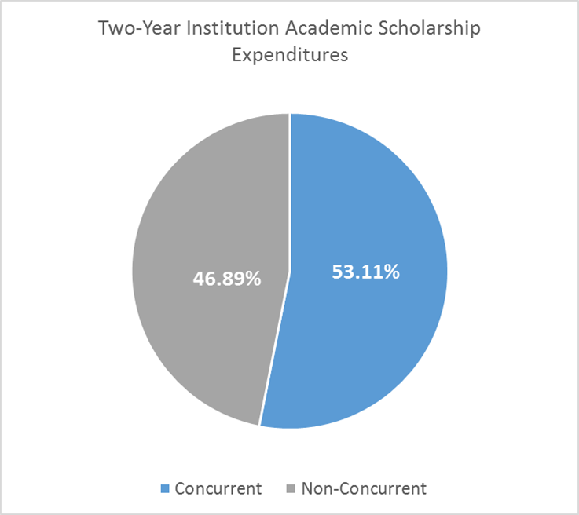
Concurrent Scholarships

