Slide 1
REGULAR MEETING OF THE
ARKANSAS HIGHER EDUCATION
COORDINATING BOARD
January 31, 2020

Slide 2

Agenda item no. 8:
Operating recommendations for the 2020-2021 fiscal year
Nick Fuller
Deputy Director

Slide 3
ADHE Recommendation
Recommendations for State Operating levels are based on Productivity Funding Recommendations as well as current estimates for EETF and WF2000 funding. Non-formula recommendations are based off of 2nd year recommendations approved last year.
ADHE is recommending an additional 2% spending authority increase to the funding recommendations within the productivity model to account for any fluctuations with the forecast for special revenues that are included in the State appropriations.

Slide 4

Operating Recommendations

Slide 5
Operating Recommendations
Table B. 2020-21 Year 3 Productivity Index

Slide 6
Operating Recommendations
Table C. 2018-19 Four-Year Universities Recommendations

Slide 7
Operating Recommendations
Table D. 2020-21 Two-Year Colleges Recommendations

Slide 8
Operating Recommendations
Table E. 2020-21 Non-Formula Entities Recommendations

Slide 9
Agenda item no. 9: personal services recommendations for the 2020-2021 fiscal year
Nick Fuller
Deputy Director

Slide 10
Summary of Recommendations
Line-item maximum salary increases were considered for the fiscal year, and all line-item maximums were adjusted by 1.9 percent per year for the biennium.
Salary recommendations for new positions were based on salaries for similar positions previously established at comparable institutions.
The following variables were used when considering request for additional positions:
  Current vacant position usage within requested titles
  Positions directly tied to student support/success
  Keep position changes minimal for the Fiscal Session

Slide 11
Summary of Recommendations
ADHE Staff recommend a net decrease of 45 positions
Decrease of .2 percent for a total of 27,986 positions (apart from UAMS)
UAMS requested no increases and currently has 11,558 authorized positions

Slide 12
Agenda item no. 10:
Annual Financial Conditions Report
Nick Fuller
Deputy Director

Slide 13
Introduction
Report Purpose:
  Describe financial conditions of Arkansas’s Public Institutions of Higher Education
  Describe challenges experienced by Arkansas’s Public Institutions of Higher Education
Topics Addressed:
  Productivity-Based Funding
  Comparison of Arkansas faculty salaries to other SREB states
  Tuition & Fees
  Fund Balances
  Institutional Scholarship expenditures
  Athletic Expenditures
Notes:
1. What is the projected date the bonds will be sold?
2. Please provide a detailed description of the new facility facilities. Please include the square feet, type of space that will make up the facility and location of the facility on the campus as well as any other relevant information.
3. Will the bond issue include furnishings?
4. What is the projected start date and completion date for facility?
5. Please list a few programs that will be housed in the facility.
6. Are there any other sources of income being used for this project? (i.e. private gifts)
7. What is the total project cost including all funding sources? Does this include all sources?

Slide 14
Comparison of Arkansas faculty salaries to other SREB states

Slide 15
Comparison of Arkansas faculty salaries to other SREB states

Slide 16
Comparison of Change in Funds per FTE Students to other SREB states - Universities

Slide 17
Comparison of Change in Funds per FTE Students to other SREB states - Colleges

Slide 18
Tuition and Fees
With the Governor’s addition of roughly $13,000,000 in State funding for higher education since the implementation of the Productivity Funding model in fiscal year 2018-19, institutions have been tasked with trying to limit tuition increases as to keep costs to students as affordable as possible.
Even with these efforts, tuition and fee increases were needed at institutions causing total Tuition and Fee changes from 2018-19 to 2019-20 to reflect the following:
  Four-year Institutions = 1-YR Average increase 3.1%
  Two-year Institutions = 1-YR Average increase 2.7%
Latest available data from SREB (2016-17 to 2017-18) –
    National Four-year Institution = 1-YR Average increase 3.5%
    SREB Four-year Institution = 1-YR Average increase 5.7%
    Arkansas Four-year Institution = 1-YR Average increase 3.0%
    National Two-year Institution = 1-YR Average increase 3.6%
    SREB Two-year Institution = 1-YR Average increase 4.2%
    Arkansas Two-year Institution = 1-YR Average increase 2.2%

Slide 19
Tuition Increases – 4 Year Institutions

Slide 20
Tuition Increases – 2 Year Institutions

Slide 21
Fund Balances
According to industry standards, optimal fund balances should range from 5% to 14% of the E & G operating budget.
  For 2018-19, all but two of the 4-year institutions’ fund balances were above 5%.
  For 2018-19, one 2-year institution’s fund balance fell below 5%.

Slide 22
Fund Balances – 4-Year

Slide 23
Fund Balances – 2-Year

Slide 24
Institutional Scholarships
(Academic and Performance)
A.C.A 6-80-106 set limitations on Institutional Scholarships from tuition and fees
  Academic and Performance scholarships awarded to students who qualify for a Pell Grant were excluded in accordance with A.C.A. § 6-80-106.
The limit is 20% of E&G tuition and fee revenue
16,659 scholarships were awarded at 4-Year Institutions at a cost of $68.6 million compared to 14,472 at a cost of $62.7 million the previous year
Scholarships as a percent of tuition and fees were 8.9% compared to 8.2% the previous year

Slide 25
Institutional Scholarships

Slide 26
Other Thoughts
Capital Funding
  The Facilities Audit Program reported the replacement values for E&G facilities as $5.3 billion. The E&G maintenance needs as of 2018 shows that the institutions have $3 billion in deferred maintenance with $244.2 million of that classified as critical.

Slide 27
Recommendations
Continue to work with institutions to monitor and refine the Productivity Funding Model policies to ensure adequate funding is available to meet student needs, innovation is encouraged, and that the policies continue to respond to attainment goals and priorities of the state.
AHECB, ADHE and institutions of higher education work with the legislature toward alignment of institutional funding policies, state financial aid policies, and tuition policies in a way that prioritizes higher education affordability.

Slide 28

Agenda item no. 11:
Economic Feasibility of a LOAN ISSUE for UNIVERSITY OF ARKANSAS AT LITTLE ROCK
Nick Fuller
Deputy Director

Slide 29
Relevant Information
$1.0 million with a term of ten (10) years @ a rate not to exceed 0.00%
Educational & General (E&G) purposes
Revenue Funding Sources: Tuition & Fee Revenue
The loan is being sought from the Arkansas Sustainable Building Design Revolving Loan Fund, which is managed by the Division of Building Authority (DBA)
Proceeds from the loan issue will be used to replace two aged and failing chillers and the associated cooling tower and pumps, which meet the revolving loan fund energy savings requirements.
Notes:
1. What is the projected date the bonds will be sold?
2. Please provide a detailed description of the new facility facilities. Please include the square feet, type of space that will make up the facility and location of the facility on the campus as well as any other relevant information.
3. Will the bond issue include furnishings?
4. What is the projected start date and completion date for facility?
5. Please list a few programs that will be housed in the facility.
6. Are there any other sources of income being used for this project? (i.e. private gifts)
7. What is the total project cost including all funding sources? Does this include all sources?

Slide 30

Agenda item no. 12:
Economic Feasibility of a LOAN ISSUE for
ARKANSAS SCHOOL FOR MATHEMATICS, SCIENCES AND THE ARTS
Nick Fuller
Deputy Director

Slide 31
Relevant Information
$1.0 million with a term of ten (10) years @ a rate not to exceed 2.50%
Educational & General (E&G) purposes
Revenue Funding Source: E&G Revenue
Proceeds from the loan issue will be used to renovate current structures into expanded student residences and shared community spaces, which will allow ASMSA to accommodate approximately 24 additional students.
Notes:
1. What is the projected date the bonds will be sold?
2. Please provide a detailed description of the new facility facilities. Please include the square feet, type of space that will make up the facility and location of the facility on the campus as well as any other relevant information.
3. Will the bond issue include furnishings?
4. What is the projected start date and completion date for facility?
5. Please list a few programs that will be housed in the facility.
6. Are there any other sources of income being used for this project? (i.e. private gifts)
7. What is the total project cost including all funding sources? Does this include all sources?

Slide 32

Agenda item no. 13:
Economic Feasibility of a LINE OF CREDIT LOAN ISSUE for HENDERSON STATE UNIVERSITY
Nick Fuller
Deputy Director

Slide 33
Relevant Information
$3.0 million revolving line of credit loan to provide overdraft protection of payroll drafts in the case that the monthly allotment of State General Revenue funds has not yet been received in the payroll account.
Educational and general purposes (E&G)
Revenue Funding Source: Tuition & Fee Revenue
Proceeds from the loan issue will be used to bridge the timing difference between the occurrence of payroll drafts and the receipt of State General Revenue funds.
Notes:
1. What is the projected date the bonds will be sold?
2. Please provide a detailed description of the new facility facilities. Please include the square feet, type of space that will make up the facility and location of the facility on the campus as well as any other relevant information.
3. Will the bond issue include furnishings?
4. What is the projected start date and completion date for facility?
5. Please list a few programs that will be housed in the facility.
6. Are there any other sources of income being used for this project? (i.e. private gifts)
7. What is the total project cost including all funding sources? Does this include all sources?

Slide 34

Dr. Jessie J Walker
Senior Associate Director of Academic Affairs
/Research & Analytics

Slide 35
ACADEMIC COMMITTEE
CONSENT AGENDA ITEMS

Slide 36
Consent Items
*14. Arkansas Tech University
Bachelor of Science in Applied Statistics with Options in Actuarial Science or Data Science
*15. Black River Technical College
Certificate of Proficiency in Riflesmithing
Certificate of Proficiency in Shotgunsmithing
Certificate of Proficiency in Pistolsmithing
Technical Certificate in Gunsmithing – Long Gun Emphasis
Associate of Applied Science in Gunsmithing
*Numbers refer to main agenda

Slide 37
Consent Items
*16. Southeast Arkansas College
Certificate of Proficiency in Lodging
Certificate of Proficiency in Restaurant Operations
Certificate of Proficiency in Beverages and Bar Operations
Technical Certificate in Hospitality Management
Associate of Applied Science in Hospitality Management
*17. Southeast Arkansas College
Certificate of Proficiency in Cyber Security Management
Technical Certificate in Cyber Security Management
Associate of applied Science in Cyber Security Management
*Numbers refer to main agenda

Slide 38
Consent Items
*18. University of Central Arkansas
Educational Specialist (EdS) in Digital Age Teaching and
Learning
*Numbers refer to main agenda

Slide 39
Agenda Item no. 19
Institutional Certification
Advisory Committee: Resolutions
Alana Boles
Program Director of Private Career and
Out-of-State Education

Slide 40
Institutional Certification Advisory Committee (ICAC)
8 Colleges
23 Degree and Certificate Programs

Slide 41
Agenda Item no. 20
Letters of Notification
Lillian Williams
Academic Affairs

Slide 42
Letters of Notification
Programs approved by the ADHE Director
Programs must be included on the AHECB agenda prior to initiation
Programs are reasonable and moderate extensions of existing certificates and degrees

Slide 43
Agenda Item no. 21
Letters of Intent
Lillian Williams
Academic Affairs

Slide 44
Letters of Intent
Notification of institutional plans to offer new programs or organizational units that require Coordinating Board approval
Chief academic officers and chief executive officers can comment on the proposals before consideration by AHECB

Slide 45
Approval of Minutes
October 24 Special Meeting
October 25 Regular Meeting

Slide 46
Agenda item no. 2:
REPORT OF NOMINATING COMMITTEE
CHAIR JIM CARR

Slide 47
Report of Nominating Committee
The Nominating Committee (Chair Dr. Michael Stanton, Chris Gilliam and Lori Griffin) will make a recommendation on the slate of Board officers for 2020-21, and the Board will act upon the recommendation.

Slide 48
Recommendation
Chair, Dr. Jim Carr
Vice-Chair, Al Brodell
Secretary, Chris Gilliam
Academic Committee Chair, Lori Griffin
Finance Committee Chair, Keven Anderson

Slide 49
Agenda item no. 3:
State Board of Higher Education Foundation Election of Supervisory Committee
CHAIR CARR

Slide 50
Election of Supervisory Committee
The Board for the Foundation includes three annually elected members: a president, a vice president and a secretary/treasurer. The Foundation was established in order to accept private funds for specific projects for the benefit of higher education in Arkansas. The current officers are:
President – Chris Gilliam
Vice President – Lori Griffin
Secretary/Treasurer – Dr. Olin Cook

Slide 51
Recommendation
President Chris Gilliam
Vice President Lori Griffin
Secretary/Treasurer Dr. Olin Cook

Slide 52
Agenda item no. 4:
REIMBURSEMENT OF EXPENSES FOR MEMBERS OF THE AHECB AND ICAC
DR. MARIA MARKHAM

Slide 53
Reimbursement of Expenses
Although members of the AHECB and ICAC by law serve without compensation, they may receive expense reimbursement for performing official board duties after following certain procedures set out by Act 1211 of 1995 (A.C.A. §25-16-901 et seq.).

Slide 54
Recommendation
Because Act 1211 of 1995 (A.C.A. §25-16-901 et seq.) is the sole authority for expense reimbursement, it is necessary for the Coordinating Board to adopt a resolution authorizing expense reimbursement for board members and members of the ICAC.

Slide 55
DR. MARIA MARKHAM
Agenda item no. 5:
REPORT OF THE DIRECTOR

Slide 56
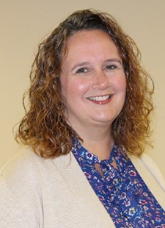
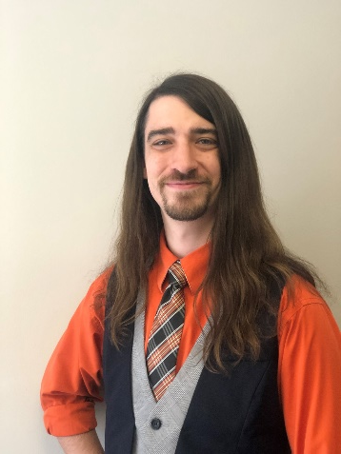
ADHE Staffing
Quinton Morgan
Financial Aid Program Specialist
Rachel Lewis
Senior Technology Analyst

Slide 57
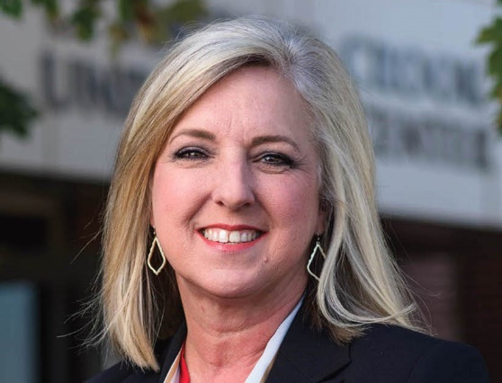
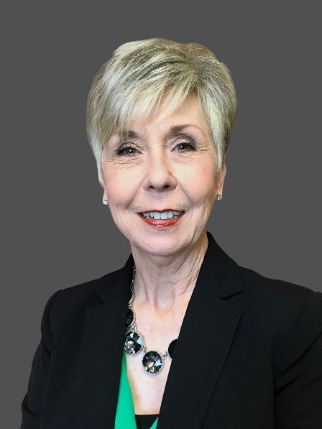
Institutional Leadership
Lisa Willenberg was selected as chancellor of the University of Arkansas Community College at Morrilton. Willenberg has worked at UACCM for 27 years, previously serving as vice chancellor for finance and operations, general accountant and vice chancellor. Willenberg is the college’s fourth leader since its founding in 1963 and the first woman named to the top post.
Dr. Peggy Doss was selected as chancellor of the University of Arkansas at Monticello. Dr. Doss has served as provost and vice chancellor for academic affairs. Doss also served as dean of the university’s College of Education for 10 years.

Slide 58
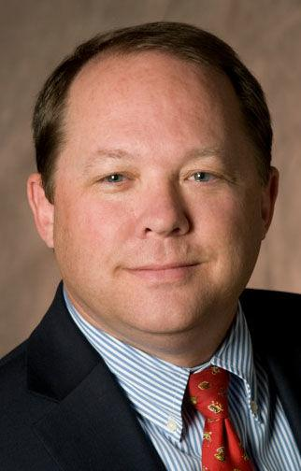
Institutional Leadership
Dr. Bentley Wallace will become the fifth president of South Arkansas Community College, on February 1, 2020. Dr. Wallace served as the dean of the School of Technical and Professional Studies at the University of Arkansas-Pulaski Technical College since 2018, after having been the vice chancellor for economic development at UAPTC since 2013. Prior, he was the director of business and transportation technology at ASU-Newport for seven years.

Slide 59
Closing the Gap at
UA Cossatot
OEM and Book Program Innovation

Slide 60
INCEPTION
We (UA Cossatot) recognized that students were spending approximately $1,400 per year for textbooks at the college’s bookstore, leased by a third party.
The contract with the third party was up for renewal in spring 2015 and we saw an opportunity to eliminate an outside vendor and instead find alternative sources to costly textbooks by establishing an internal textbook rental and open educational resource (OER) program.

Slide 61
OBJECTIVE
Create an internal textbook rental and OER program that strives to minimize textbook expenses for students.
Ensure the program remains financially self-sustaining.
Encourage faculty to consider Creative Commons (CC) licensed materials instead of expensive textbooks.

Slide 62
IMPLEMENTATION
Find someone willing to build and maintain the program.
Establish a chancellor-appointed board to oversee OER.
Request recommended funds for textbook procurement.

Slide 63
RESULTS
UA Cossatot’s director of educational resources and OER specialist agreed to build and maintain the internal program.
Began procuring textbooks to build inventory in March 2015.
The program continues to remain financially self-sustaining.
The program’s director suggested using the Educational Resource Center (ERC) to distribute textbooks.
Within the program’s first four years, UA Cossatot has saved its students over $1.5 million in textbook expenses.
With the exception of eVersity, UA Cossatot leads Arkansas in the adoption and development of open resources with over 54 percent of its courses using OER.

Slide 64
RESULTS
Recognizing the interest in OER and the faculty’s willingness to consider open resources, UA Cossatot became the first college in the state to join the Open Textbook Network (OTN) in 2018.
UA Cossatot is a leader in the OER movement, with its OER specialist serving as an OER state leader and an OTN Steering Committee member.
UA Cossatot’s director of educational resources and OER specialist has been invited to help other Arkansas schools by sharing program details and encouraging others to join UA Cossatot’s effort to remove financial barriers that students face, as well as being invited to participate in national and community college OER discussions. She was also recently selected to chair the Arkansas academic library consortium (ARKLink) OER Task Force.

Slide 65

AHECB Meeting
January 31, 2020
Agenda Item 6
Annual Enrollment Report
Sonia Hazelwood
Associate Director, Research & Analytics

Slide 66
Annual Enrollment Report
National Enrollment Trends
According to data released in December 2019 by the National Student Clearinghouse Research Center (NSCRC), all sectors experienced fall term enrollment declines in Fall 2019.
The NSCRC reported for Fall 2019 that in the U.S. overall postsecondary enrollments decreased 1.3 percent from Fall 2018 enrollments.
Fall 2019 enrollment at 4-Year public institutions declined by 1.2 percent compared to Fall 2018, and the 2-Year public colleges experienced a 1.4 percent decline in enrollment.
Looking at the public sector as a whole, Fall 2019 enrollment declined by 1.3 percent from Fall 2018.
Additional enrollment reports can be found at the NSCRC website at nscresearchcenter.org.

Slide 67
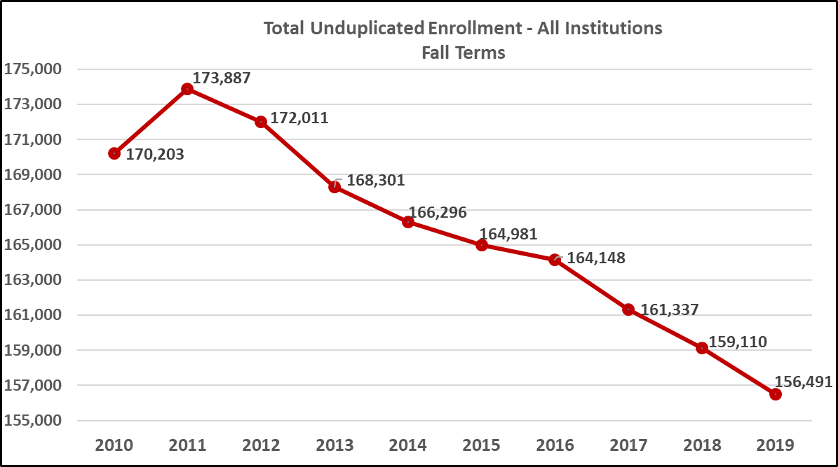
Annual Enrollment Report
The total unduplicated enrollment for Fall 2019 in all sectors of Arkansas higher education, including public universities, public colleges, private/independent colleges and universities, and nursing schools was 156,491 students; representing a 1-year decline of 1.6 percent.

Slide 68
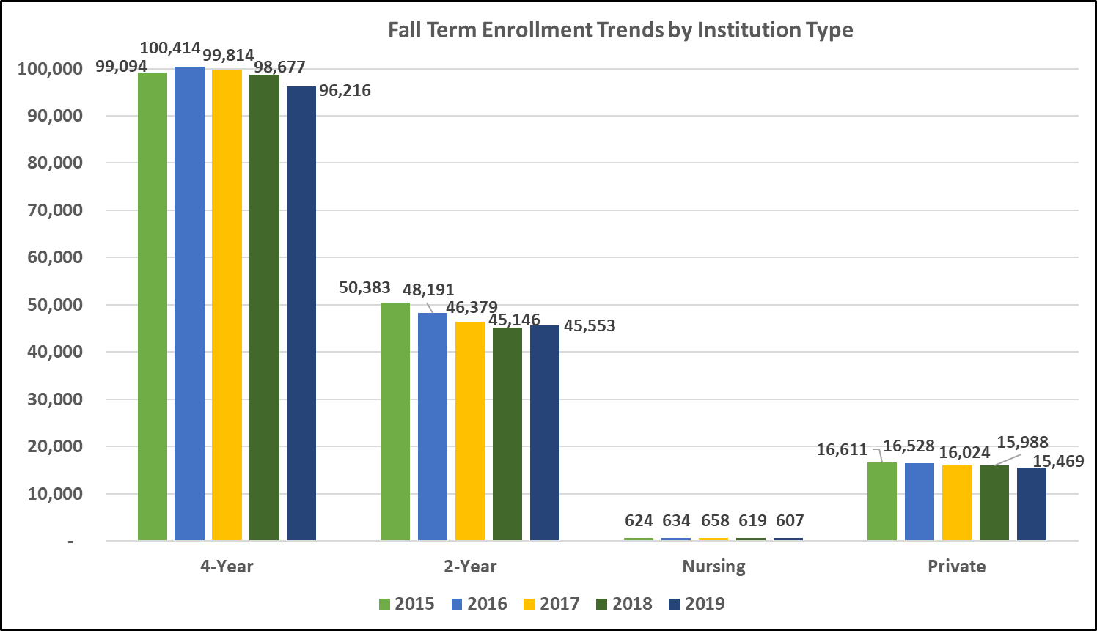
Annual Enrollment Report
The following graph provides a five-year total enrollment trend for each sector of Arkansas higher education. 4-Year universities, nursing schools, and the private and independent institutions all experienced a decline in enrollment, while the 2-Year colleges reported their first increase in enrollment since Fall 2011.

Slide 69
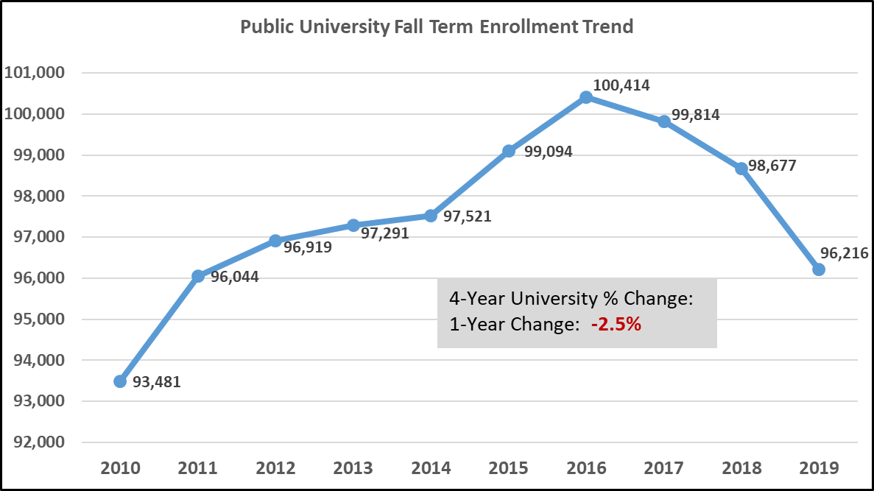
Annual Enrollment Report
The 4-Year Public Universities reported a fall term decline for the third year in a row. They experienced their highest enrollment in fall 2016 of 100,414. The 1-year percentage change was a -2.5%.

Slide 70
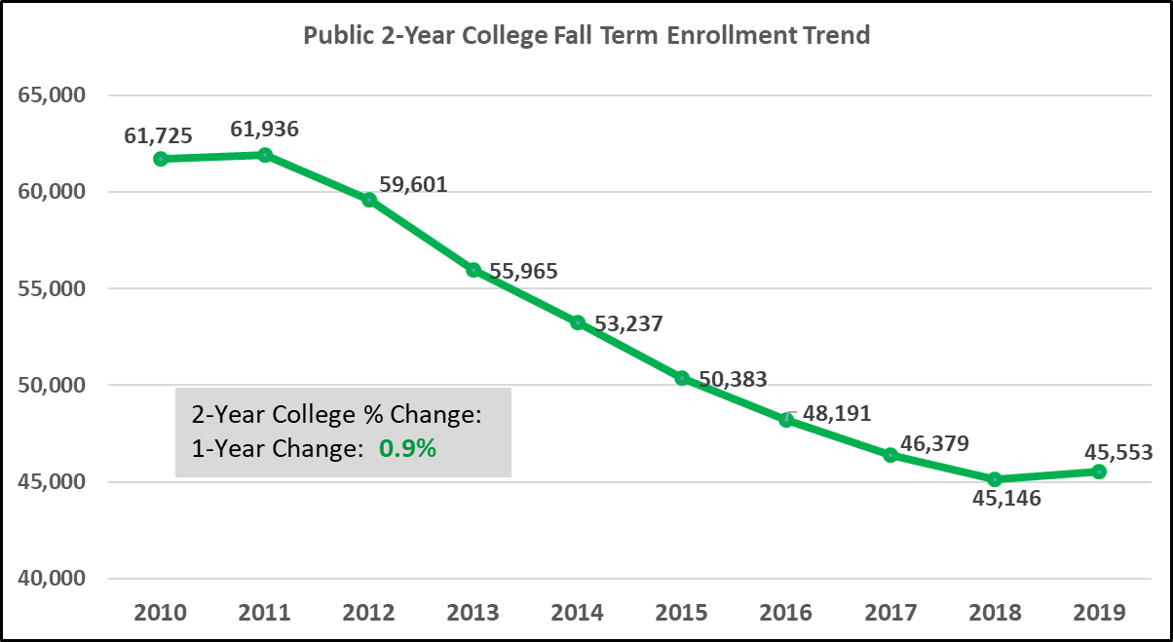
Annual Enrollment Report
In Fall 2019, the 2-Year Public Colleges reported their first fall term enrollment increase since fall 2011 where they reported their highest enrollment of 61,936. Fall 2019 enrollment was a .9 percent improvement over Fall 2018.

Slide 71
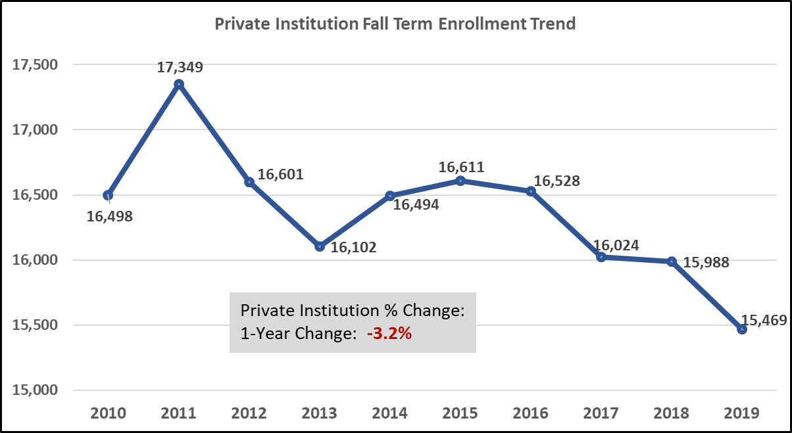
Annual Enrollment Report
The Private/Independent Colleges fall term enrollment has declined the last four years. Fall 2019 enrollment was a 3.2 percent decline compared to Fall 2018.

Slide 72
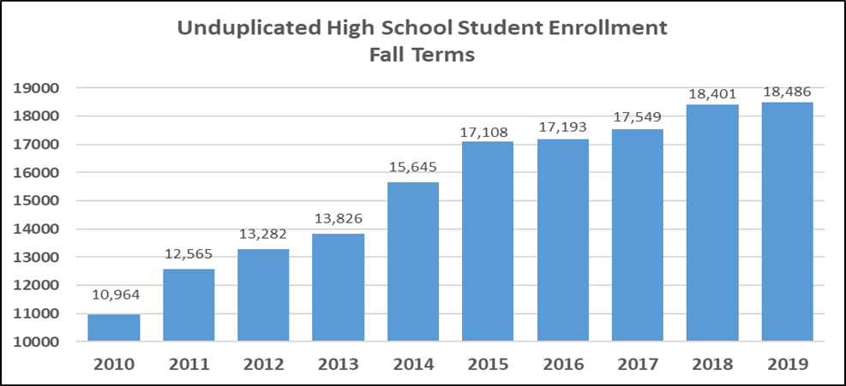
Annual Enrollment Report
High School student enrollment, including both concurrent and dually enrolled students, continued to increase, but Fall 2019 gained only 85 students over Fall 2018 high school student enrollment. Each fall term, around 700 or 4 percent of high school students enroll in courses at more than one college or university.

Slide 73
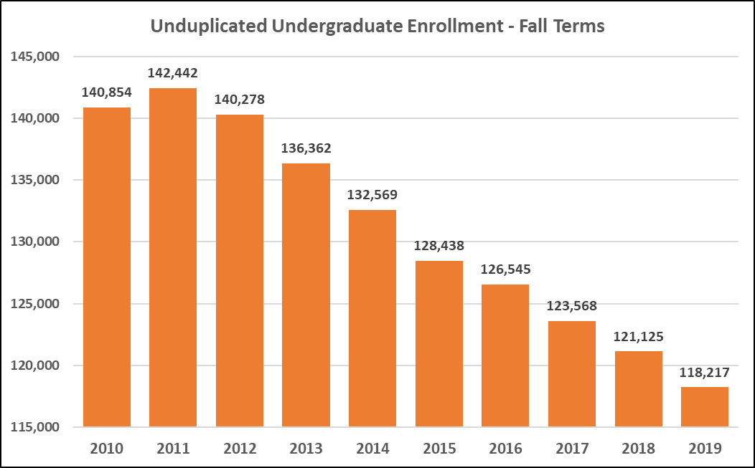
Annual Enrollment Report
Undergraduate enrollment reported here does not include high school student enrollment. Undergraduate enrollment had its largest decline in five years of 2.4 percent. The largest undergraduate class on record is 142,442 reported in Fall 2011.

Slide 74
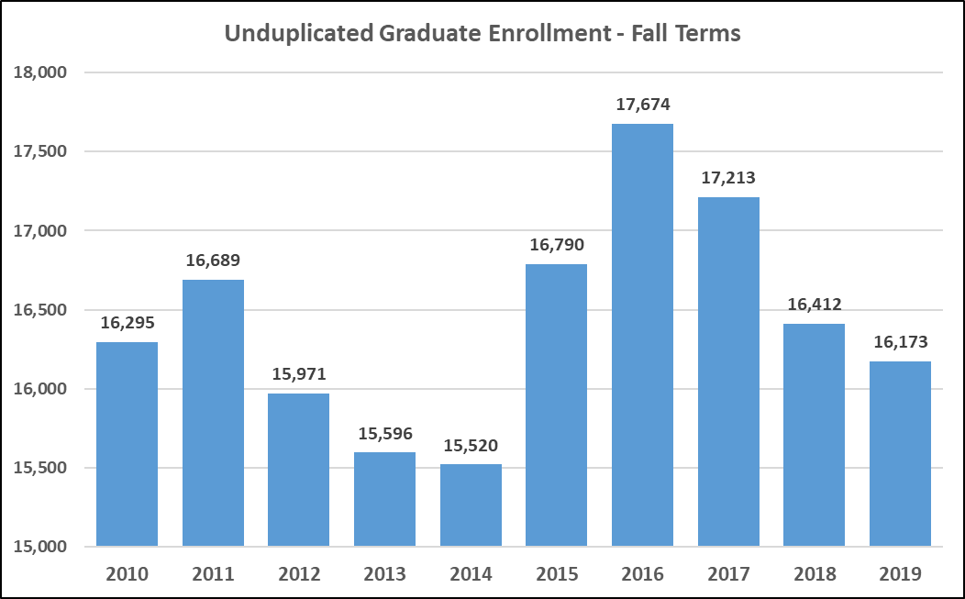
Annual Enrollment Report
Graduate enrollment for all public and private institutions is reporting a decline for the third year in a row. The largest graduate enrollment on record was reported in Fall 2016 at 17,674.

Slide 75
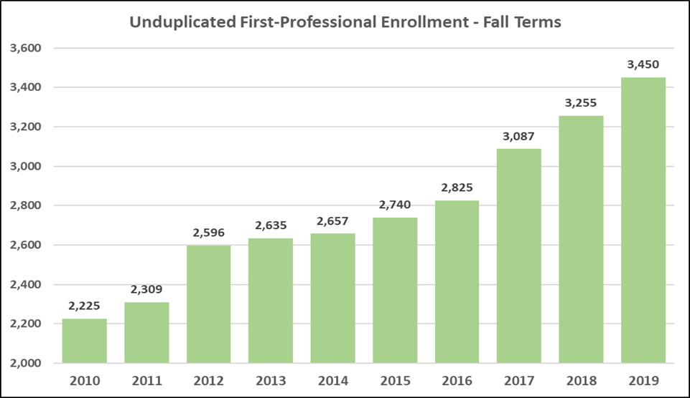
Annual Enrollment Report
First-Professional enrollment has grown each of the last ten years. Enrollment in this level includes students majoring in law, medicine, pharmacy, advanced nursing programs, occupational and physical therapies.

Slide 76
Annual Enrollment Report
HSU and SAUM were the only two public universities reporting a Fall 2019 enrollment increase over Fall 2018.
UALR and UAM reported the highest enrollment declines from Fall 2018 to Fall 2019 of more than 8%.
ASUJ, HSU, SAUM and UAF all reported an increase in Fall 2019 enrollment over Fall 2015.

Slide 77
Annual Enrollment Report
Enrollment for both high school concurrent and dual enrolled students is included in this table.
Comparing Fall 2018 to Fall 2019, SAUM reported the highest percentage increase of 29.3%.
HSU has grown their high school student enrollment from 3 students in Fall 2015 to 459 students in Fall 2019.
ATU reported the largest high school student enrollment of 3,028.

Slide 78
Annual Enrollment Report
Only two public universities, ATU and UAMS, reported one-year increases in undergraduate fall enrollment.
SAUM and UAF both reported an increase in undergraduate enrollment when comparing Fall 2019 to Fall 2015.

Slide 79
Annual Enrollment Report
Unlike undergraduate enrollment, more than half of our public universities saw an increase in graduate student enrollment from Fall 2018 to Fall 2019.

Slide 80
Annual Enrollment Report
Enrollment in this level includes students majoring in law, medicine, pharmacy, advanced nursing programs, occupational and physical therapies.
ASUJ, UALR and UCA all reported increased first-professional enrollment between Fall 2018 and Fall 2019.

Slide 81
Annual Enrollment Report
12 colleges reported an increase in fall term enrollment from Fall 2018 to Fall 2019.
Only six colleges reported a one-year increase last year.
ANC, EACC, SEAC and UACCB all reported the highest increases which fell between 10% - 13%.
Fall 2019 was the first time since Fall 2011 the 2-Year colleges reported an overall increase in total enrollment.
Notes:
NSCRC reported 2-year public colleges declined by 1.4 percent.

Slide 82
Annual Enrollment Report
More than half of the 2-Year Colleges reported an increase in high school student enrollment over Fall 2018.
NWACC reported the highest increase in actual number of high school students (195).
NWACC also enrolls the largest number of high school students, reporting over 1,900 for the Fall 2019.

Slide 83
Annual Enrollment Report
Half of our 2-Year Colleges reported an increased Fall 2019 undergraduate enrollment over Fall 2018.
CCCUA and EACC reported the highest percent changes over Fall 2018.
Only ASUN and EACC reported an increased enrollment comparing Fall 2019 to Fall 2015.

Slide 84
Annual Enrollment Report
BHCLR reported .5% increase over Fall 2018, while JSN reported a decline.
ACHE – Arkansas Colleges of Health Education in Fort Smith is showing steady growth in its first three years.
WBC reported a 13.5% Fall 2019 enrollment increase over Fall 2018.
Notes:
ACHE – College of Osteopathic Medicine Masters degree in Biomedicine Coming next year a Doctoral degree in Occupational Therapy

Slide 85
Annual Enrollment Report
This presentation will be available on the ADHE website early next week.
Additional enrollment data are available via our online data request form at https://www.adhe.edu/institutions/institutional-research/data-request.

Slide 86
Alana Boles
Program Director of Private Career and Out-of-State Education
Agenda item no. 7
2019 Institutional Certification Advisory Committee Annual Report

Slide 87
ICAC Oversight
Out-of-State Postsecondary Institutions and For-Profit Institutions
Institutions Exempt from Oversight:
Institutions offering only church-related training
Institutions on military bases
  Institutions in regional and national reciprocity agreements

Slide 88
Institutions Certified under ICAC Rules
2018-19: 37 Institutions
16 Arkansas Campuses
21 institutions with programs delivered only through distance technology
  10 institutions offering programs both on Arkansas campuses and delivered through distance technology
  6 institutions offering programs only on an Arkansas campus

Slide 89
Institutions Certified under ICAC Rules
2017: 38 Institutions
15 Arkansas campuses
2016: 43 Institutions
14 Arkansas campuses

Slide 90
Degrees Offered
July 1, 2018 – June 30, 2019
Type of Degree | Number of degrees offered
Undergraduate | 227
Graduate | 243
Total | 471
July 1, 2017 – June 30, 2018
Type of Degree | Number of degrees offered
Undergraduate | 182
Graduate | 218
Total | 400

Slide 91
Student Enrollment and Graduates
July 1, 2018 – June 30, 2019
Total Enrollment – 6,293
Online enrollment – 2,362
Arkansas campus enrollment – 3,931
Total Graduates – 1,306

Slide 92
Student Enrollment and Graduates
July 1, 2017 – June 30, 2018
Total Enrollment – 6,662
Online enrollment – 3,065
Arkansas campus enrollment – 3,597
Total Graduates – 1,624

Slide 93
Graduates by Degree
July 1, 2018 – June 30, 2019
Type of Degree | Number of Graduates by Degree Type
Certificates | 165
Associate of Applied Science Degrees | 635
Associate of Arts/Science Degrees | 43
Bachelor’s Degrees | 127
Master’s Degrees | 324
Doctoral Degrees | 12
Total | 1,306

Slide 94
Graduates by Degree
July 1, 2017 – June 30, 2018
Type of Degree | Number of Graduates by Degree Type
Certificates | 392
Associate of Applied Science Degrees | 653
Associate of Arts/Science Degrees | 4
Bachelor’s Degrees | 166
Master’s Degrees | 400
Doctoral Degrees | 9
Total | 1,624

Slide 95
Institutions Exempt from Certification
30 institutions offering only church-related training
3 institutions offering programs on military installations
The majority (51% of total annual enrollment) of students enrolled at the institution located on the military installation must be active or retired military personnel and/or their dependents
Out-of-state institutions approved by state higher education agencies to offer degrees by distance technology through a recognized regional or national education compact such as the Southern Regional Education Board (SREB) or the State Authorization Reciprocity Agreement

Slide 96
State Authorization Reciprocity Agreements (SARA)
ADHE must approve Arkansas colleges and universities offering distance technology programs for SARA participation based on institutional accreditation, financial stability, and student complaint resolution policy and procedures.
SARA participation is optional for Arkansas institutions.
Arkansas will renew membership in SARA in June 2021; every state, Puerto Rico, D.C., and the Virgin Islands have joined SARA except California.
33 Arkansas institutions are in SARA; over 1,650 institutions have joined nationwide.
Applications from out-of-state institutions have decreased as more states and institutions have joined SARA.
Data on enrollment by Arkansas students in SARA institutions in available at the SARA website: www.nc-sara.org/

