Slide 1
REGULAR MEETING OF THE
ARKANSAS HIGHER EDUCATION
COORDINATING BOARD
October 30, 2020

Slide 2
Agenda item no. 11:
REPORT ON intercollegiate ATHLETIC REVENUES & EXPENDITURES 2019-20
Nick Fuller
Assistant Director for Finance

Slide 3
Athletic Report
A.C.A. §6-62-106 directs AHECB to develop and establish uniform accounting standards and procedures for reporting revenues and expenditures.
The 2019-20 Athletic actual expenditures for state-supported universities was $191.5 million and $1.75 million for two-year colleges.
This represents an decrease of 4.8 percent over 2018-19.

Slide 4
Revenues by Source

Slide 5
% of Athletic Revenues By Source 2019-20
Athletic Revenues by Source 2009-10

Slide 6
Expenditures by Source

Slide 7
% of Athletic Expenditures By Source 2019-20
Athletic Revenues by Source 2009-10

Slide 8
Agenda item no. 12:
Bond and loan feasibility updates
Nick Fuller
Assistant Director for Finance

Slide 9
Bond & Loan Feasibility Updates
This update consists of the actual terms for bond and loan issues receiving AHECB approval that occurred from October 2019 through October 2020.
Report includes the actual date of bond/loan issue, amount of bond/loan issue and actual bond/loan terms for bond and loans approved during the reporting period

Slide 10

Dr. Jessie J Walker
Assistant Director for Academic Affairs

Slide 11
ACADEMIC COMMITTEE
CONSENT AGENDA ITEMS

Slide 12
Consent Items
*13. Henderson State University
Bachelor of Science in Computer Engineering
*14-15. North Arkansas College
Associate of Science in Cybersecurity
Technical Certificate in Programming
Associate of Science in Data Science
*16. University of Arkansas at Little Rock
Bachelor of Science in Cybersecurity
*17. University of Arkansas – Rich Mountain
Associate of Applied Science in Massage Therapy
Certificate of Proficiency in in Aesthetics
*Numbers refer to main agenda

Slide 13
Agenda Item no. 18
Institutional Certification
Advisory Committee: Resolutions

Slide 14
Institutional Certification Advisory Committee (ICAC)
4 Colleges
19 Degree and Certificate Programs

Slide 15
Agenda Item no. 19
Letters of NOTIFICATION

Slide 16
Letters of Notification
Programs approved by the ADHE Director
Programs must be included on the AHECB agenda prior to initiation
Programs are reasonable and moderate extensions of existing certificates and degrees

Slide 17
Agenda Item no. 20
Letters of Intent

Slide 18
Letters of Intent
Notification of institutional plans to offer new programs or organizational units that require Coordinating Board approval
Chief academic officers and chief executive officers can comment on the proposals before consideration by AHECB

Slide 19
FULL AHECB Meeting
REGULAR MEETING OF THE
ARKANSAS HIGHER EDUCATION
COORDINATING BOARD
October 30, 2020

Slide 20
Approve Minutes
July 31 Regular Meeting
September 11 Special Meeting

Slide 21
Appointment of Nominating Committee
Chairman Jim Carr will appoint members of the Arkansas Higher Education Coordinating Board nominating committee. The nominating committee will recommend Board officers for 2021-22 at the January 29, 2021 meeting.
Chair - Dr. Michael Stanton
Chris Gilliam
Lori Griffin
Chad Hooten

Slide 22
2021 Coordinating Board Meeting Schedule
The proposed 2021 schedule for these regular quarterly meetings follows:
January 29, 2021 Zoom Virtual Meeting
April 23, 2021 Zoom Virtual Meeting
July 30, 2021 Zoom Virtual Meeting
October 29, 2021 Zoom Virtual Meeting

Slide 23
Agenda item no. 4:
REPORT OF THE DIRECTOR
DR. MARIA MARKHAM

Slide 24
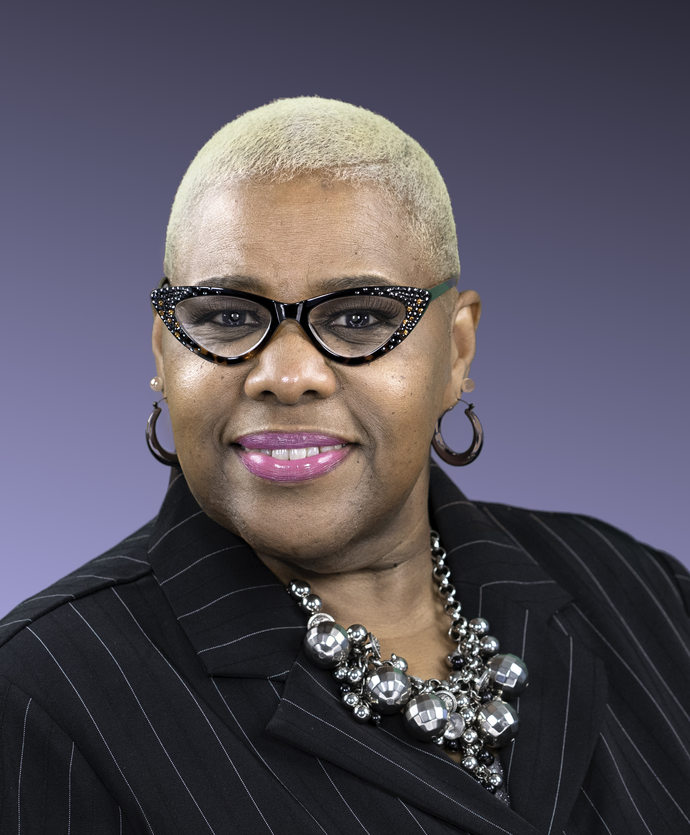
Agency Staff Changes
Dr. Cortez Henderson joins ADHE with a plethora of higher education and secondary education experiences. She has served as Vice President of Student Affairs at ASU Three Rivers (formally College of the Quachitas). She also has served many administrative, managerial and teaching positions at the University of Arkansas at Pine Bluff. She received her Ph.D. in Higher Education Administration, her ME in Family and Consumer Sciences from Iowa State University and her BS in Family and Consumer Sciences from UAPB.

Slide 25
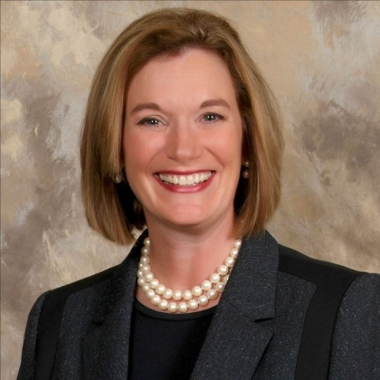
Institutional Leadership
Dr. Sandra Massey, Arkansas State University-Newport Chancellor, is retiring at the end of the year. Before becoming chancellor, Dr. Massey served as ASU-Newport’s Vice Chancellor for Academic Affairs. She has been at ASU-Newport for seven years.

Slide 26
Challenge Scholarship &
Lottery Updates
Year | Count | Amount | Status
2017 | 33,225 | $86,333,054 | Actual
2018 | 33,010 | $91,744,450 | Actual
2019 | 32,486 | $89,350,575 | Actual
2020 | 31,645 | $89,127,736 | Actual
2021 | 31,000 | $91,000,000 | Estimated

Slide 27

HIGHER EDUCATION
COVID-19 RESPONSE

Slide 28


Slide 29
Annual Review of Faculty Performance
Dr. Jessie J Walker
Assistant Director for Academic Affairs

Slide 30
Annual Review of Faculty Performance
Colleges and universities are required to conduct faculty performance reviews under Arkansas Code Annotated §6-63-104 and AHECB policy 5.5.
ADHE staff is required to monitor faculty evaluation processes adopted at Arkansas public institutions and report annually to the AHECB and Legislative Council.
All institutions conducted faculty performance reviews during 2019-2020 using a variety of methods including assessment by students, classroom visits by administrators, peer review, and self-evaluation activities.
Student Ratings
External Perspective
Artifacts

Slide 31
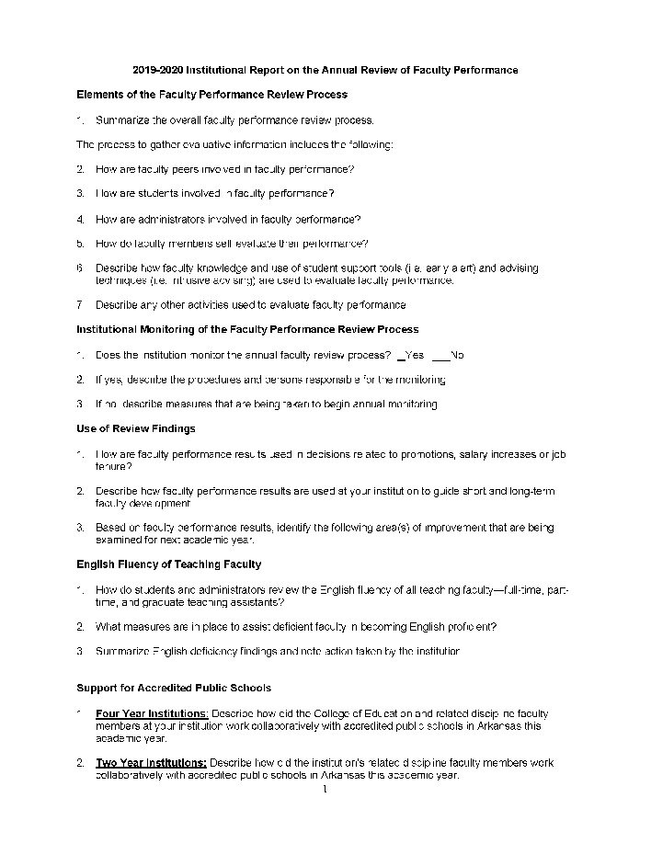
Annual Review of Faculty Performance Notable Findings
Institutions have implemented a variety of training programs to strength faculty development around performance review elements:
  Advising Techniques (e.g. intrusive advising, coaching, and mentoring)
  Tools/approaches to assess student learning outcomes (capstone projects, e-portfolios, rubrics)
Development of quantitative/qualitative component ratings of faculty
  Utilization of technology in the classroom
  Participation in English training including: English as a Second Language courses, and accent reduction training.

Slide 32

Annual Report on
Academic Program Deletions
AHECB Meeting
October 30, 2020
Agenda Item 6
Sonia Hazelwood, Assistant Director
Information Technology, Data & Analytics

Slide 33
Academic Program Deletions
Throughout the year, ADHE Academic Staff receive Letters of Notification from colleges and universities informing us of their intent to delete an academic program. Each quarter those deletions are presented for approval in the Letters of Notification agenda item.
This annual report provides a summary of all academic programs deleted during the 2019-20 academic year.

Slide 34
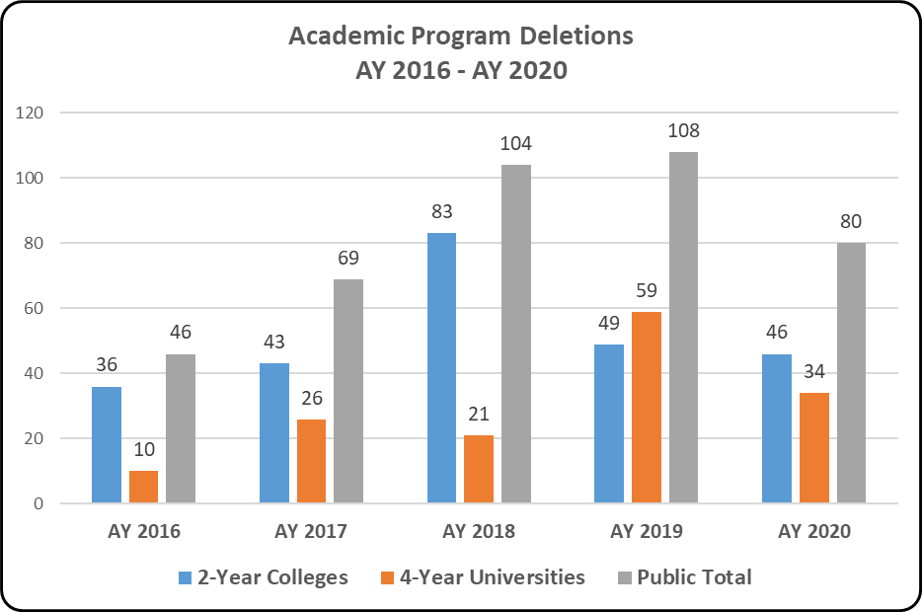
2-Year Colleges accounted for 57.5% of all academic program deletions in AY 2019-20
4-Year Universities had 42.5% of the AY 2019-20 academic program deletions
Notes:
.

Slide 35
Associate degrees and certificates accounted for 70% of the AY 2019-20 academic program deletions
Bachelor’s and higher-level credentials comprised 30% of all academic program deletions in AY 2019-20
Notes:
.

Slide 36
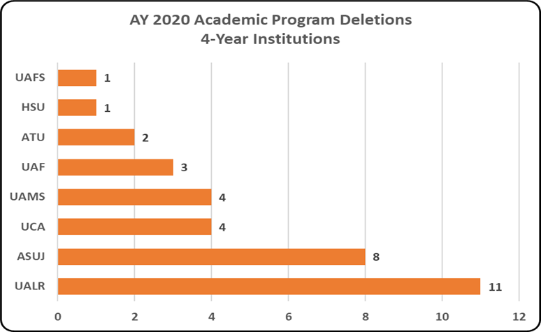
UALR, ASUJ, UCA & UAMS deleted the most academic programs during the 2019-20 academic year
Of the 11 programs UALR deleted, 7 of those were Graduate and Doctoral Programs.
Notes:
.

Slide 37
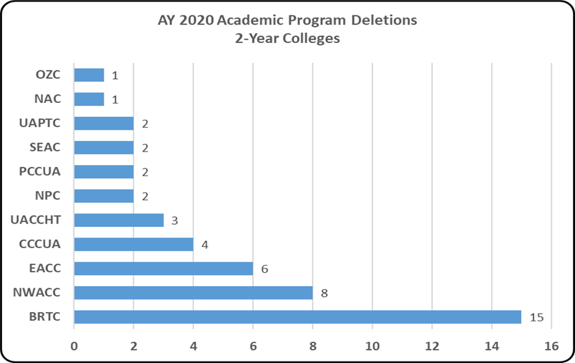
For our 2-Year Colleges, 11 of 22 deleted at least one program during the 2019-20 AY.
BRTC and NWACC deleted the most academic programs during AY 2020, followed by EACC, CCCUA, and UACCHT.
Notes:
.

Slide 38
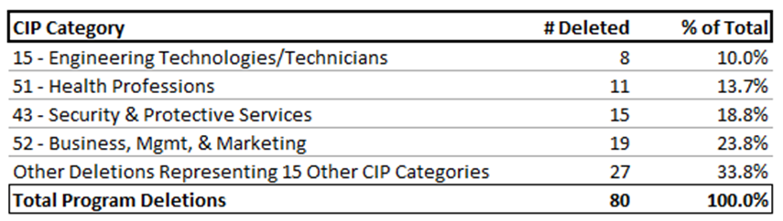
Academic Program Deletions by Program Area
Notes:
.

Slide 39

Annual Report on the College-Going Rate of Arkansas Public High School Graduates
AHECB Meeting
October 30, 2020
Agenda Item 7
Sonia Hazelwood, Assistant Director
Information Technology, Data & Analytics

Slide 40
Methodology
The college-going rate measures the proportion of students enrolling in postsecondary education in the fall semester after finishing high school. The percentage reflects the accessibility of higher education and students’ assessment of the value of attending college when compared to entering the workforce, entering the military or following other pursuits.
This report is a collaboration between the Division of Elementary and Secondary Education (DESE) and the Division of Higher Education (ADHE) of the Arkansas Department of Education. ADHE received 2019 public high school graduate data from DESE and combined it with Fall 2019 data submitted to ADHE from all Arkansas public and private institutions. The College-Going Rate calculations provided include only students graduating from an Arkansas Public High School or Public Charter High School.

Slide 41
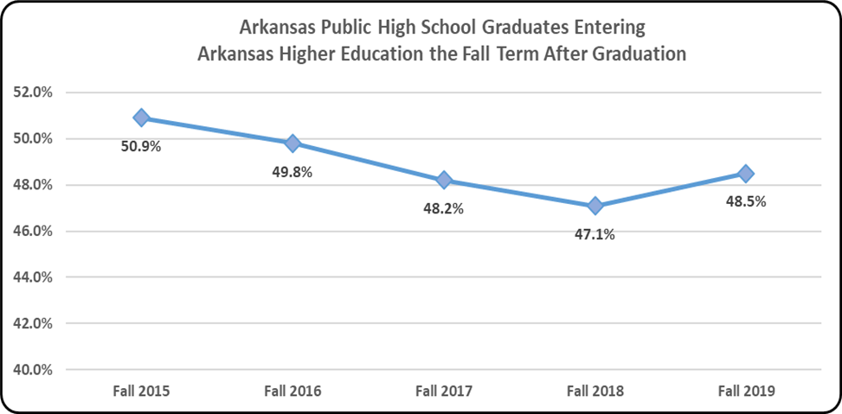
College-Going Rate – 5 Year Review
The public high school student college-going rate for all Arkansas public and private/independent colleges and universities for the Fall 2019 term was 48.5%. This represents an increase of 1.4% from the previous fall term.

Slide 42
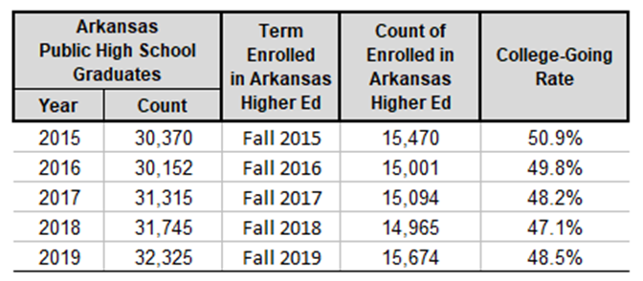
College-Going Rate – 5 Year Review
The table below provides the actual number of Arkansas public high school graduates along with the total number of students entering Arkansas public and private higher education the year following their high school graduation. The CGR column represents the college-going rate for that year.
Notes:
Our college-going rate has been on a steady, but slight decline for the past three years with a slight increase this year,

Slide 43
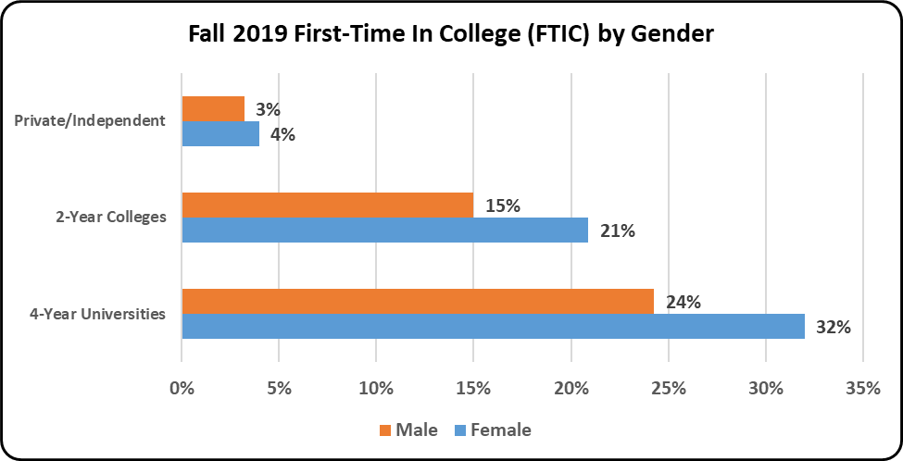
GENDER
The following chart provides the gender breakdown for each institution type for Spring 2019 High School Graduates who entered Arkansas Public and Private/Independent institutions in the Fall 2019 semester.

Slide 44
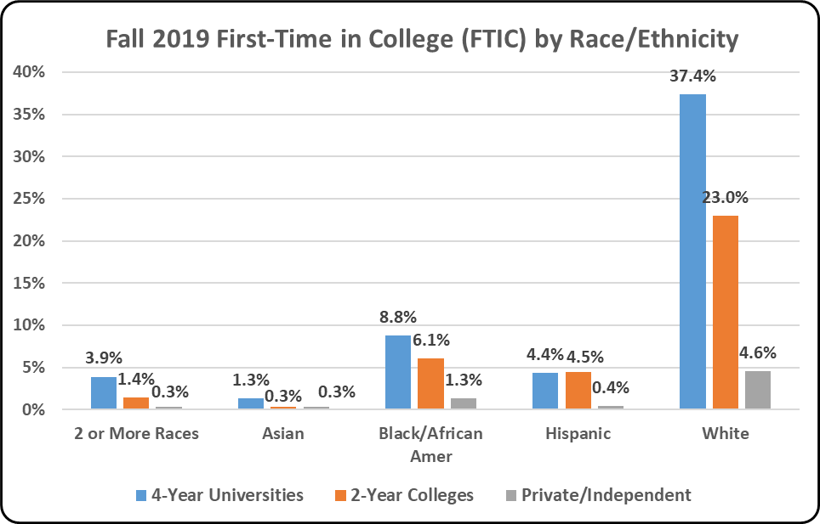
Race/Ethnicity
The following chart provides the race/ethnicity breakdown for each institution type for Spring 2019 High School Graduates who entered Arkansas Public and Private/Independent institutions in the Fall 2019 semester.
Notes:
Of the 15,674 students enrolled in our colleges and universities, 65% are white, 16% are black/African Amer and over 9% are of Hispanic ethnicity.

Slide 45
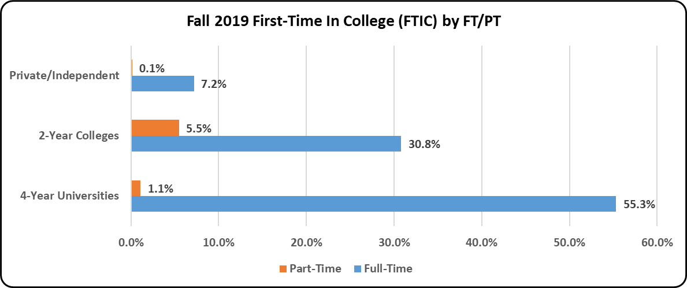
Attendance Status
The following chart provides the attendance status (FT/PT) breakdown for each institution type for Spring 2019 High School Graduates who entered Arkansas Public and Private/Independent institutions in the Fall 2019 semester.
Notes:
Only 6.7% of students entering college immediately after high school enrolled part-time. This is typical for our traditional-aged students enrolling in higher education the semester after graduating high school.

Slide 46
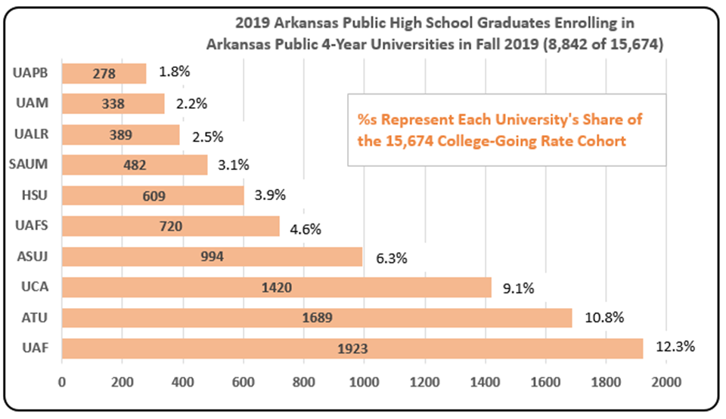
4-Year Universities
The table below shows the number of Spring 2019 public high school graduates entering into their 4-Year university of choice for the Fall 2019 term. The UAF enrolled almost 2,000 Arkansas public high school graduates, followed by ATU, UCA, and ASUJ.

Slide 47
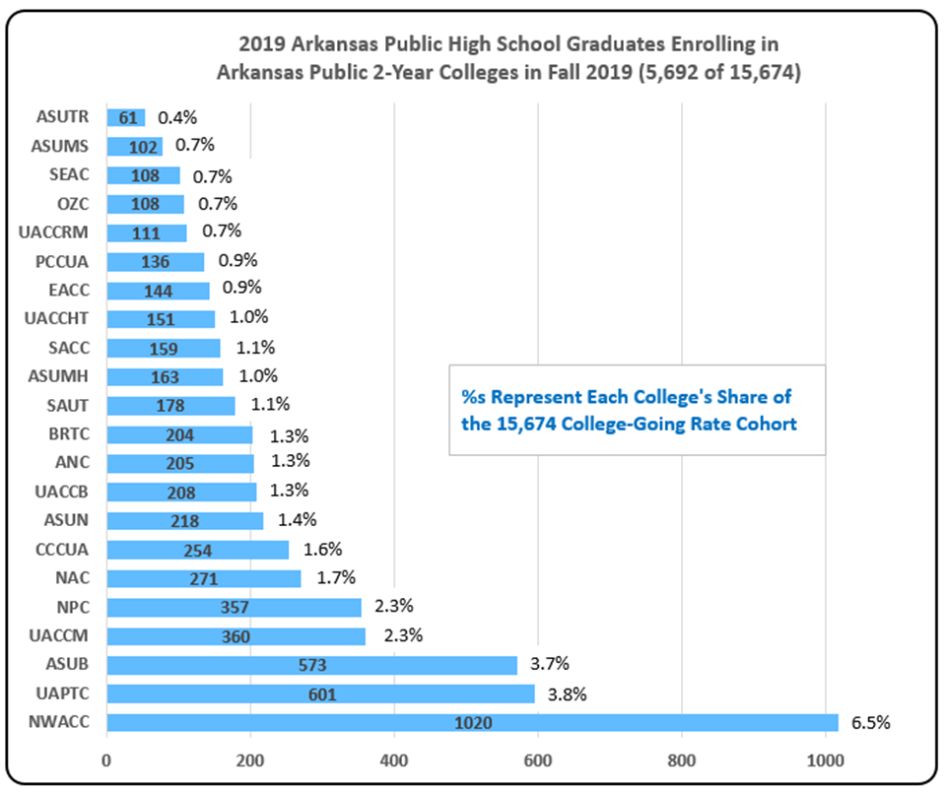
2-Year Colleges
The top three 2-Year Colleges were NWACC, UAPTC, and ASUB.

Slide 48
Arkansas Graduates Leaving the State
ADE’s Division of Elementary and Secondary Education (DESE) sends high school graduate data to the National Student Clearinghouse. The Clearinghouse does a data match to its college enrollment database and provides a data file back to DESE. The Clearinghouse data was shared with ADHE this year, allowing us the opportunity to report on our Arkansas Public High School graduates who chose to attend an out-of-state college or university.
The Clearinghouse data reported 2,035 (6.3%) of our 32,325 public high school graduates attended college outside of Arkansas during the Fall 2019 semester. 48 different states are represented as well as the District of Columbia and Puerto Rico. These 2,035 students attended 616 different colleges and universities. Including these graduates in the college-going rate increases the rate to 54.8%.
The top 6 states:
  Missouri – 325 students
  Oklahoma – 235 students
  Texas – 232 students
  Tennessee – 153 students
  Louisiana – 143 students
  Mississippi – 138 students

Slide 49
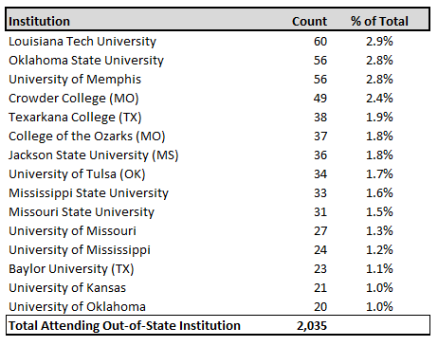
Out-of-State Institutions

Slide 50
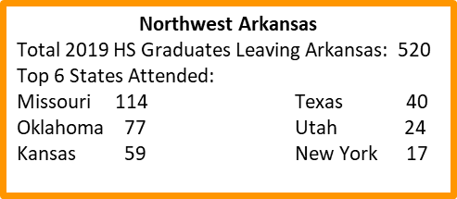
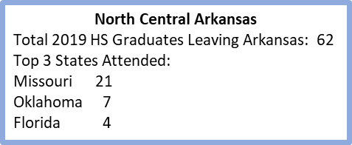
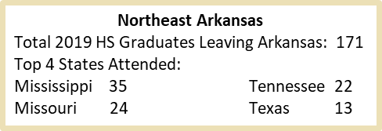
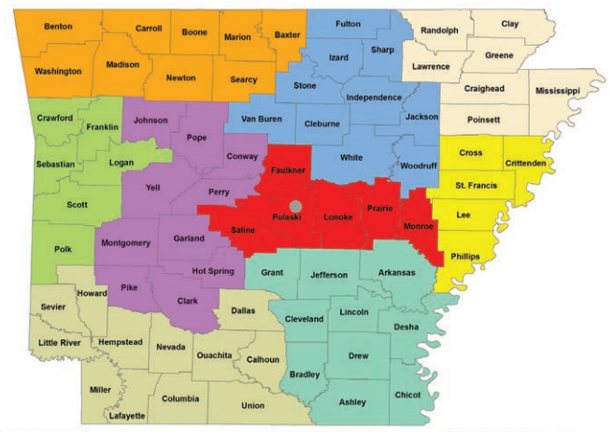
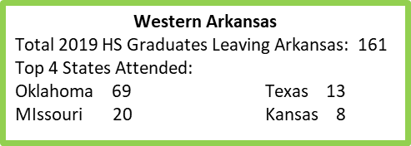
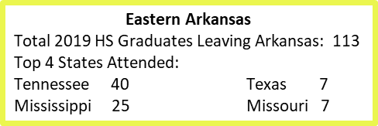
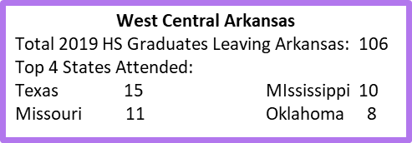
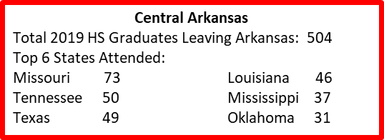
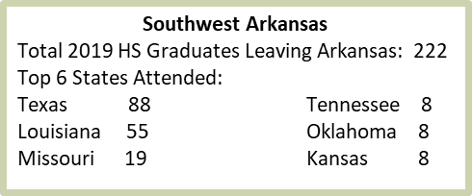
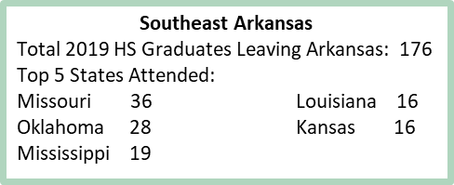

Slide 51
Annual Report of
Credentials Awarded
AHECB Meeting
October 30, 2020
Agenda Item 8
Sonia Hazelwood, Assistant Director
Information Technology, Data & Analytics

Slide 52
Certificates and Degrees Awarded by
Arkansas Higher Education Institutions
Every year colleges and universities submit a Graduated Student File to the Arkansas Higher Education Information System (AHEIS).
This file contains a record for every certificate and degree awarded to students by the institution between July 1st and June 30th of each year.
This year’s annual report includes AY 2020 credentials awarded between July 1, 2019 and June 30, 2020.

Slide 53
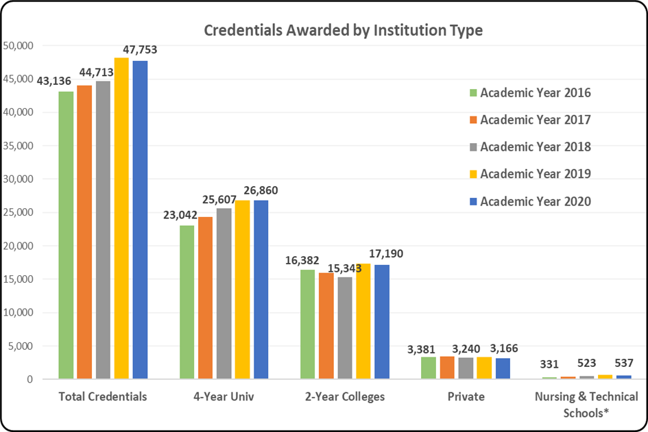
Certificates and Degrees Awarded
There was a 7.6% increase in total credentials from 2018 to 2019, but 2020 credentials declined 0.9% over 2019.
This is the first decline in total credentials since the 2011 and 2012 academic years. It is likely the Covid-19 pandemic played a significant role in delaying graduation for some students who expected to graduate in Spring 2020.

Slide 54
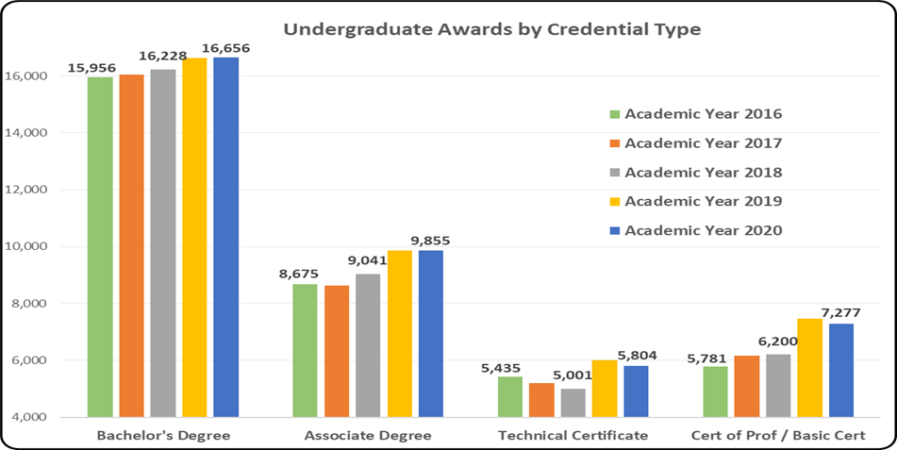
Certificates and Degrees Awarded
Bachelor and Associate degree credentials awarded in 2020 remained basically unchanged over 2019.
Both the Technical Certificates and the Certificates of Proficiency categories experienced declines of 3.4% and 2.5% in 2020.

Slide 55
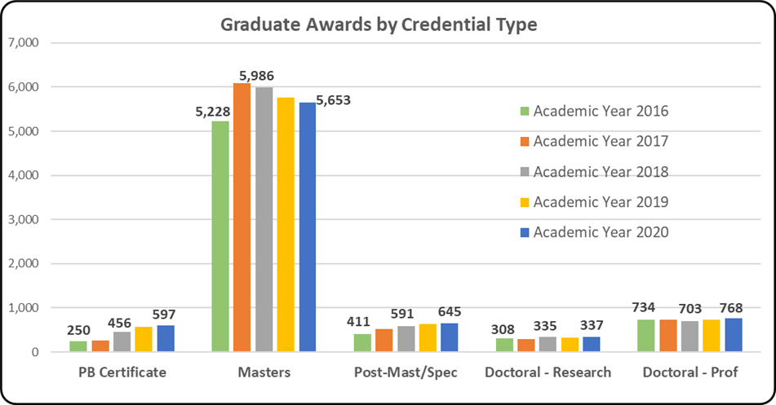
Certificates and Degrees Awarded
For the graduate level credentials, Masters credentials reported a 1.8% decline and Doctoral credentials, including both Research and Professional Practice degrees, reported a 4.1% increase from 2019 to 2020.

Slide 56
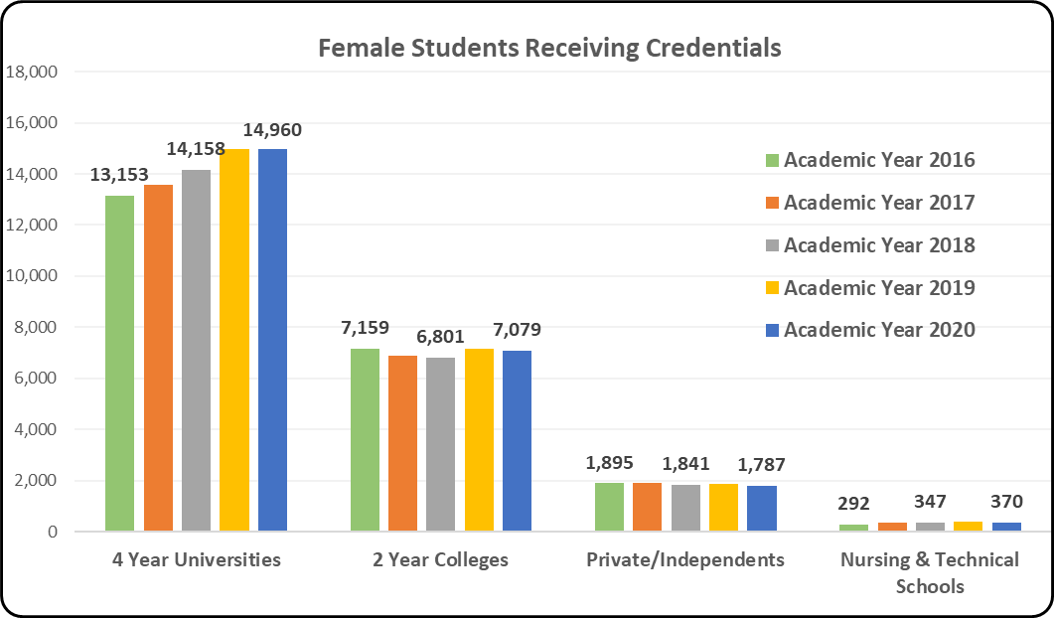
Certificates and Degrees Awarded
For both the 2-year and 4-year public institutions, credentials awarded to female students remained consistent from 2019 to 2020, but the private institutions experienced a 4% decline in awards made to female students.

Slide 57
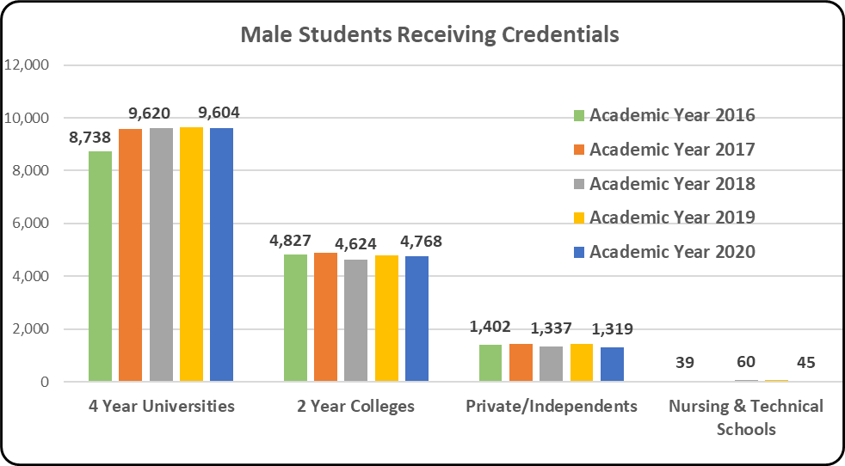
Certificates and Degrees Awarded
For both the 2-year and 4-year public institutions, credentials awarded to male students remained consistent from 2019 to 2020, but the private institutions reported a 9.1% decline in awards made to male students.

Slide 58
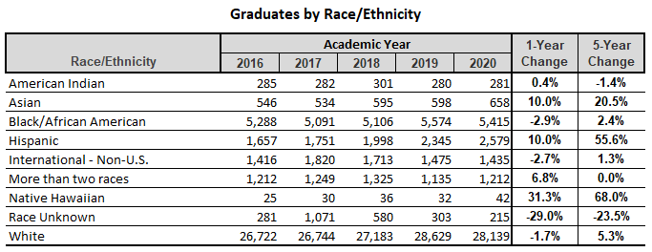
Certificates and Degrees Awarded

Slide 59

Agenda item no. 9 annual status report for sexual assault PREVENTION ON CAMPUS
Ann Clemmer
Assistant Director for Government Relations

Slide 60
Sexual Assault on Campus
ANNUAL STATUS REPORT FOR SEXUAL ASSAULT
PREVENTION ON CAMPUS (ACT 563 OF 2017)
Under Act 563 of 2017, the Higher Education Coordinating Board was directed to develop an action plan to address the prevention of sexual assault on College and university campuses. ADHE has collected the annual campus status reports for the 2018–2019 academic year, as required by the legislation. All campuses have submitted reports.
The legislative requirements for the action plan direct Arkansas public colleges and universities:
To incorporate sexual assault prevention into advising and student orientation;
To integrate information into academic courses as appropriate;
To identify opportunities to raise awareness and provide resources for sexual assault prevention across the entire student population;
To identify available grants and partnerships to assist with the work;
To collaborate with sources for access to care; and
To identify other topics or issues relating to the prevention and reduction of sexual assault.

Slide 61

Agenda item no. 10
UNPLANNED PREGNANCy prevention annual report
Ann Clemmer
Assistant Director for Government Relations

Slide 62
Unplanned Pregnancy Prevention
Under Act 943 of 2015 the Arkansas Higher Education Coordinating Board (AHECB) was directed to develop an action plan to address unplanned pregnancies on college campuses. ADHE has collected the campus implementation reports for 2017-2018.
The Arkansas Department of Higher Education has collected reports from all 11 public four year universities in the state and all 22 two year colleges. The reports show that all campuses are in compliance with Act 943.

Slide 63
Relevant Information
The legislation directs higher education institutions in nine areas. Among those directives, colleges and universities are to identify methods of addressing the problem of unplanned pregnancy, to collaborate with health centers, to identify a measure of success, and to incorporate into academic coursework “as appropriate”. The legislation mandates that campuses include in their orientation information on the prevention of unplanned pregnancy.
The implementation reports will be scanned and posted on the ADHE website for campuses to use as they look for additional ways to address this important issue.

