Slide 1
AHECB Meeting
July 31, 2015

Slide 2
Agenda item no. 5:
Certification of Intercollegiate Athletic Budgets for 2015-16
Tara Smith
Senior Associate Director, Institutional Finance

Slide 3
Relevant Information
Athletic Fees Per SSCH
Institution | 2014-15 Athletic Fee | 2015-16 Athletic Fee
ASUJ | $17.00 | $19.00
ATU | $14.00 | $15.00
HSU | $15.00 | $16.25
SAUM | $17.00 | $17.00
UAF | $0.00 | $0.00
UAFS | $16.00 | $16.00
UALR | $17.25 | $18.75
UAM | $13.00 | $13.00
UAPB | $17.00 | $17.00
UCA | $17.00 | $17.00

Slide 4
Intercollegiate Athletic Report for 2015-16

Slide 5
Relevant Information
Percentages of funds supporting athletic budgets excluding UAF:
  Student Athletic fees – 40.5%
  Athletic generated revenues – 21.2%
  Educational and General transfer – 16.7%
  Remaining Sources of Income – 15.2%
    Includes Other Auxiliary Profits, Endowment and Investment Income, Contributions, and Other Athletic Income.

Slide 6

Agenda item no. 6:
Economic Feasibility of BonD ISSUE for
ARKANSAS NORTHEASTEN COLLEGE
Chandra Robinson
Program Coordinator, Institutional Finance

Slide 7
Relevant Information
$5.105 million for 30 years @ a rate not to exceed 4.50%
Educational and general purposes
Revenue Funding Source: Millage Revenue
Proceeds from the bond issue will be used for the construction and equipping of the College's Center for Allied Technologies and pay the expenses of issuing the bonds
Notes:
1. What is the projected date the bonds will be sold?
2. Please provide a detailed description of the new facility facilities. Please include the square feet, type of space that will make up the facility and location of the facility on the campus as well as any other relevant information.
3. Will the bond issue include furnishings?
4. What is the projected start date and completion date for facility?
5. Please list a few programs that will be housed in the facility.
6. Are there any other sources of income being used for this project? (i.e. private gifts)
7. What is the total project cost including all funding sources? Does this include all sources?

Slide 8

Agenda item no. 7:
Economic Feasibility of BOND ISSUE for Arkansas TECH UNIVERSITY
Chandra Robinson
Program Coordinator, Institutional Finance

Slide 9
Relevant Information
$1.25 million for 30 years @ a rate not to exceed 4.75%
Auxiliary purposes
Revenue Funding Source: Housing Revenue
Proceeds will be used to renovate Wilson Residence Hall on the campus of Arkansas Tech University
Notes:
1. What is the projected date the bonds will be sold?
2. Please provide a detailed description of the new facility facilities. Please include the square feet, type of space that will make up the facility and location of the facility on the campus as well as any other relevant information.
3. Will the bond issue include furnishings?
4. What is the projected start date and completion date for facility?
5. Please list a few programs that will be housed in the facility.
6. Are there any other sources of income being used for this project? (i.e. private gifts)
7. What is the total project cost including all funding sources? Does this include all sources?

Slide 10
Agenda item no. 8:
Economic Feasibility of BOND ISSUE for Arkansas TECH UNIVERSITY
Chandra Robinson
Program Coordinator, Institutional Finance

Slide 11
Relevant Information
$2.0 million for 5 years @ a rate not to exceed 3.0%
Educational and general purposes
Revenue Funding Source: Tuition and Fee Revenue
Proceeds will be used for upgrading computer hardware in the University's computer center
Notes:
1. What is the projected date the bonds will be sold?
2. Please provide a detailed description of the new facility facilities. Please include the square feet, type of space that will make up the facility and location of the facility on the campus as well as any other relevant information.
3. Will the bond issue include furnishings?
4. What is the projected start date and completion date for facility?
5. Please list a few programs that will be housed in the facility.
6. Are there any other sources of income being used for this project? (i.e. private gifts)
7. What is the total project cost including all funding sources? Does this include all sources?

Slide 12
Agenda item no. 9:
Economic Feasibility of LOAN ISSUE for Arkansas TECH UNIVERSITY
Chandra Robinson
Program Coordinator, Institutional Finance

Slide 13
Relevant Information
$1.0 million for 10 years @ a rate not to exceed 4.0%
Auxiliary purposes
Revenue Funding Source: Housing Revenue
Proceeds from the loan will be used to renovate Wilson Residence Hall on the campus of Arkansas Tech University
Notes:
1. What is the projected date the bonds will be sold?
2. Please provide a detailed description of the new facility facilities. Please include the square feet, type of space that will make up the facility and location of the facility on the campus as well as any other relevant information.
3. Will the bond issue include furnishings?
4. What is the projected start date and completion date for facility?
5. Please list a few programs that will be housed in the facility.
6. Are there any other sources of income being used for this project? (i.e. private gifts)
7. What is the total project cost including all funding sources? Does this include all sources?

Slide 14

Agenda item no. 10:
Economic Feasibility of BOND ISSUE for UNIVERSITY OF Arkansas, FAYETTEVILLE
Chandra Robinson
Program Coordinator, Institutional Finance

Slide 15
Relevant Information
$8.0 million for 30 years @ a rate not to exceed 5.50%
$3.86 million for Educational and General purposes & $4.14 million for Auxiliary purposes
Revenue Funding Sources: Tuition and Fee Revenue & Auxiliary Revenues (Generated by Fraternities)
Proceeds will be used to fund a utility infrastructure expansion and to renovate and construct (1) housing for Lambda Chi Alpha Fraternity, (2) housing for the Pi Kappa Alpha Fraternity, and (3) other capital improvements and infrastructure and various equipment for auxiliary purposes if proceeds are available
Notes:
1. What is the projected date the bonds will be sold?
2. Please provide a detailed description of the new facility facilities. Please include the square feet, type of space that will make up the facility and location of the facility on the campus as well as any other relevant information.
3. Will the bond issue include furnishings?
4. What is the projected start date and completion date for facility?
5. Please list a few programs that will be housed in the facility.
6. Are there any other sources of income being used for this project? (i.e. private gifts)
7. What is the total project cost including all funding sources? Does this include all sources?

Slide 16
ACADEMIC COMMITTEE
Consent Agenda Items
Agenda Item No. 11: Institutional Certification Advisory Committee (ICAC)
Agenda Item No. 12: Letters of Notification
Agenda Item No. 13: Letters of Intent

Slide 17
AHECB Meeting
July 31, 2015

Slide 18
Agency UPDATEs
Dr. Brett Powell
Director

Slide 19


Institutional Leadership
Phillips Community College of the U of A
  Dr. Keith Pinchback, Chancellor
    Began June 30, 2015
Arkansas State University Mid-South
  Dr. Debra West, Chancellor
    Will begin August 1, 2015

Slide 20
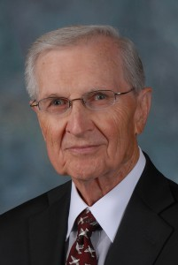
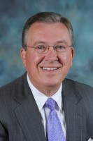
Institutional Leadership
Ouachita Baptist University
  Dr. Charles Wright, Interim President
    Will begin August 1, 2015
Arkansas’ Independent Colleges and Universities
  Dr. Rex Horne, Jr., President
    Will begin August 1, 2015

Slide 21
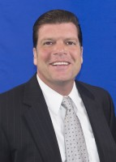
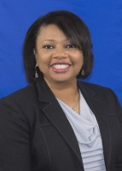
Personnel Changes
Callan Callaway
Financial Aid Program Specialist
Lisa Smith
Outreach and Communication
Coordinator

Slide 22
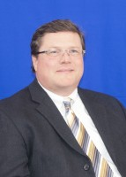
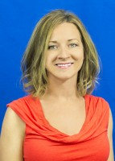
Personnel Changes
Dr. Tim Atkinson
Senior Associate Director for Research
and Technology
Kristi Rainwater
Financial Aid Program Specialist
Resigned, last day August 7

Slide 23
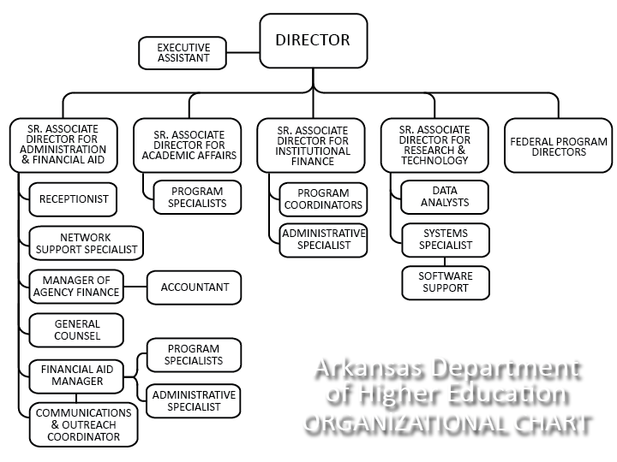
Agency
Organizational Chart

Slide 24
Faculty Performance Reviews
Colleges and universities are required to conduct faculty performance reviews under Arkansas Code Annotated §6-63-104 and AHECB policy 5.5.
ADHE staff is required to monitor faculty evaluation processes adopted at Arkansas public institutions and report annually to the AHECB and Legislative Council.
All institutions conducted faculty performance reviews during 2014-15 using a variety of methods including assessment by students, classroom visits by administrators, peer review, and self-evaluation activities.

Slide 25
Regional Workforce Grants
Grant guidelines approved May 1
Letters of intent due from institutions August 1
Grant proposals due September 1
Award notices October 1

Slide 26
Legislative Update
Student Loan Debt Interim Study
Rep. Greg Leding
  Avg. student loan debt for 2013 was over $25K
  Examine the impact of student loans on students; consider federal role and impact of college savings
Higher Education Realignment Task Force
Rep. Mark Lowery, Sen. Jane English
  Redundancies, efficiencies, accountability and communication
Fiscal Session
Operating Budgets/Personnel Recommendations presented in October

Slide 27
SHEEO Annual Meeting
US Department of Ed report
  College ratings system
  Graduation rate calculations
  Federal aid disbursement
National Student Clearinghouse
  Reverse Transfer
  Grad School enrollments
Kentucky College Readiness

Slide 28
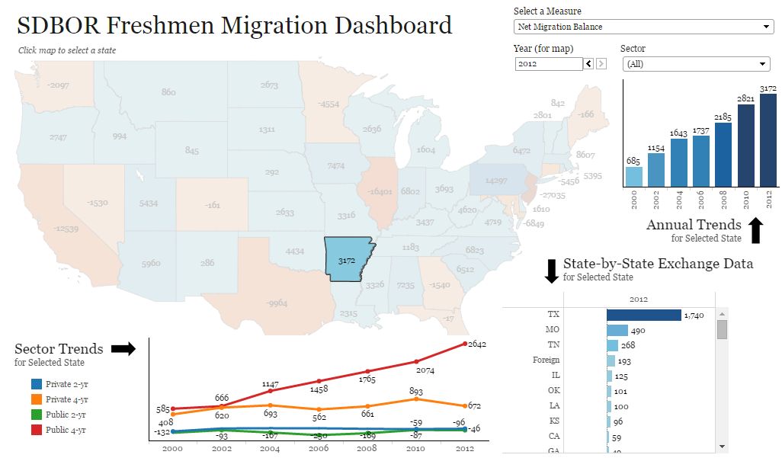

Slide 29
Agency Projects
Launch of New ADHE Website
    August 3, 2015
Policy Review
Remediation Models
  Remedial Placement
  College Readiness
  Placement Exams (Compass)
Student Loan Debt
  Cost of Attendance
CTE Course Transfer System
Guided Pathways
Need-based Aid
Funding Model
Prior Learning Assessment
ACTS Review
ADE Data Sharing - HS Seniors
Cooperative Purchasing Agreement Reporting
Credentials-to-Careers Mapping

Slide 30
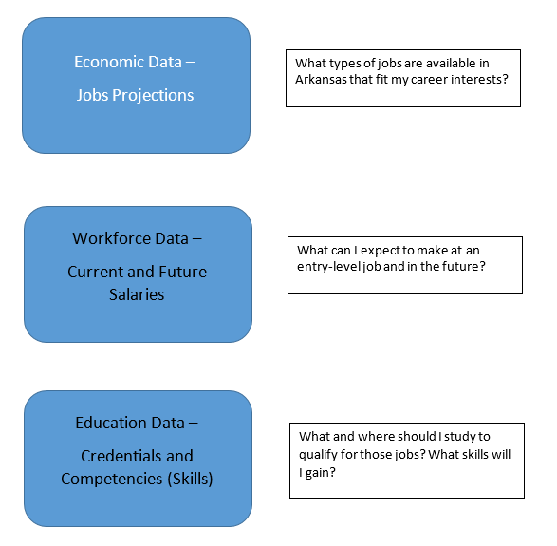
Credentials-to-Careers

Slide 31
2016 AHECB Meeting Schedule
Proposed Dates
January 29, 2016 Arkansas Department of Higher Education
Little Rock
April 21-22, 2016 National Park College
Hot Springs
July 29, 2016 Arkansas Department of Higher Education
Little Rock
October 28, 2016 Arkansas Department of Higher Education
Little Rock

Slide 32
Agenda item no. 3:
Amendment to the Performance Based Funding
Dr. Brett Powell
Director

Slide 33
Performance Based Funding Policy Updates
Updates:
Performance Funding scoring requirements for Universities & Colleges
  To maintain 100% of performance funding, a minimum score of 6 out of 10 is required
  If score is below 6, performance funding may be reduced using a graduated scale based on an institution’s score
Distribution of Performance Funding
  Institutions that meet minimum score requirements will maintain 100% of their performance funds
  Performance funds for institutions that score below the minimum score requirements will be redistributed based on the following:
    First year minimum score not met an improvement plan may be submitted to earn back performance funds
    Second consecutive year and each consecutive year thereafter that the minimum score is not
    met, funds will be redistributed on a competitive basis to other institutions that meet the
    minimum score requirements

Slide 34
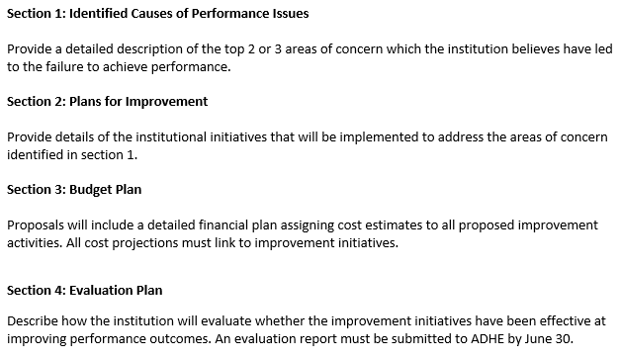
Performance Based Funding Policy Updates
Performance Improvement Plan

Slide 35
College-Going Rate
AHECB Meeting of July 31, 2015

Slide 36
Fifth Year of New Methodology
New methodology focuses on students that (1) graduated from an Arkansas public school district in Academic Year 2012-2013, (2) are first-time entering students in 2013 Fall term, and (3) are Arkansas residents. This new methodology more closely follows that used by the National Center for Education Statistics (NCES). However, there are three differences:
1. NCES filters by the age range of 16-24 – ADHE ignores age but focuses on high school graduates from the previous year as most all high school graduates are between the ages of 16 and 24;
2. NCES includes GED students as their report is based on a survey. ADHE does not have data on annual graduating classes of GED students, therefore, GED students are excluded; and
3. Since the NCES report is a survey, it may include private high schools and home school students. ADHE has no data on annual graduating classes of private high schools or home school students. ADHE does obtain data on graduating classes of Arkansas public high schools (from the Arkansas Department of Education). Therefore, the new methodology is a College-Going Rate calculation for Arkansas public high school graduates only attending college in Arkansas.

Slide 37
Why Did the Methodology Change?
The Old Methodology Did Not
Measure College-Going Rate
The old methodology consisted of the Fall student cohort including
(1) first-time,
(2) full-time, and
(3) on-campus that attend an Arkansas public or independent institution after completing high school or GED.
NOTE: An error was discovered in calculations. Correction results in changes ranging from 0.0% to 3.5% differences.

Slide 38
College-Going Rate is Down 1.3%
Arkansas’ rate has increased and leveled off with slight downward trend over last 2 fall terms. The national rate is trending downward for last 5 years.

Slide 39
Students Entering College is Up
Term | Public HS Graduates | Those Entering College | CGR
2010 Fall | 28,939 | 15,164 | 52.4%
2011 Fall | 28,921 | 15,119 | 52.3%
2012 Fall | 28,896 | 15,286 | 52.9%
2013 Fall | 29,714 | 15,263 | 51.4%
2014 Fall | 30,800 | 15,419 | 50.1%
While the College-Going Rate decreased slightly (1.3%), the actual number of public high school graduates entering college increased by 156. The CGR decreased because the number of public high school graduates increased by over 1,000.

Slide 40
Distribution by Institution Type: 2014 Fall
4-Yr. Univ. = 61.9% | 31.0%
2-Yr. Coll. = 32.4% | 16.2%
Priv./Ind. = 5.7% | 2.9%
Total = 100.0% | 50.1%

Slide 41
Distribution by Institution Type: History

Slide 42
Gender and Race/Ethnicity

Slide 43
4-Year Universities: Where They Attend

Slide 44
2-Year Colleges: Where They Attend

Slide 45
Private/Independent Institutions:
Where They Attend
Three institutions had 10 or less students entering and no data is shown in the above graph: Philander Smith College (PSC), Shorter College (SC), and Williams Baptist College (WBC).

Slide 46
SREB Comparison
Percentage of 18- to 24-year-olds enrolled in degree-granting postsecondary institutions: 2013 | SREB States Only
State | Percent | Rank
United States | 42.7 | NA
Maryland | 45.6 | 1
Delaware | 43.0 | 2
Virginia | 42.9 | 3
Mississippi | 41.5 | 4
Florida | 41.4 | 5
North Carolina | 40.9 | 6
South Carolina | 40.3 | 7
Kentucky | 40.3 | 8
Georgia | 39.7 | 9
Alabama | 38.1 | 10
Arkansas | 38.1 | 11
Texas | 37.8 | 12
Tennessee | 37.4 | 13
Oklahoma | 36.4 | 14
Louisiana | 36.3 | 15
West Virginia | 36.2 | 16
Source: NCES, Digest of Education Statistics 2013, Table 302.65.
Arkansas ranks 11th out of 16 SREB states in the percent of 18-24 year-olds attending college.

