Slide 1
Agenda item no. 6 operating needs and recommendations for the 2017-19 biennium
Tara Smith
Senior Associate Director, Institutional Finance

Slide 2
Institutional Need
SSCH used in the funding model decreased 3.5% for Colleges and increased 0.5% for Universities over the previous year
FY18 Need for Higher Education is approximately $975 million for institutions and $239 million for non-formula entities

Slide 3
ADHE Recommendation
ADHE recommends an increase of approximately $169 million for all entities.
This recommendation will bring all institutions and entities to 75% of Need

Slide 4
Operating Recommendations
Table A. Summary of Operating Needs & Recommendations for the 2017-19 Biennium

Slide 5

Operating Recommendations
Table B. 2017-19 Two-Year Colleges Recommendations

Slide 6
Operating Recommendations
Table C. 2017-19 Four-Year Universities Recommendations

Slide 7
Operating Recommendations
Table D. 2017-19 Technical Centers Recommendations

Slide 8
Operating Recommendations
Table E. 2015-17 Non-Formula Entities Recommandations

Slide 9
Agenda item no. 7 personal services recommendations for the 2017-19 biennium

Slide 10
Summary of Recommendations
Line-item maximum salary increases were considered this biennium, and all line-item maximums were adjusted by 1.4 percent per year.
  University President & Chancellor LIM were adjusted to labor market rates based on SREB category
  Salary recommendations for new positions were based on salaries for similar positions previously established at comparable institutions.
Institutions have 19,941 non-classified positions currently authorized, excluding UAMS.
  ADHE Staff recommends an increase of 166 non-classified positions for institutions.
  Increase of 0.8 percent for a total of 20,107 non-classified positions
UAMS had no net new position requests.
  ADHE Staff recommends no change in non-classified UAMS positions, for a total of 8,801 for UAMS.

Slide 11
Agenda item no. 8 capital funding recommendations for the 2017-19 biennium

Slide 12
Capital Funding Requests
Arkansas higher education has a current replacement value for its educational and general (E&G) space of approximately $5.6 billion
50 percent of useful life of campus facilities has been expended
$1.14 billion requested for construction, renovation and technology infrastructure
Over $2.7 billion needed for deferred maintenance & $211.9 million for critical maintenance

Slide 13
Capital Funding Requests
A total of $250.05 million recommended for all projects
  $150.96 million for renovation, new construction and technology infrastructure
  $21.16 million for critical maintenance
  $55.84 million for deferred maintenance
  $22.09 million for equipment, library

Slide 14
Agenda item no. 9 certification of Budgeted intercollegiate athletic revenues and expenditures for 2016-17
Jake Eddington
Program Specialist, Institutional Finance

Slide 15
Athletic Fees Per SSCH
Institution | 2015-16 Athletic Fee | 2016-17 Athletic Fee
ASUJ | $19.00 | $19.00
ATU | $15.00 | $15.50
HSU | $16.25 | $17.25
SAUM | $17.00 | $18.00
UAF | $0.00 | $0.00
UAFS | $16.00 | $16.00
UALR | $18.75 | $20.00
UAM | $13.00 | $13.00
UAPB | $17.00 | $17.00
UCA | $17.00 | $18.00

Slide 16
Intercollegiate Athletic
Budget Report for 2016-17

Slide 17
ACADEMIC COMMITTEE
Consent Agenda Items
Ann Clemmer
Senior Associate Director, Academic Affairs

Slide 18
Consent Items
*10. Arkansas State University – Jonesboro
Certificate of Proficiency in Emergency Medical Technician –
Basic
Technical Certificate and Associate of Applied Science in Paramedic
*11. Arkansas State University – Jonesboro
Graduate Certificate in Play Therapy

Slide 19
Agenda Item no. 12
Institutional Certification
Advisory Committee: Resolutions
Alana Boles
Program Specialist, Academic Affairs

Slide 20
Institutional Certification Advisory Committee (ICAC)
Two new members to the ICAC
12 Colleges and Universities
48 Programs
Likewise College – Request for Institutional Planning and Development to Establish an Arkansas Independent College to Offer Associate Degrees

Slide 21
Agenda Item no. 13
Letters of Notification
Lillian Williams
Program Specialist, Academic Affairs

Slide 22
Letters of Notification
Programs approved by the ADHE Director
Programs must be included on the AHECB agenda prior to initiation
Programs are reasonable and moderate extensions of existing certificates and degrees

Slide 23
Agenda Item no. 14
Letters of Intent
Lillian Williams
Program Specialist, Academic Affairs

Slide 24
Letters of Intent
Notification of institutional plans to offer new programs or organizational units that require Coordinating Board approval
Chief academic officers and chief executive officers can comment on the proposals before consideration by AHECB

Slide 25
AHECB Meeting
July 29, 2016

Slide 26
Agency UPDATEs
Dr. Brett Powell
Director

Slide 27
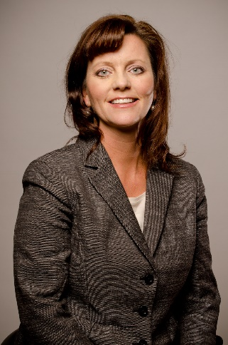
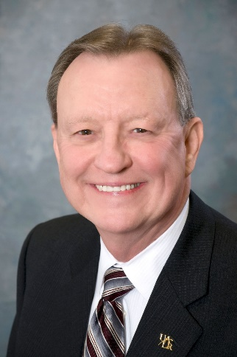
Institutional Leadership
North Arkansas College
  Dr. Jackie Elliott
    Last day was June 30 , 2016
Elliott
University of Arkansas at Little Rock
  Dr. Joel Anderson
    Last day was June 30, 2016
Anderson

Slide 28
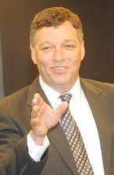
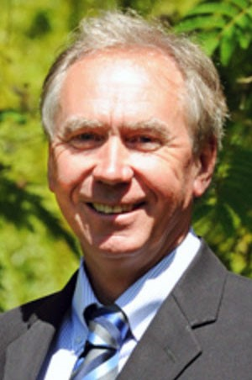
Institutional Leadership
North Arkansas College
  Dr. Randy Esters, President
  (Previously was Dean of Liberal Arts at Louisiana State University)
    Began July 1, 2016
Esters
University of Arkansas at Little Rock
  Dr. Andrew Rogerson, Chancellor
  (Current Provost of Sonoma State University, California)
    Will begin September 1, 2016
Rogerson

Slide 29
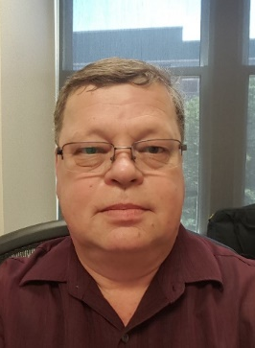
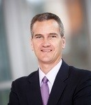
ADHE Personnel Changes
Ken Wall
Senior Software Support Specialist
  Began July 5, 2016
Brett Powell
Vice President for Finance and Administration, HSU
  Last day is July 29, 2016

Slide 30
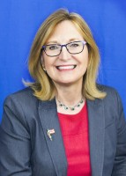
ADHE Personnel Changes
Ann Clemmer
Interim Director
  Starting July 30

Slide 31
Annual Faculty Performance Review
Colleges and universities are required to conduct faculty performance reviews under Arkansas Code Annotated §6-63-104 and AHECB policy 5.5.
ADHE staff is required to monitor faculty evaluation processes adopted at Arkansas public institutions and report annually to the AHECB and Legislative Council.
All institutions conducted faculty performance reviews during 2015-16 using a variety of methods including assessment by students, classroom visits by administrators, peer review, and self-evaluation activities.

Slide 32
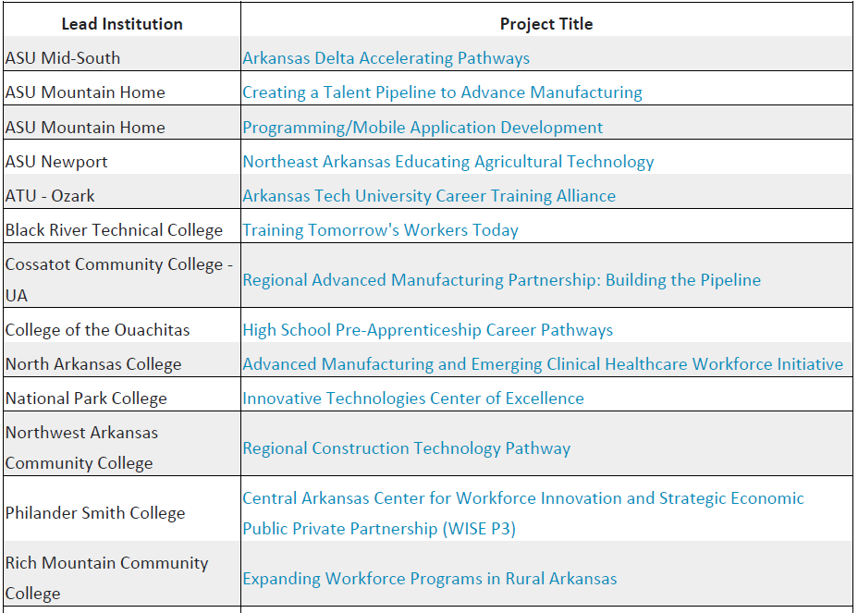
Regional Workforce Grants

Slide 33
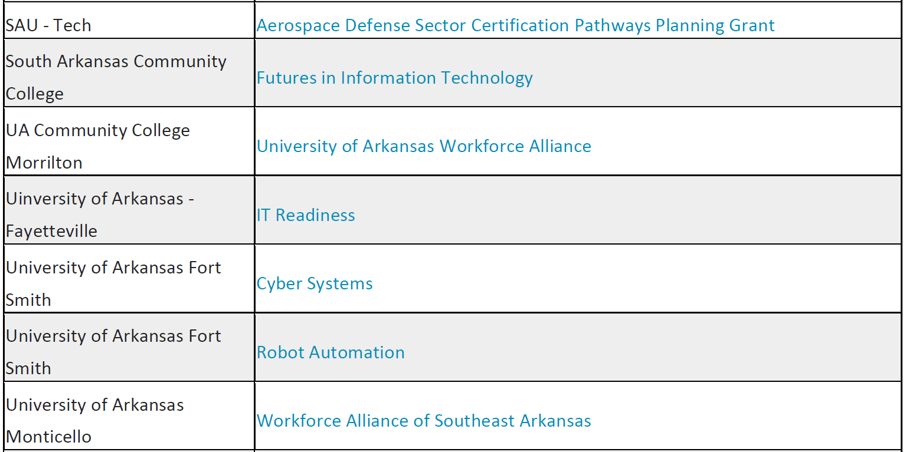
Regional Workforce Grants

Slide 34
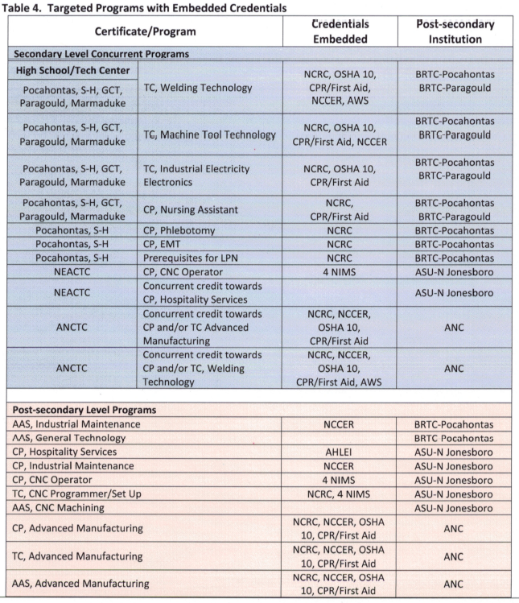
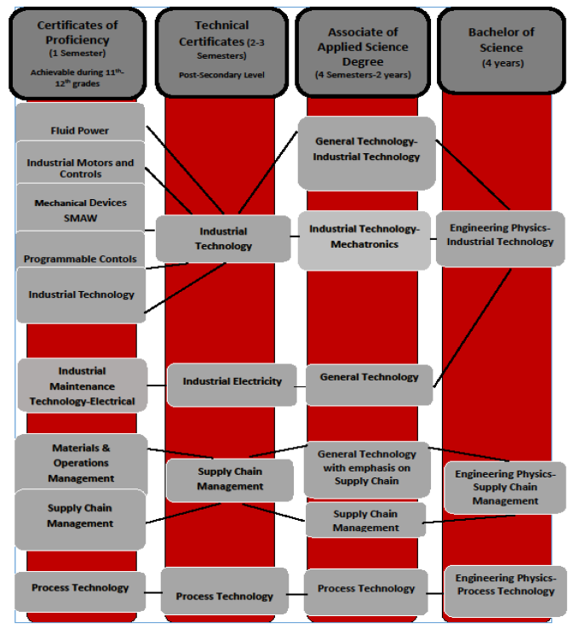
Regional Workforce Grants

Slide 35
College & Career Readiness Pilot
South Arkansas Community College
  El Dorado
  Junction City
  Parkers Chapel
  Smackover-Norphlet
  Strong-Huttig
Henderson State University
  Arkadelphia
  Hot Springs
  Malvern

Slide 36
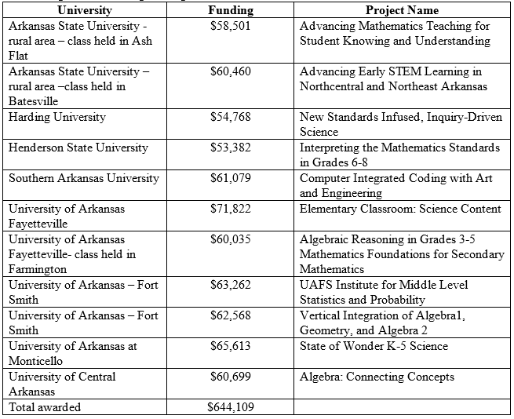
Improving Teacher Quality Grants

Slide 37
Performance-Based Funding
UA – Monticello $182,949 performance funding lost FY15
Performance improvement plan submitted August 6, 2015
$207,740 in expenditures directed to improvement efforts in FY16
  Institutional Research
  Student Success Initiative
FY17 budget includes $370,000 in funding for student success initiatives
  Reform remedial education practices
  Improve academic advising practices
  Better understand student risk factors and effectiveness of interventions through data analytics

Slide 38
Conferences and Workshops
Placement Policy Workshop
Interstate Passport Summer Meeting
15 to Finish
Outcomes Based Funding Workshop

Slide 39
College-Going Rate
AHECB Meeting of July 29, 2016

Slide 40
Sixth Year of New Methodology
New methodology focuses on students that (1) graduated from an Arkansas public school district in Academic Year 2014-2015, (2) are first-time entering students in 2015 Fall term, and (3) are Arkansas residents. This new methodology more closely follows that used by the National Center for Education Statistics (NCES). However, there are three differences:
1. NCES filters by the age range of 16-24 – ADHE ignores age but focuses on high school graduates from the previous year as most all high school graduates are between the ages of 16 and 24;
2. NCES includes GED students as their report is based on a survey. ADHE does not have data on annual graduating classes of GED students, therefore, GED students are excluded; and
3. Since the NCES report is a survey, it may include private high schools and home school students. ADHE has no data on annual graduating classes of private high schools or home school students. ADHE does obtain data on graduating classes of Arkansas public high schools (from the Arkansas Department of Education). Therefore, the new methodology is a College-Going Rate calculation for Arkansas public high school graduates only attending college in Arkansas.

Slide 41
Why Did the Methodology Change?
The Old Methodology Did Not
Measure College-Going Rate
The old methodology consisted of the Fall student cohort including
(1) first-time,
(2) full-time, and
(3) on-campus that attend an Arkansas public or independent institution after completing high school or GED.
NOTE: An error was discovered in calculations. Correction results in changes ranging from 0.0% to 3.5% differences.

Slide 42
College-Going Rate increased 0.9%
Arkansas’ rate has slightly increased by 0.9% representing an additional 60 students in the recent CGR cohort engaging in higher education. The national rate was trending downward but has experienced an increase.

Slide 43
Students Entering College Increases
Term | Public HS Graduates | Those Entering College | CGR
2011 Fall | 28,921 | 15,119 | 52.3%
2012 Fall | 28,896 | 15,286 | 52.9%
2013 Fall | 29,714 | 15,263 | 51.4%
2014 Fall | 30,800 | 15,419 | 50.1%
2015 Fall | 30,370 | 15,479 | 51.0%
The number of public high school graduates decreased (-430) while the number of public high school graduates entering college increased by 60.

Slide 44
Distribution by Institution Type: 2015 Fall
4-Yr. Univ. = 60.5% | 30.9%
2-Yr. Coll. = 31.9% | 16.3%
Priv./Ind. = 7.6% | 3.8%
Total = 100.0% | 51.0%

Slide 45
Distribution by Institution Type: History
Attendance distribution by institution type has remained steady in Arkansas over a five-year period with 5-yr total fluctuation less than 1.5% for all institution types.

Slide 46
Fall 2015 CGR by Race/Ethnicity

Slide 47
4-Year Universities:
Where AR Public HS Graduates Attend

Slide 48
2-Year Colleges: Where HS Students Attend

Slide 49
College-Going Rate: STEM Majors
Arkansas exhibits a continued increase of students enrolling in STEM programs. The graph illustrates the 5-year growth of AR public high school graduates entering STEM degree programs.

Slide 50
AHECB Meeting
July 29, 2016

Slide 51
Closing the gap 2020
Implementation plan

Slide 52
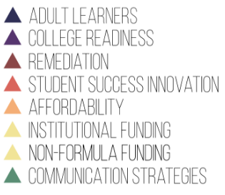
Workgroups

Slide 53
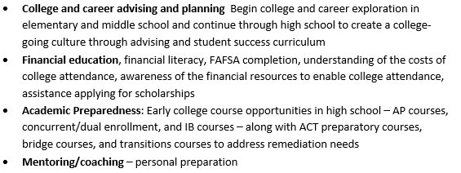
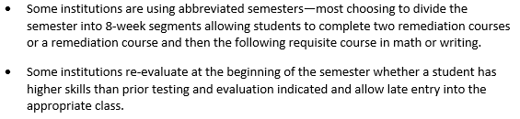
Implementation Plan Strategies
Readiness
Affordability
Financial literacy for secondary students, new post-secondary students
Need based-financial aid
Summer aid disbursement
Administrative efficiencies through shared services
Reduced time to degree:
  Clear degree plans
  Summer bridge
  Effective advising
Adult Learners
Outcomes-Based Funding
Prior Learning Assessment
Fresh Start
Flexible Course Offerings/Schedules
Competency-Based Education

Slide 54
AHECB Meeting
July 29, 2016

Slide 55
Outcomes-based funding model framework

Slide 56
Why Outcomes-Based Funding?
“Many states are reconsidering enrollment-based funding model and instead are aligning funding models with state goals and priorities.”
    National Conference of State Legislatures (July 31, 2015)
“[Enrollment-based] allocation rewards expanded access to higher education but does not incent program/degree completion—one of today’s most pressing policy challenges.”
    Snyder, Martha (2015). Driving Better Outcomes: Typology and Principles to Inform Outcomes-Based Funding Models. HCM Strategists. February 12, 2015.
“Stakeholder engagement proceeds from people’s starting point attitudes and works to mend the splits and disconnects among stakeholders enough to make progress on a particular policy issue.”
    Kadlec, A. and Shelton, S. (2015). Outcomes-Based Funding and Stakeholder Engagement. Lumina Issue Papers. November, 2015.

Slide 57
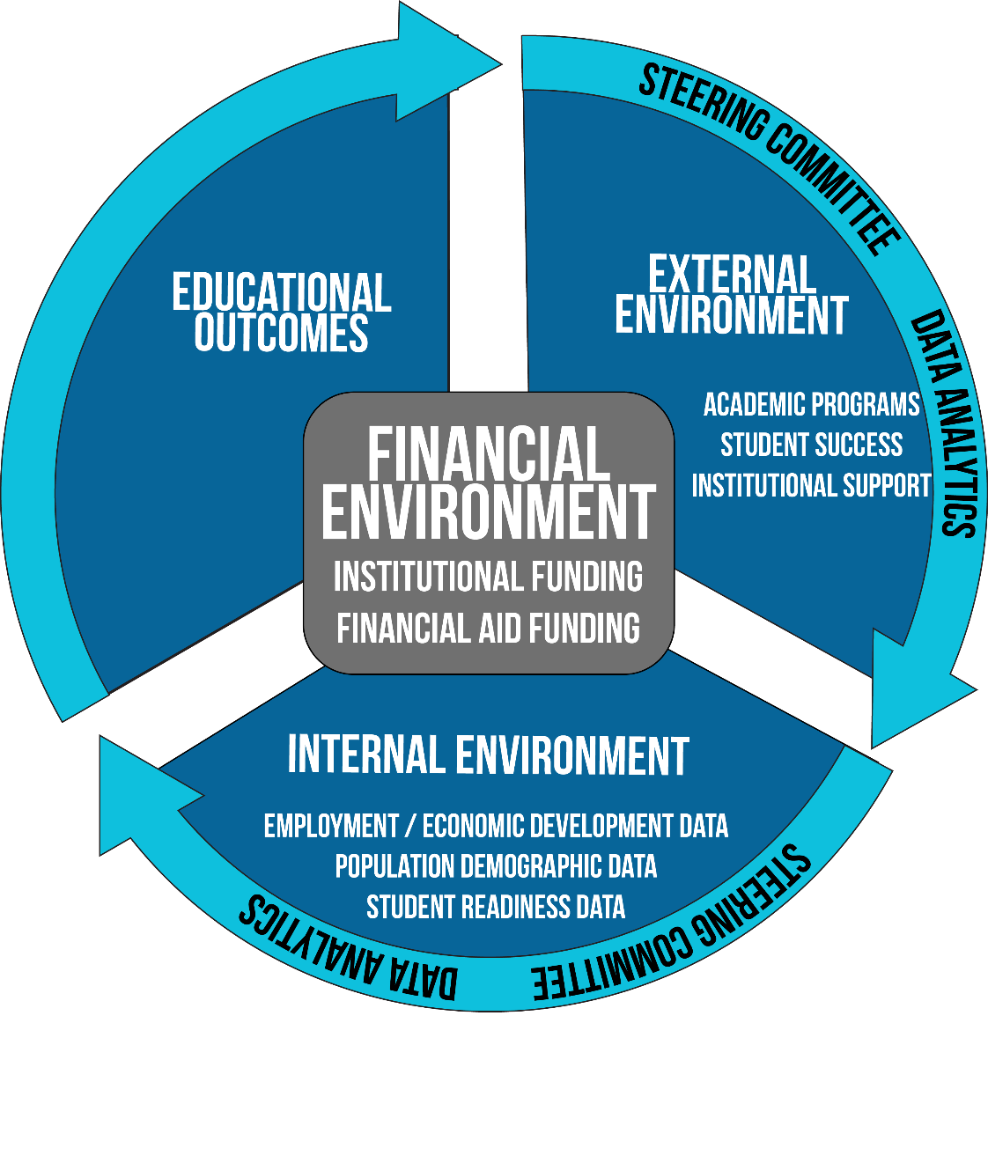
Why Outcomes-Based Funding?

Slide 58
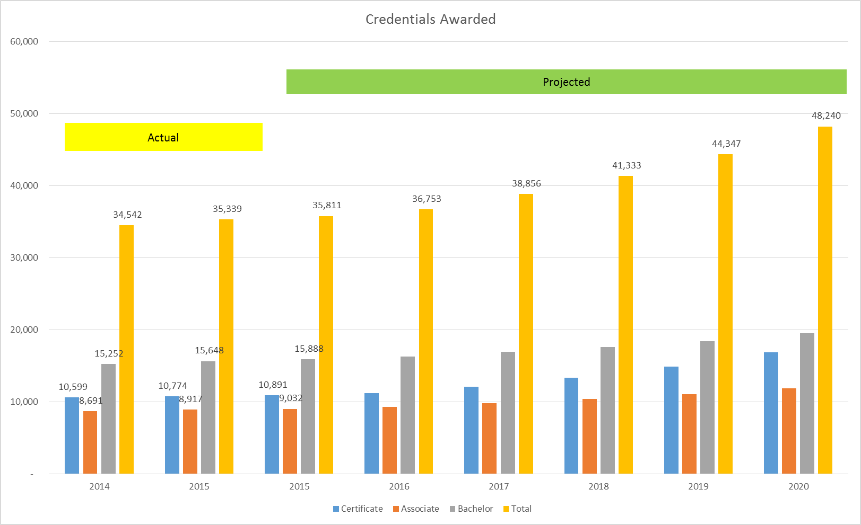
Data Dashboard

Slide 59
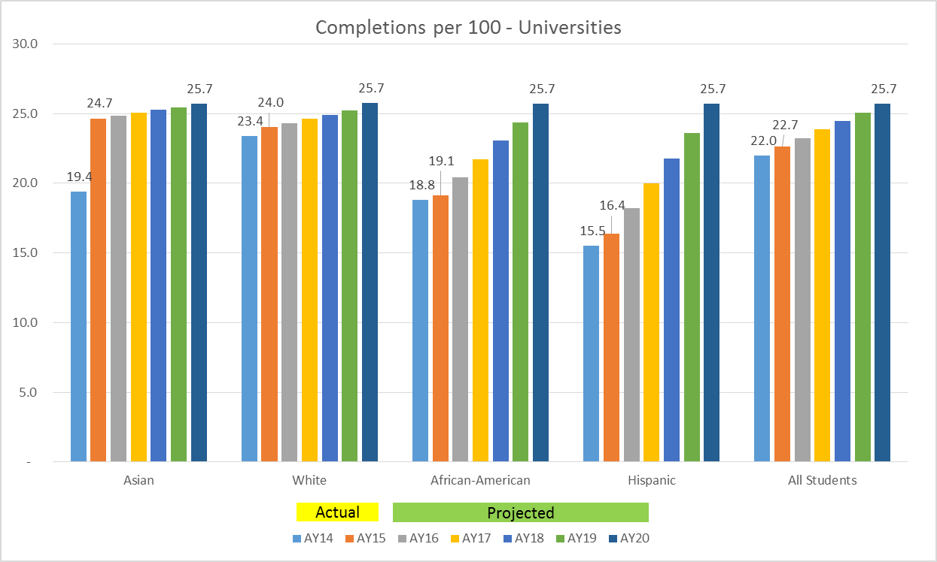
Data Dashboard

Slide 60
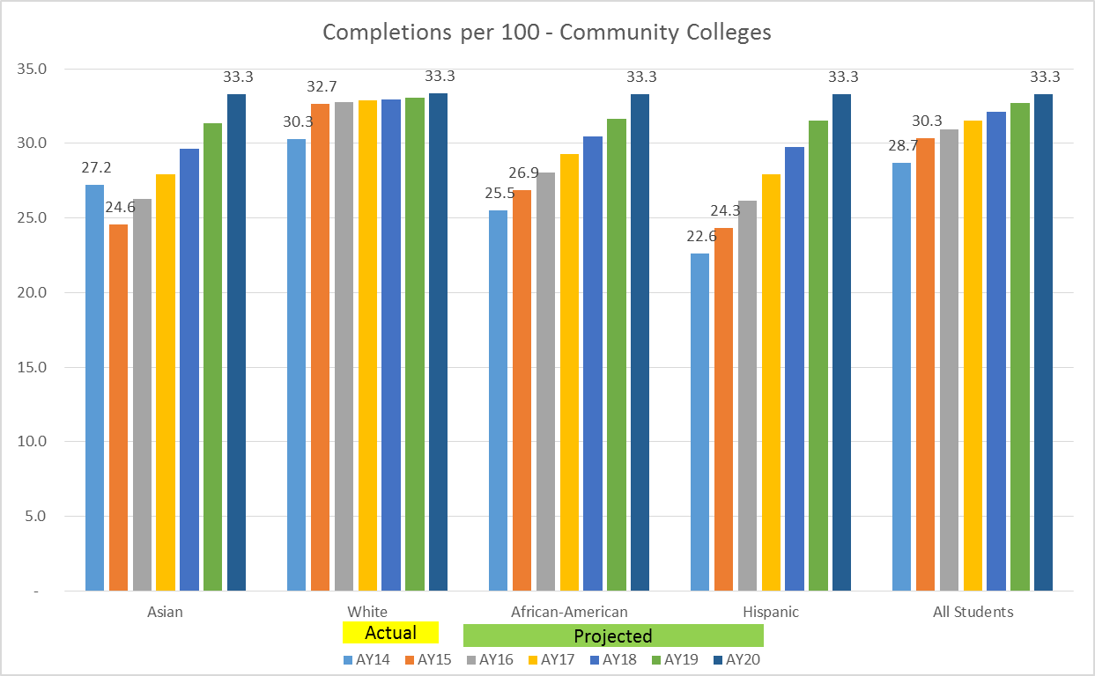
Data Dashboard

Slide 61
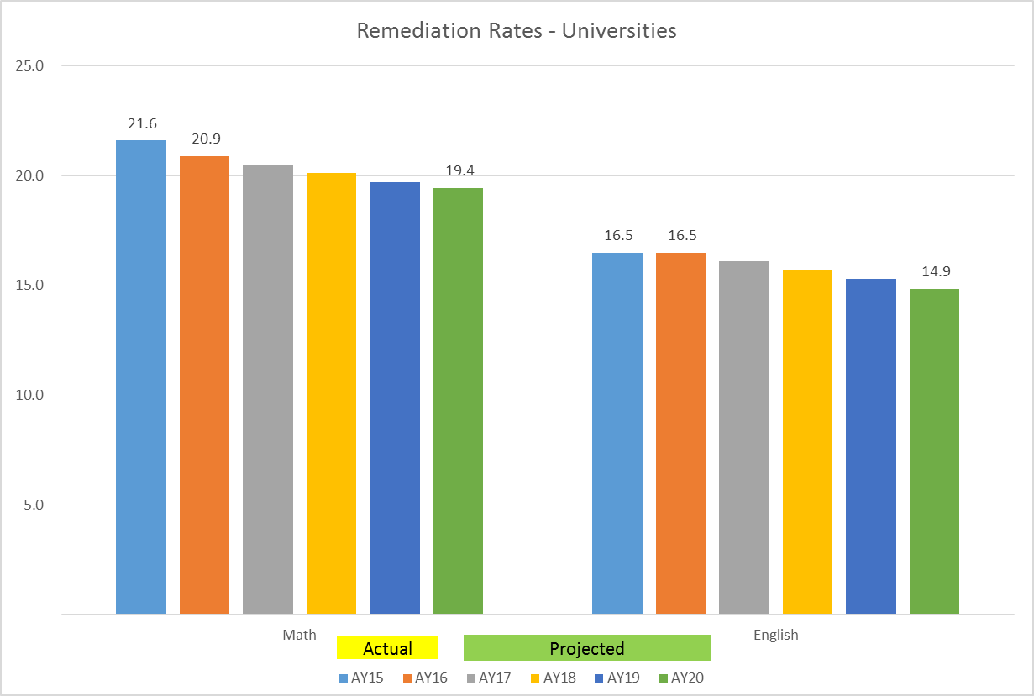
Data Dashboard

Slide 62
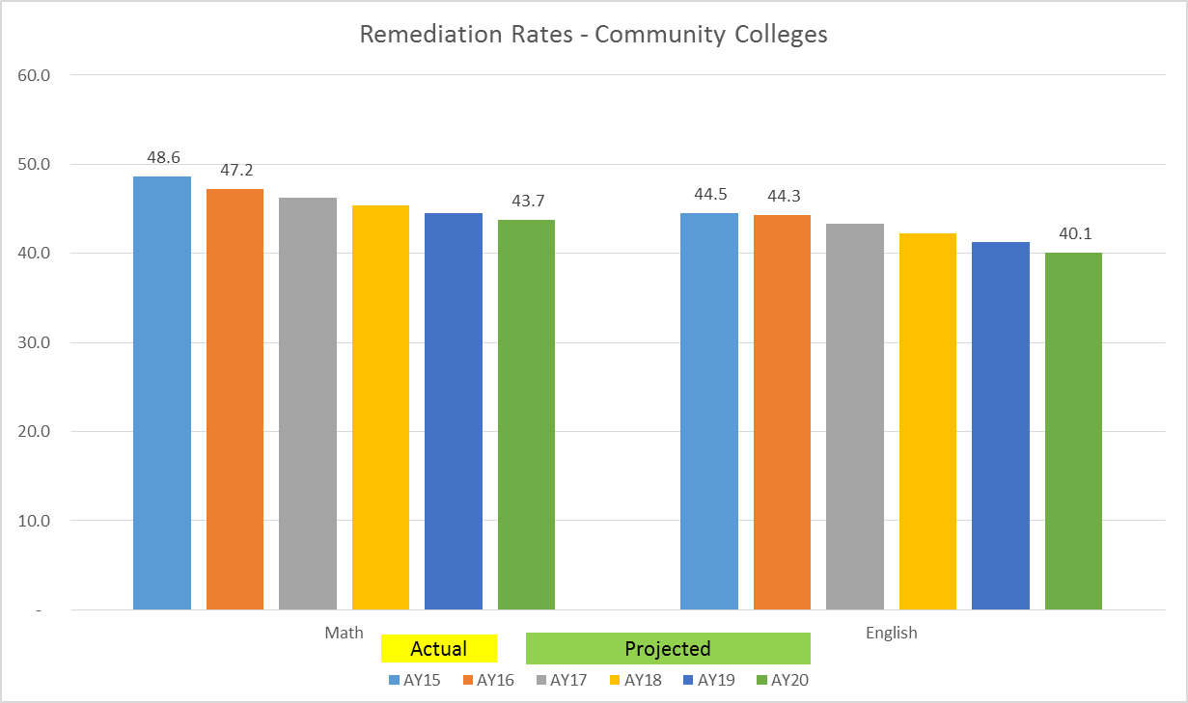
Data Dashboard

Slide 63
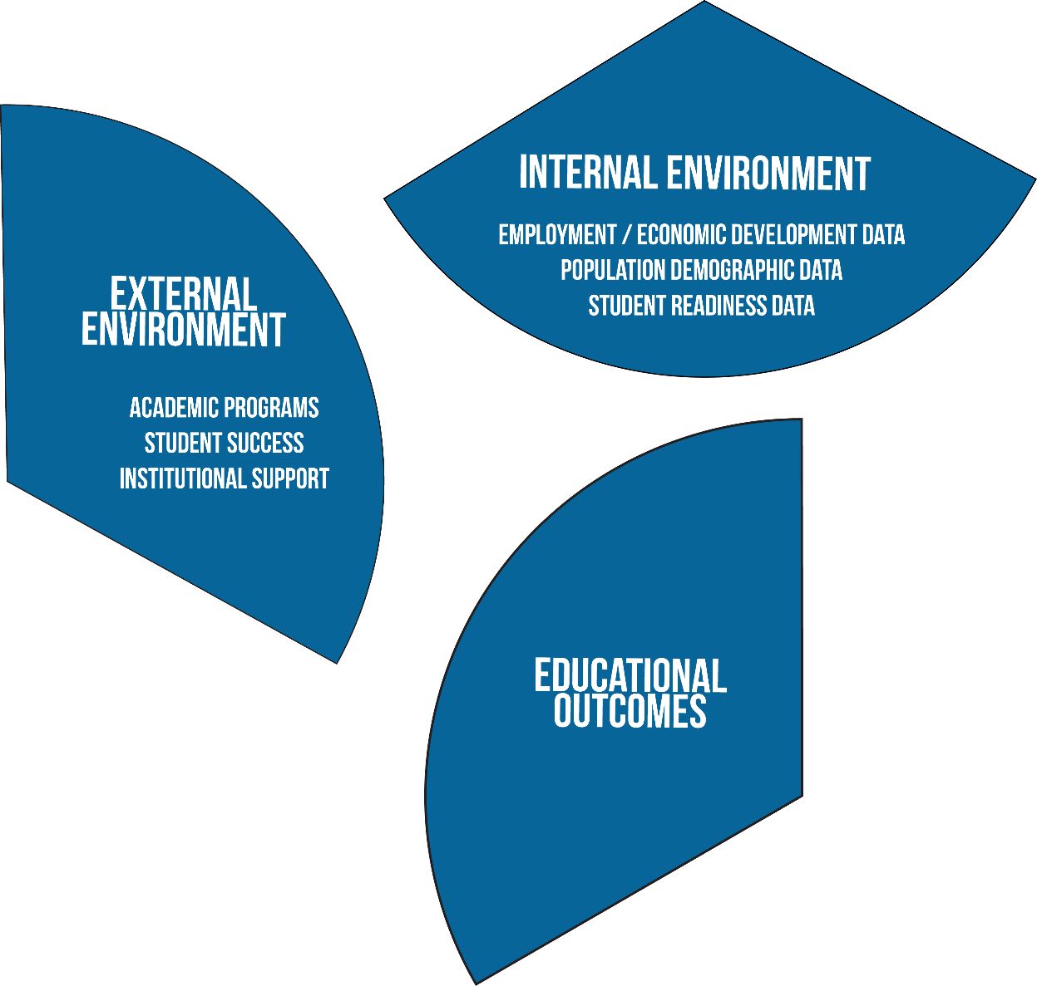
Why Outcomes-Based Funding?

Slide 64
Why Adopt This Framework?

Slide 65
Why Not Adopt This Framework?

Slide 66
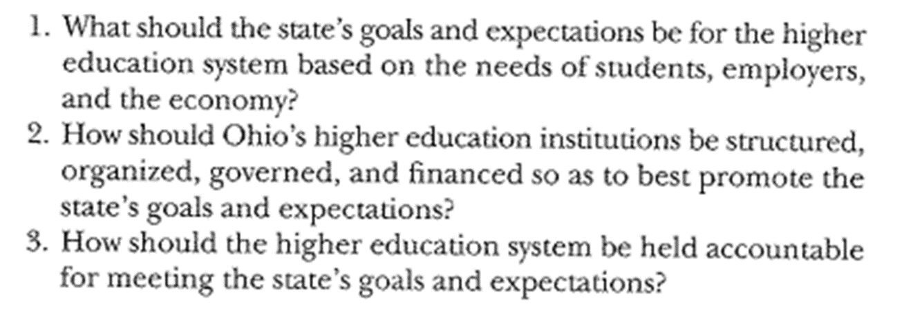
Accountability Questions
Burke, Joseph C. and Associates (2005). Achieving Accountability in Higher Education: Balancing Public, Academic, and Market Demands. Jossey-Bass: San Francisco, CA. p. 56

Slide 67
What are you approving?

