Slide 1
AHECB Meeting
April 22, 2016

Slide 2
Agenda item no. 7:
Funding Formula for the
2017-19 biennium
Tara Smith
Senior Associate Director, Institutional Finance

Slide 3
Funding Formula Overview
2-YR College Need-Based Funding Formula updates
Technical Institutes Need-Based Funding Formula updates
University Need-Based Funding Formula updates
Non-Formula Funding Recommendation updates

Slide 4
Funding Formula Components
Needs-based Elements – Two-Year Colleges
Only changes for new biennium are inflationary adjustments to tuition rates, faculty salary and student services rates
Full-Time Equivalent (FTE) Faculty: Total number of FTE faculty needed is calculated by assigning each SSCH generated to one of four weighted categories.
General Education 22 students / 660 SSCH
Technical Education 16 students / 480 SSCH
Basic Skills 16 students / 480 SSCH
Allied Health 12 students / 360 SSCH

Slide 5
Funding Formula Components
Needs-based Elements – Two-Year Colleges
Faculty Salaries: The total FTE faculty is adjusted for part-time faculty.
Institutions with < 3,000 FTE students
Of the total FTE faculty, seventy (70) percent are considered full-time and thirty (30) percent are considered part-time.
  Full-time salary is equal to the projected SREB average for 2017-19.
  Part-time salary is equal to fifty (50) percent of the calculated full-time salary.

Slide 6
Funding Formula Components
Needs-based Elements – Two-Year Colleges
Institutions with >3,000 FTE students
Of the total FTE faculty, fifty (50) percent are considered full-time and fifty (50) percent are considered part-time.
  Full-time salary is equal to the projected SREB average for 2017-19.
  Part-time salary is equal to fifty (50) percent of the calculated full-time salary.

Slide 7
Funding Formula Components
Needs-based Elements – Two-Year Colleges
Student Services Rates: Student Services is calculated based on a variable rate per student using the mean of FTE students and headcount. The updated rates are:
$788/student for the first 750 students
$560/student for the next 2,250 students
$347/student for all students over 3,000

Slide 8
Funding Formula Components
Needs-based Elements – Technical Institutes
Only changes for new biennium are inflationary adjustments to tuition rates, faculty salary and student services rates
Full-Time Equivalent (FTE) Faculty: Total number of FTE faculty needed is calculated by assigning SSCH generated to one of four weighted categories.
General Education 22 students / 660 SSCH
Technical Education 16 students / 480 SSCH
Basic Skills 16 students / 480 SSCH
Allied Health 12 students / 360 SSCH
Faculty Salaries: The total FTE faculty generated above is multiplied by the average faculty salary for technical institutes in the SREB region.

Slide 9
Funding Formula Components
Needs-based Elements – Technical Institutes
Student Services Rates: Student Services is calculated based on a variable rate per FTE. The updated rates are:
$150,000 flat amount for the first 200 FTE
$547/FTE for all FTE above 200

Slide 10
Funding Formula Components
Needs-based Elements – Four-Year Universities
Changes for new biennium include inflationary adjustments to tuition rates and faculty salaries
This formula provides equal funding for similar levels and disciplines at each university and determines the minimum level of funding needed for each university.
Full-Time Equivalent Faculty:
Faculty Load Factors (SSCH Required to Produce One FTE Faculty)
Undergraduate Graduate Doctoral
Cost Category I 645 175 130
Cost Category II 480 250 145
Cost Category III 365 160 120
Cost Category IV 230 102 70

Slide 11
Funding Formula Components
Needs-based Elements – Four-Year Universities
The total number of FTE faculty needed is determined by dividing the faculty load factors into the SSCH enrollment matrix for each institution’s latest enrollment. This determines for Arkansas the number of FTE faculty needed at each of the three levels.
Faculty Salaries: Each institution receives the same faculty salary amount per its SSCH in the four cost categories and at each level. Since the other expenditure function computations are a percentage of faculty salaries all institutions receive the same funding recommendation for the same kind of SSCH.

Slide 12
Funding Formula Components
Needs-based Elements – Non-Formula
The recommendation for new funds for non-formula entities will be developed using a nominal percentage for the continuing level of programs plus programmatic justification for enhancements and/or expansions.

Slide 13
Agenda item no. 8: performance funding outcomes
Tara Smith
Senior Associate Director, Institutional Finance

Slide 14
Universities
Methodology
Total Possible Points = 10
Minimum Score Requirement = 6
Compensatory points for percentage of Pell receiving undergraduates may be added to the total points, but cannot increase the total points above 10.

Slide 15
Universities
Mandatory Measures – maximum of 4 points
  Bachelor Credentials
  Total Credentials
  STEM Credentials
  Progression
Optional Measures – maximum of 6 points
  Minority Credentials
  Non-Traditional Credentials
  Remedial Credentials
  Transfer Student Credentials
  Course Completion
  External Grants & Awards
  Regional Economic Needs Credentials

Slide 16
Universities - Results

Slide 17
Colleges
Methodology
Total Possible Points = 10
Minimum Score Requirement = 6
Compares average of the most recent 3 years to an average of the most recent 5 years
Compensatory points for special populations (based on percentage of enrollment)

Slide 18
Colleges
Mandatory Measures – maximum of 6 points
  Course Completion
    Remedial
    Non-Remedial
  Progression
  Credentials
    Certificates of Proficiency
    Technical Certificates
    Associate Degrees
    Total Credentials (rate)
  Compensatory
    Low-Income
    Underprepared
Region/Mission Measures – maximum of 4 points
  STEM Credentials
  High Demand Credentials
  Adult Credentials
  Minority Credentials
  Transfer Students
  Workforce Training

Slide 19
Colleges - Results

Slide 20
Agenda item no. 9:
Distribution of Mineral lease funds
Tara Smith
Senior Associate Director, Institutional Finance

Slide 21
Distribution of Mineral Lease Funds
It is recommended that up to $750,000 be allocated (from the H.E. Research Development Fund) to the University of Arkansas, Fayetteville for continuing personal services and operating expenses associated with ARE-ON.
$11,153,100.75 has been distributed since May 2006, the first transfer of funds
The current balance of the Research Development Fund is $451,700.

Slide 22
ACADEMIC COMMITTEE
Consent Agenda Items
Lillian Williams
Program Specialist, Academic Affairs

Slide 23
Consent Items
*10. Phillips Community College of the University of Arkansas Associate of Applied Science in Criminal Justice
*11. Cossatot Community College of the University of Arkansas
Associate of Applied Science in Physical Therapy Assistant
*12. NorthWest Arkansas Community College
Associate of Fine Arts in Arts
*13. University of Arkansas, Fayetteville
Bachelor of Fine Arts in Graphic Design
*14. Arkansas Tech University
Bachelor of Science in Computer Science Education

Slide 24
Consent Items
*15. University of Arkansas – Fort Smith
Bachelor of Science in Electrical Engineering Technology
*16. Arkansas State University
Master of Science in Media Management
*17. University of Central Arkansas
Doctor of Occupational Therapy
*18. Institutional Certification Advisory Committee: Resolutions

Slide 25
Agenda Item no. 19
Letters of Notification
Lillian Williams
Program Specialist, Academic Affairs

Slide 26
Letters of Notification
Programs approved by the ADHE Director
Programs must be included on the AHECB agenda prior to initiation
Programs are reasonable and moderate extensions of existing certificates and degrees

Slide 27
Agenda Item no. 20
Letters of Intent
Lillian Williams
Program Specialist, Academic Affairs

Slide 28
Letters of Intent
Notification of institutional plans to offer new programs or organizational units that require Coordinating Board approval
Chief academic officers and chief executive officers can comment on the proposals before consideration by AHECB

Slide 29
AHECB Meeting
April 22, 2016

Slide 30
Agency UPDATEs
Dr. Brett Powell
Director

Slide 31
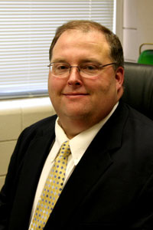
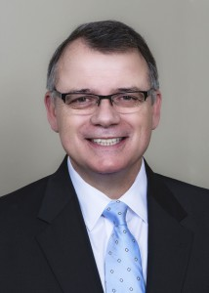
Institutional Leadership
College of the Ouachitas
  Dr. Steve Rook, President
    Beginning June 1, 2016
Rook
Ouachita Baptist University
  Dr. Ben Sells, President
    Beginning June 1, 2016
Sells

Slide 32
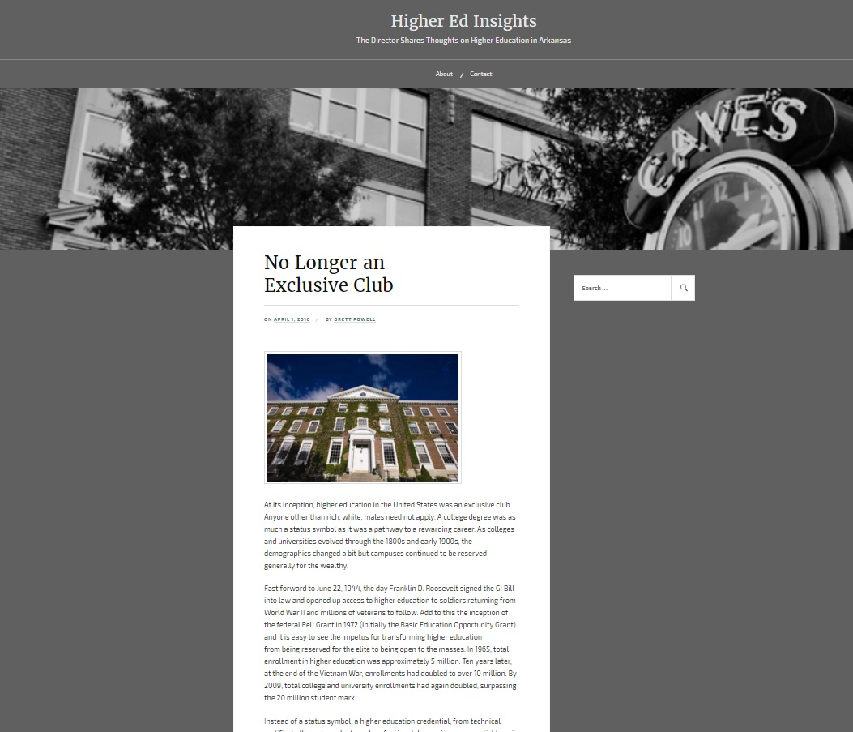
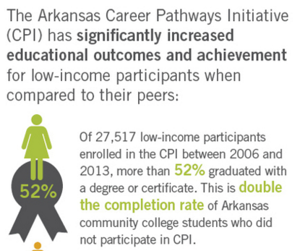
http://www.collegecounts.us/results

Slide 33
Governor’s Distinguished
Due to the record number of qualified Governor’s Distinguished Scholarship recipients, we will be requesting $2,000,000 from General Improvement Funds For the coming Fiscal Year.
613 students qualified for scholarships, which will pay up to $10,000 per year for tuition, mandatory fees, room and board at any approved Arkansas college or university and is renewable for up to four years. This was up from last years qualifiers of 598. This past year we awarded 601 students of which 491 accepted. Currently for FY17 we have awarded 613 students. We anticipate the number of students that accept to be over 500 for the coming year.
To be eligible, a student must have either a minimum ACT composite score of 32, or minimum SAT composite score of 1410, along with a 3.50 academic grade point average, or be selected as a National Achievement Finalist or National Merit Finalist.

Slide 34
Fiscal Session Update
Fiscal session convened Wednesday, April 13
Ending no later than May 27

Slide 35
Closing the Gap 2020 Work Groups
Adult Learners
College Readiness
Remediation
Student Success Innovations
Affordability
Communication Strategies
Institutional Funding

Slide 36
Agency Projects
Policy Review
Remediation Models
  Remedial Placement
  College Readiness
  Placement Exams (Compass)
Need-based Aid
Funding Model
Student Loan Debt
  Cost of Attendance
CTE Course Transfer System
Guided Pathways
Prior Learning Assessment
ACTS Review
ADE Data Sharing - HS Seniors
Cooperative Purchasing Agreement Reporting
Credentials-to-Careers Mapping

Slide 37
Institutional Funding
Outcomes-Based Funding Model
  Would replace both needs-based and performance-based models

Slide 38
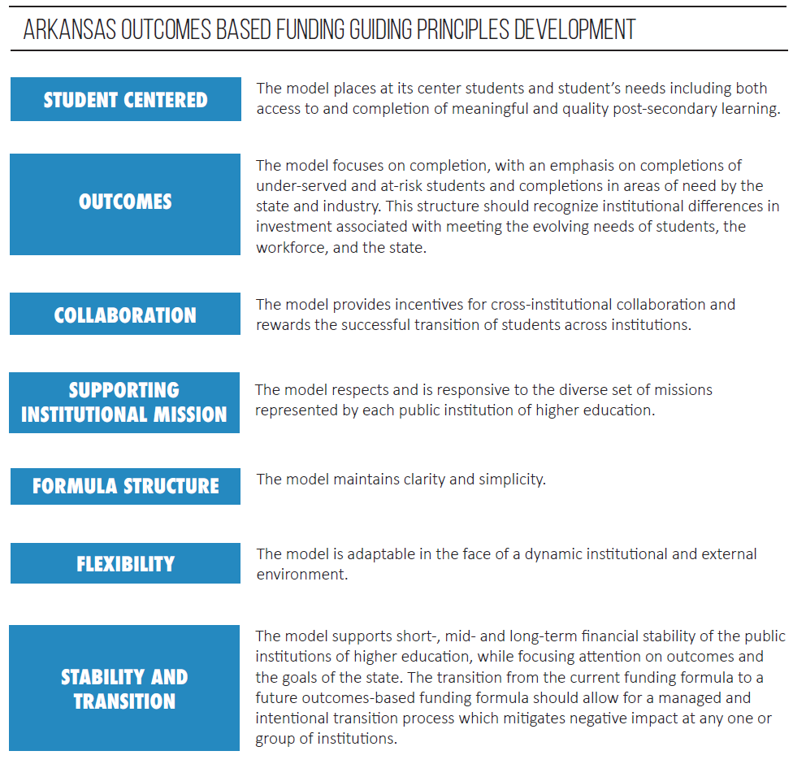

Slide 39
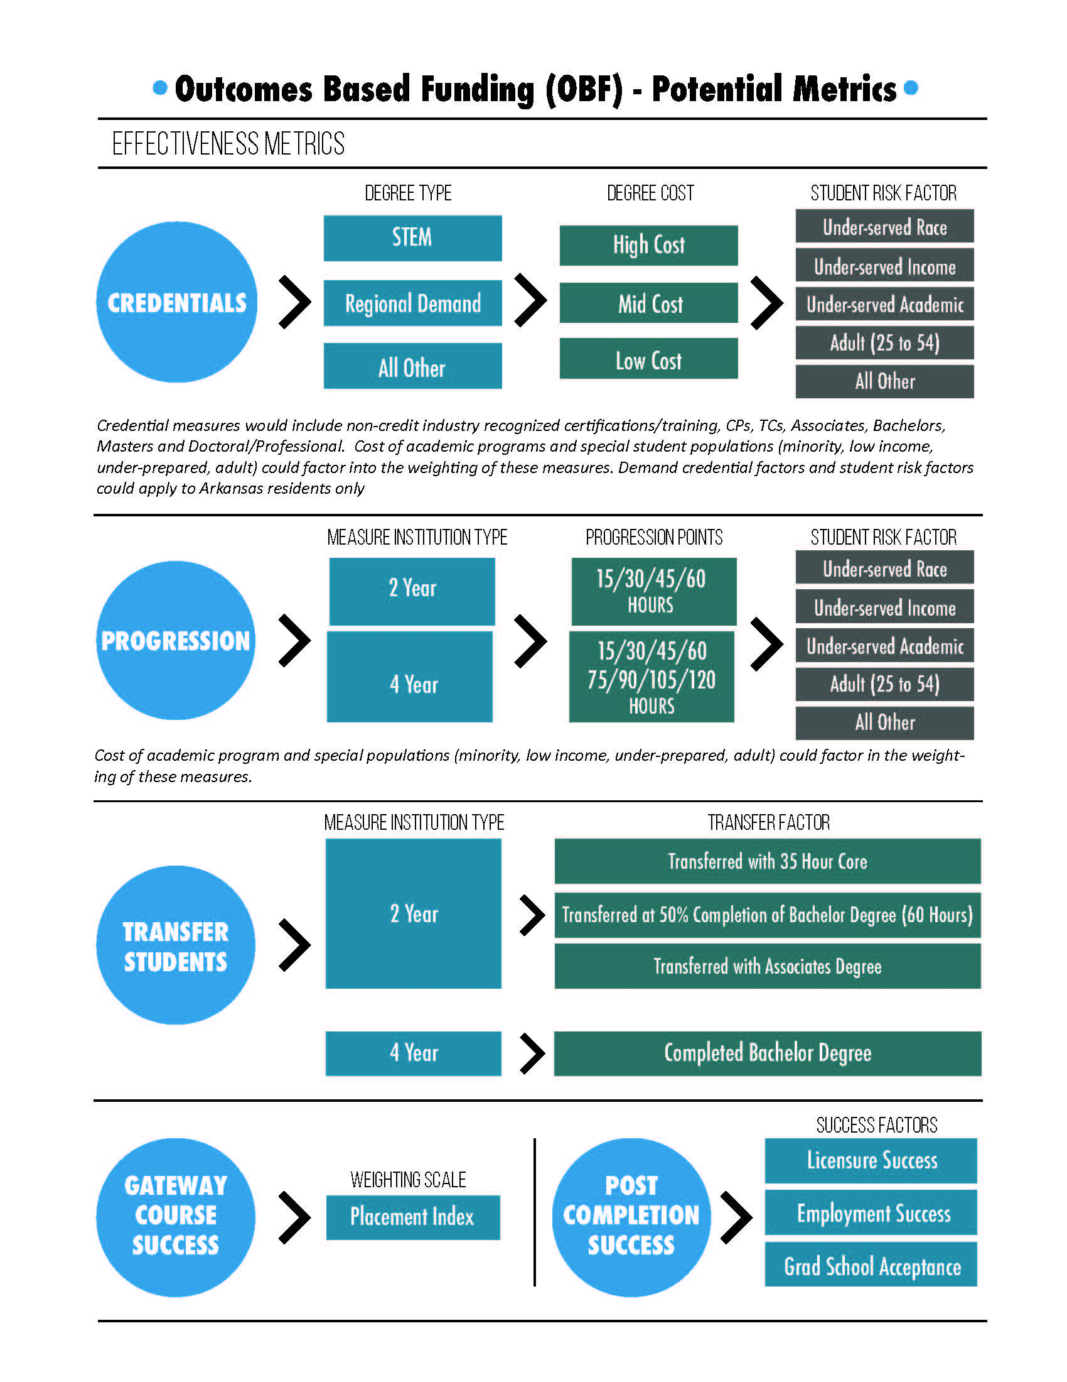

Slide 40
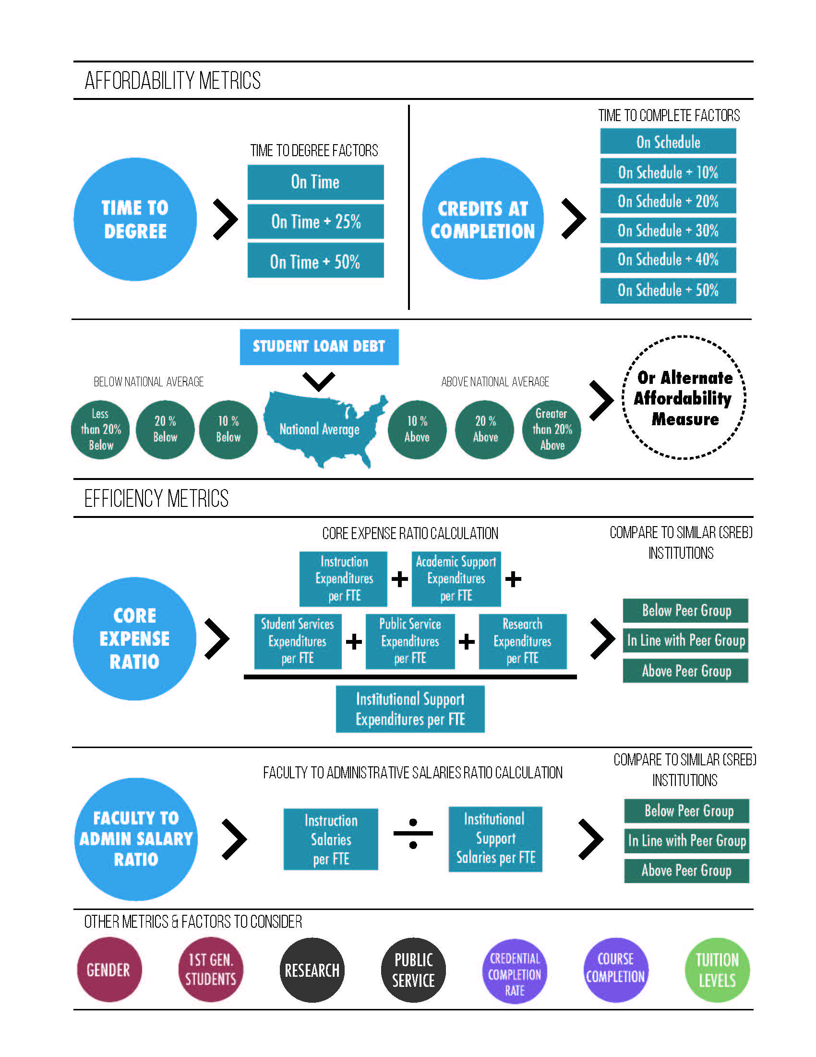

Slide 41
Student Success Initiatives
Interstate Passport
Math Pathways

Slide 42
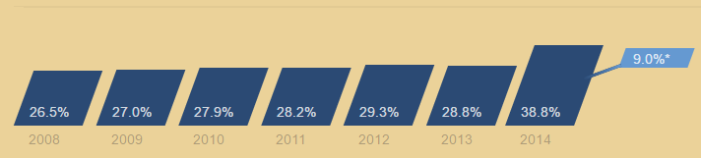
Lumina Report – Attainment Rates
http://strongernation.luminafoundation.org/report/#arkansas

Slide 43
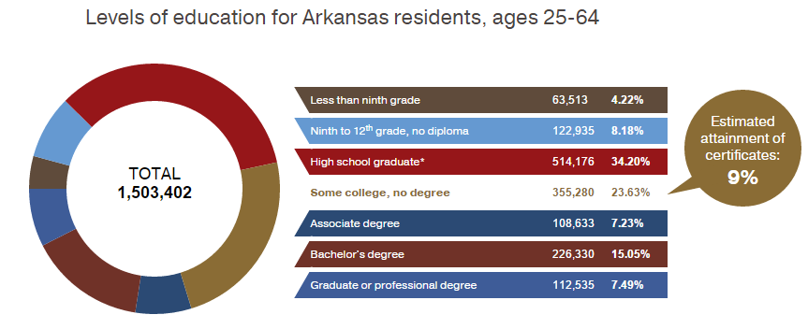
Lumina Report – Attainment Rates
http://strongernation.luminafoundation.org/report/#arkansas

Slide 44
Attainment Rates – Arkansas Rankings
Degree Attainment
29.8% 48th (LA and WV)
Certificate Attainment
9% 4th (LA, AZ, KY)
Total Attainment
38.8% 45th (WV, NV, MS, AL, ID)
http://strongernation.luminafoundation.org/report/

Slide 45
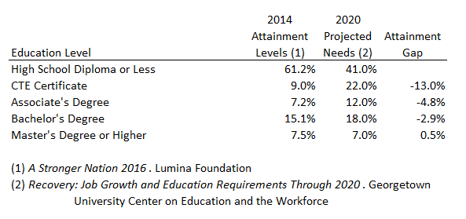
Attainment Gap
2013 Census Data
2014 Census Data

Slide 46
Economic Value
What is the value of a degree?

Slide 47
Economic Value

Slide 48
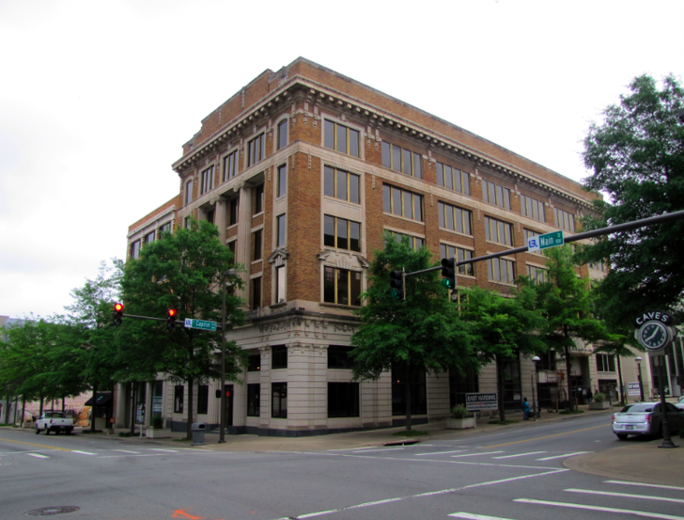

Five Main Under Construction
Large construction equipment on site
Unable to provide any guest parking
Due to noise level, not ideal for outside meetings at this time
Notes:
The Annex and Old ADHE building are currently under construction.
Very limited parking, if any!
May have to consider a new location for the July 29 AHECB meeting.

Slide 49
Upcoming Dates
Deadline to apply for the Academic Challenge Scholarship – June 1
Institution Budget Hearings – June 7 to June 17
Placement Policy Implementation Workshop – June 15
Board Retreat – June 21 to 22
Master Plan Work Groups –
http://www.adhe.edu/institutions/master-plan/calendar/

Slide 50
Credentials Awarded
AHECB Meeting of April 22, 2016

Slide 51
Dr. Marla Strecker
Senior Associate Director, Research & Technology

Slide 52
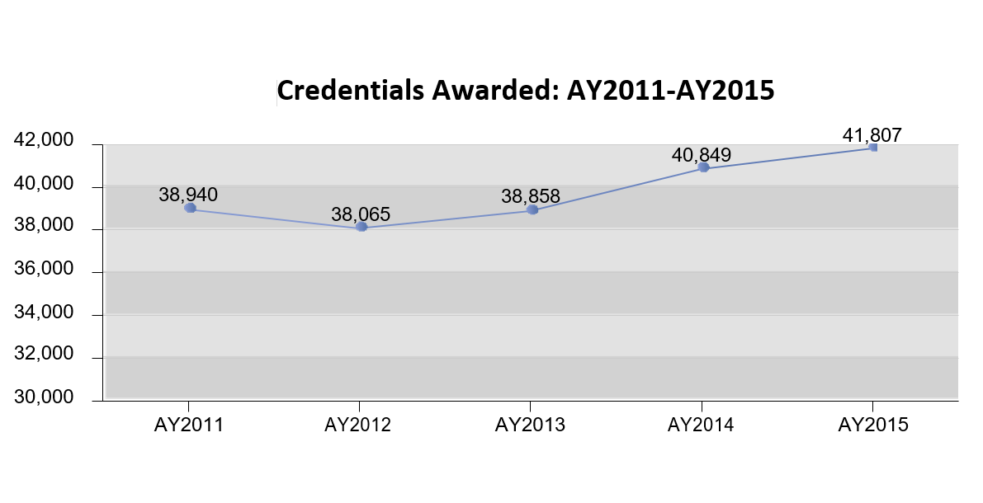
Credentials Awarded
Increases to 41,807

Slide 53
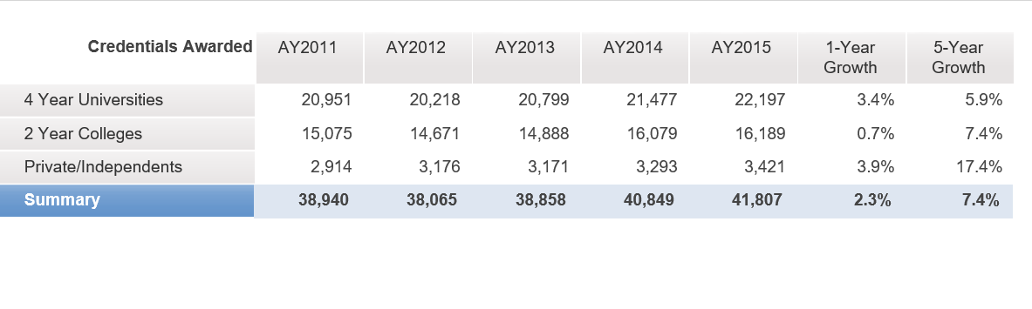
Credentials Awarded
Growth: 1-year & 5-year

Slide 54
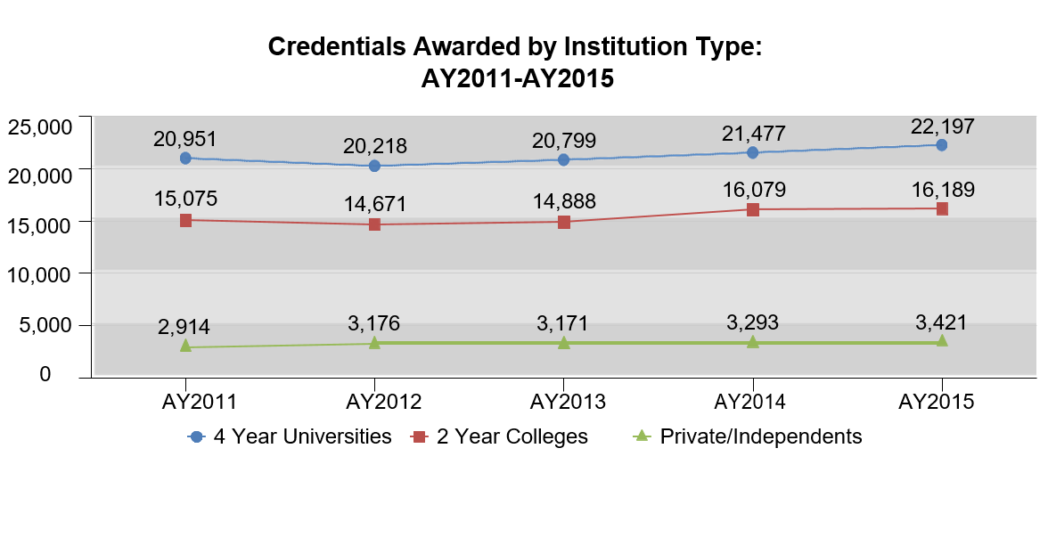
Credentials Awarded by Institution Type

Slide 55
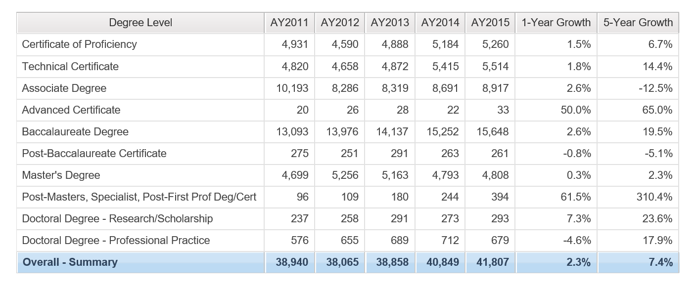
Credentials Awarded by Degree Level
Growth: 1-year & 5-year

Slide 56
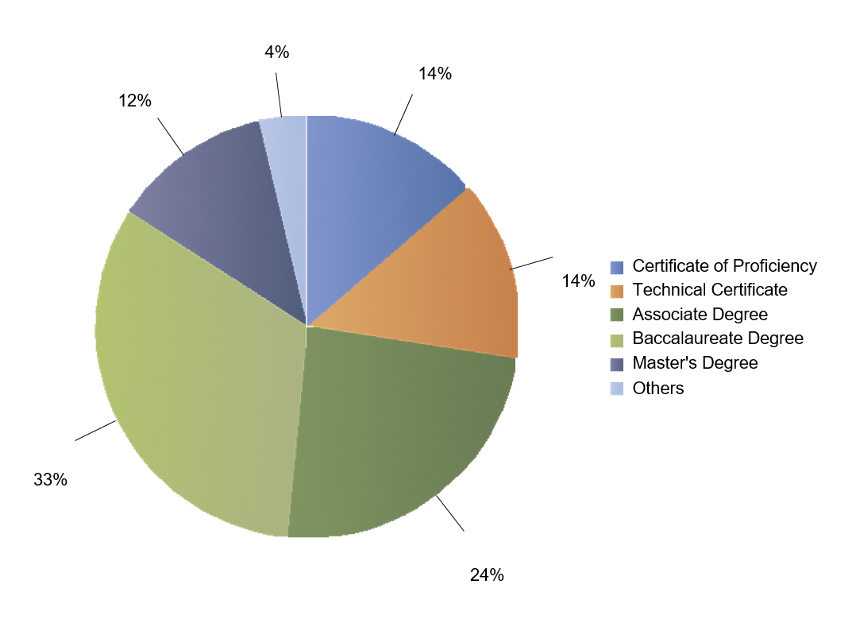
Credentials Awarded by Degree Level

Slide 57
Enrollments & Credentials:
Past Five Years
Institution Type | Enrollments | Credentials
4-Year | 2.4% | 5.9%
2-Year | -15.5% | 7.4%
Private | -0.5% | 17.4%
Nursing | -9.5% | -1.3%

Slide 58
Retention and Graduation Rates
AHECB Meeting of April 22, 2016

Slide 59
Dr. Marla Strecker
Senior Associate Director, Research & Technology

Slide 60
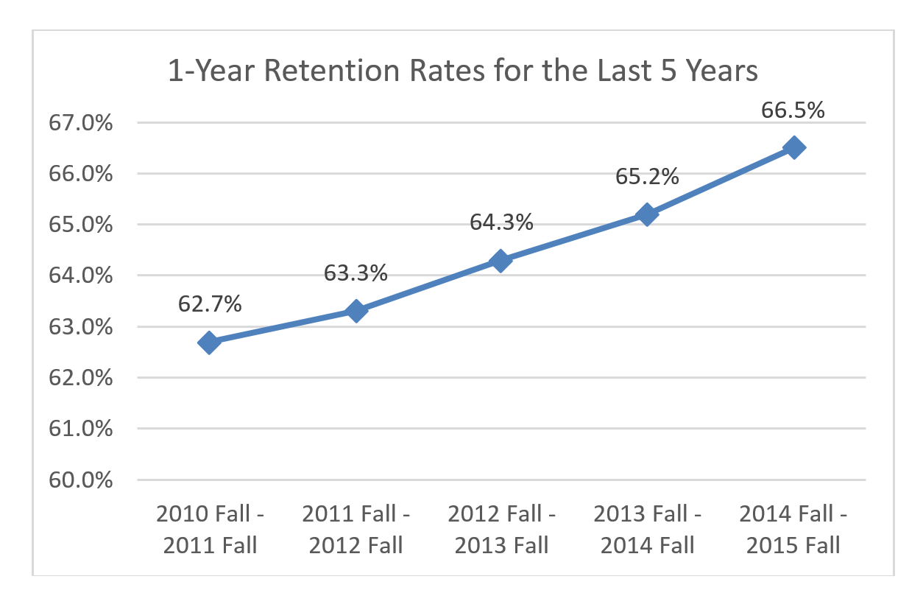
Fall-to-Fall Retention

Slide 61
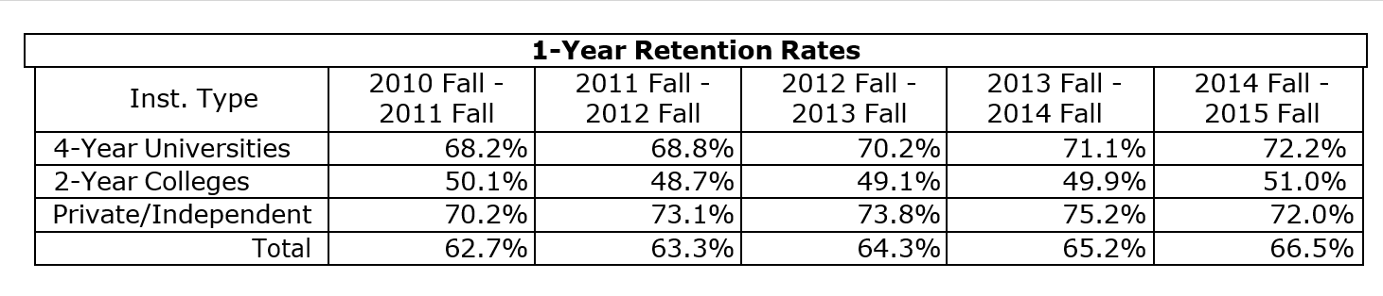
1-Year Retention by Institution Type
4-Year Universities and Private/Independent Institutions have similar retention rates, but the Private/Independent Institutions have the highest retention rates.
2-Year Colleges have the lowest retention rates.

Slide 62
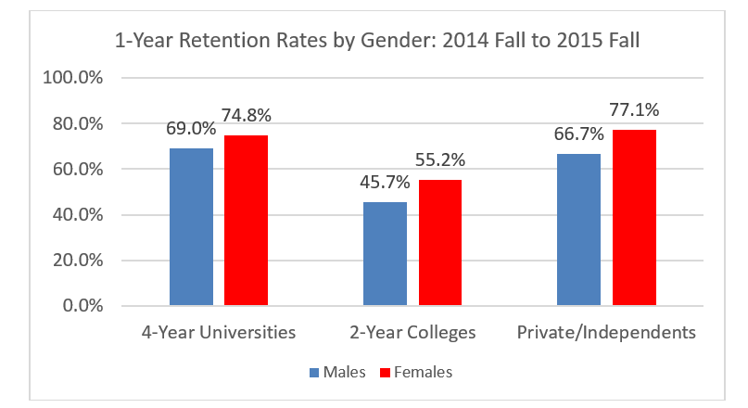
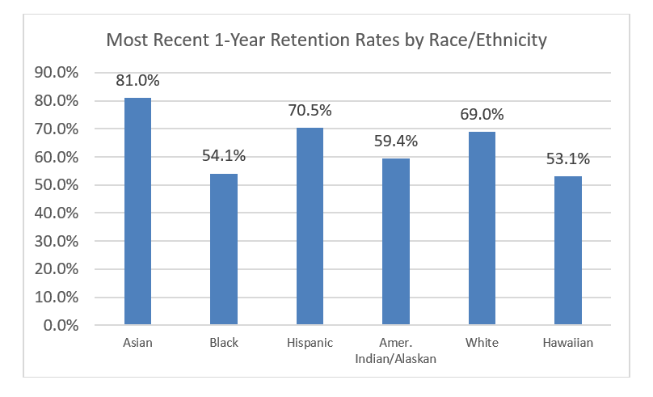
1-Year Retention by Gender and Race/Ethnicity

Slide 63
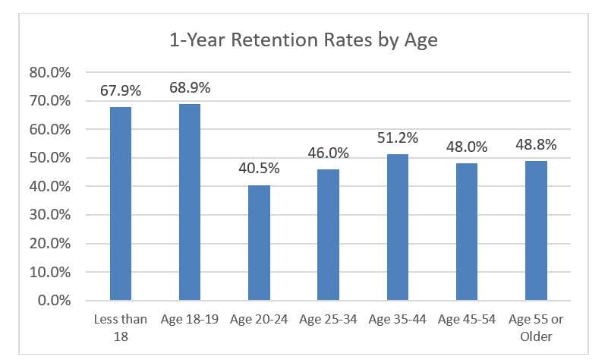
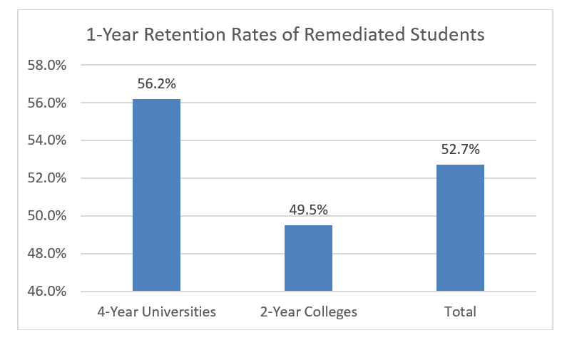
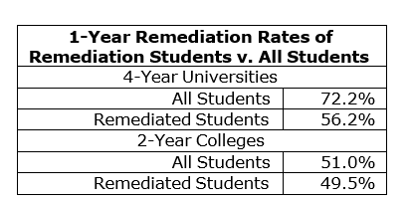
1-Year Retention by Age and for Remediated Students

Slide 64
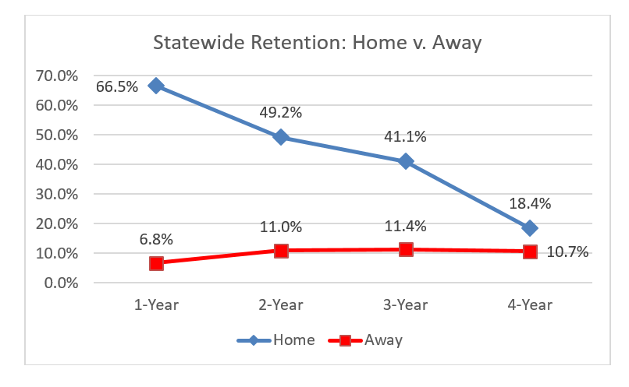
Statewide Retention
While many students are not retained at their “home” institution, many are retained at “away” Arkansas institutions as transfer students.

Slide 65
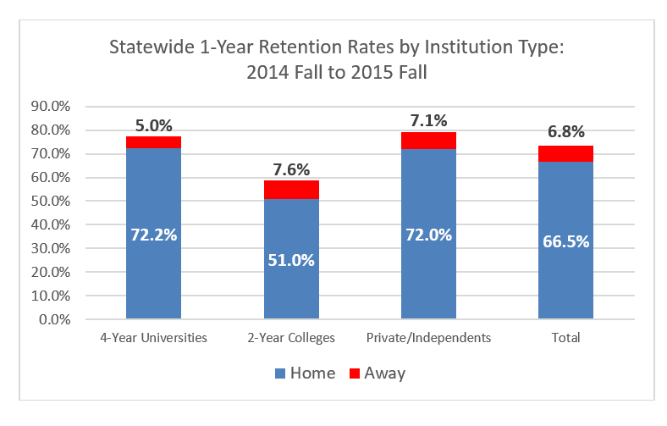
Statewide Retention
While many students are not retained at their “home” institution, many are retained at “away” Arkansas institutions as transfer students.

Slide 66
ADHE Annual Graduation Rates
The graduation rates reported herein have been re-designed. The graduation rate uses a cohort of:
first-time entering,
credential-seeking students,
from the entire academic year, not just the fall term, and
includes all full-time and part-time students.
In addition, the new graduation rates uses a 100%, 150%, and 250% time rate for counting graduates. Such time rate in years is used for counting all credentials earned.
Inst. Type | 100% Rate | 150% Rate | 250% Rate
4-Year Universities | 4 Years* | 6 Years* | 10 Years*
2-Year Colleges | 2 Years* | 3 Years* | 5 Years*
Private/Independents | 4 Years* | 6 Years* | 10 Years*
*Plus the months of July and August for the next academic year.

Slide 67
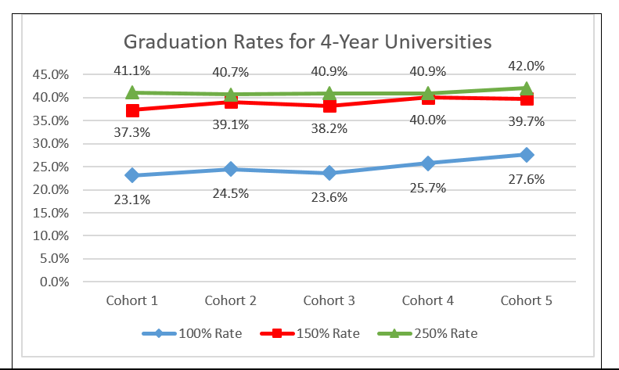
4-Year Universities

Slide 68
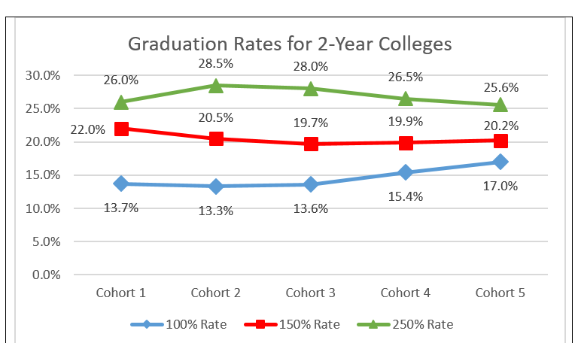
2-Year Colleges

Slide 69
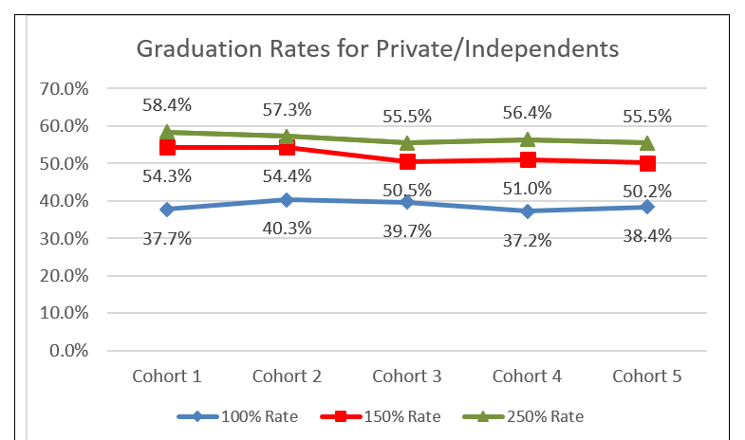
Private/Independent Institutions

Slide 70
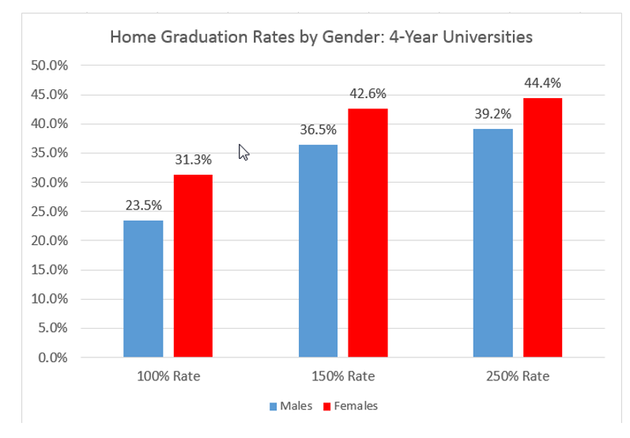
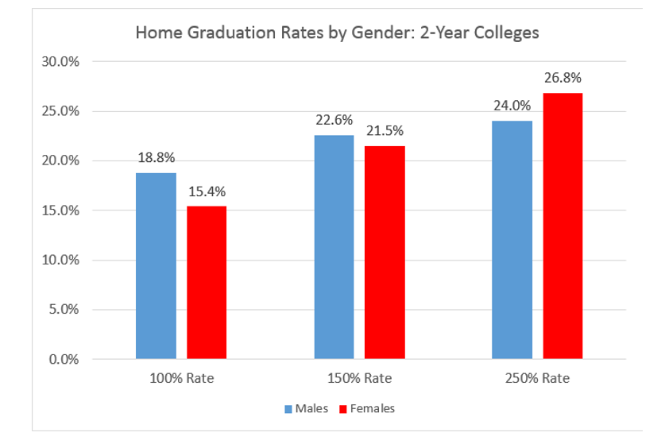
Graduation Rates by Gender
Females have higher graduation rates than males except for the 2-Year Colleges 100% and 150% rates.

Slide 71
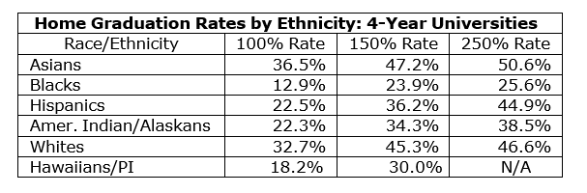
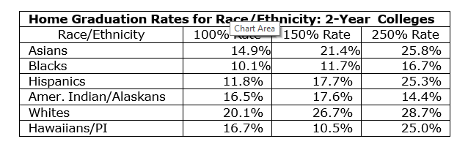
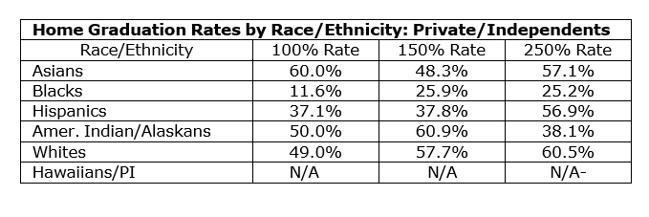
Graduation Rates by Race/Ethnicity

Slide 72
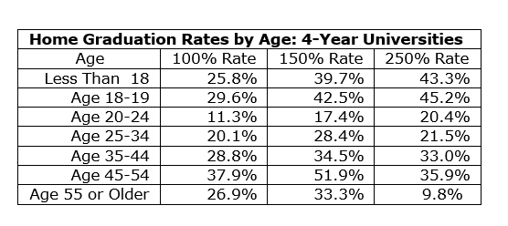
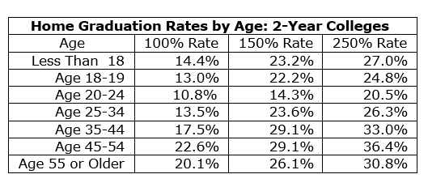
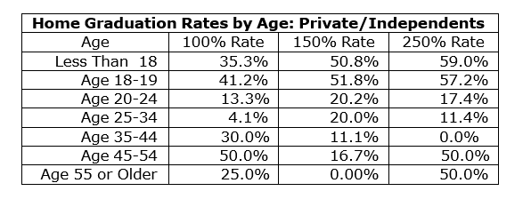
Graduation Rates by Age
Generally, students in the groups Age 18-19 and Age 45-54 have the highest graduation rates; whereas, the group Age 20-24 have the lowest graduation rates.

Slide 73
Graduation Rates of Remediated Students
v. Non- Remediated Students
Institution Type | 100% Rate |  | 150% Rate |  | 250% Rate
 | Remed. Students | Non-Remed. Students | Remed. Students | Non-Remed. Students | Remed. Students | Non-Remed. Students
4-Year Universities | 11.1% | 37.2% | 22.2% | 52.7% | 25.0% | 55.4%
2-Year Colleges | 8.8% | 28.9% | 13.5% | 35.9% | 18.7% | 37.2%
Non-remediated students graduate at higher rates in all three (100%, 150% & 250%) time frame designations.

Slide 74
Athletic Retention and Graduation Rates
AHECB Meeting of April 22, 2016

Slide 75
Dr. Marla Strecker
Senior Associate Director, Research & Technology

Slide 76
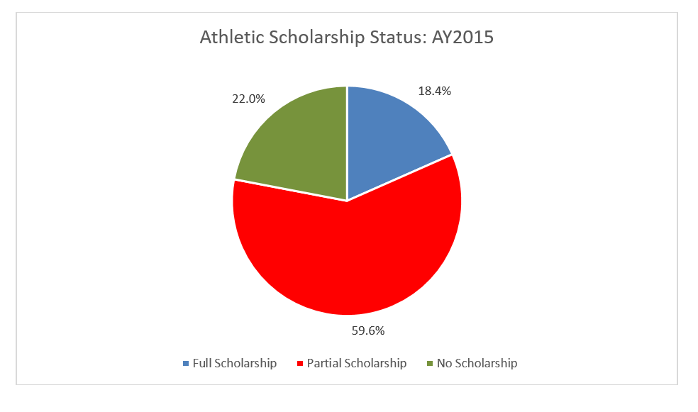
Scholarships

Slide 77
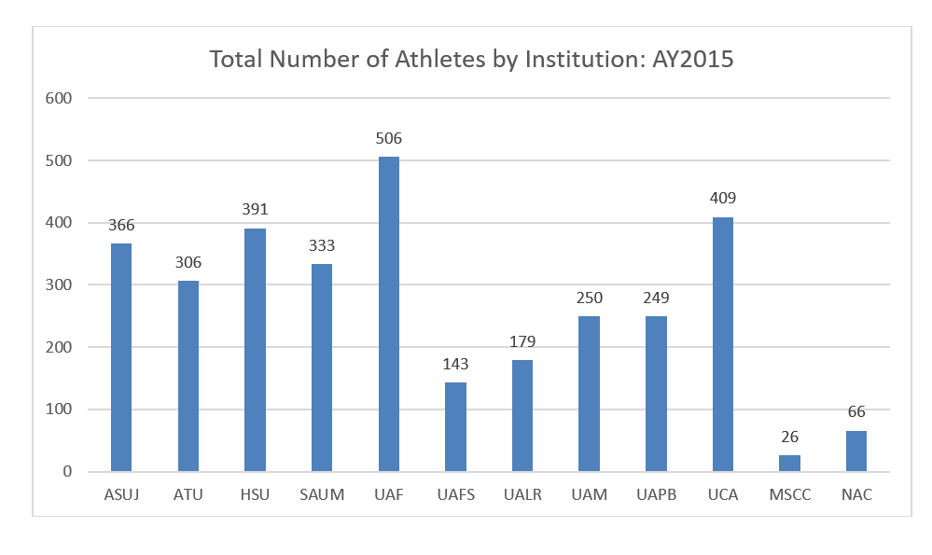
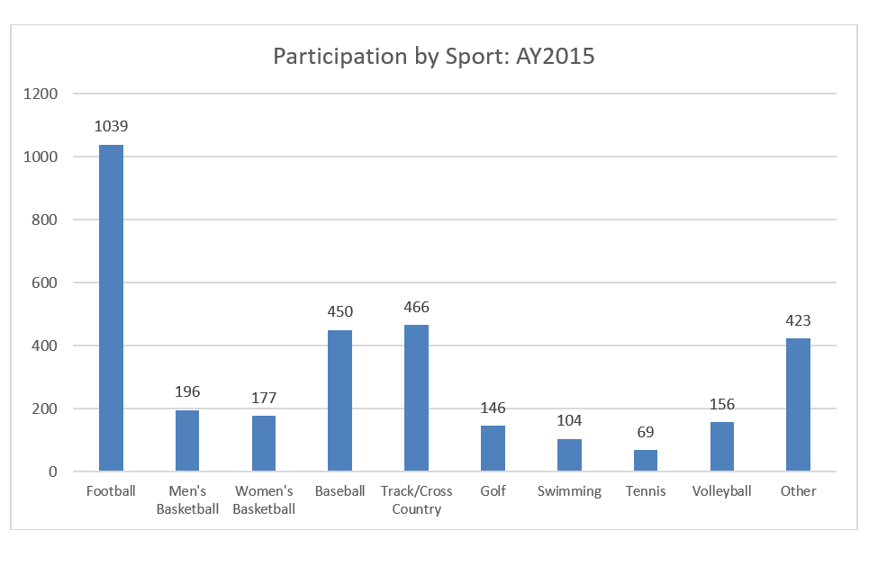
Participation

Slide 78
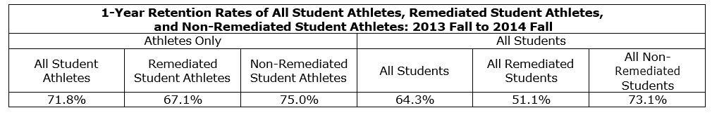
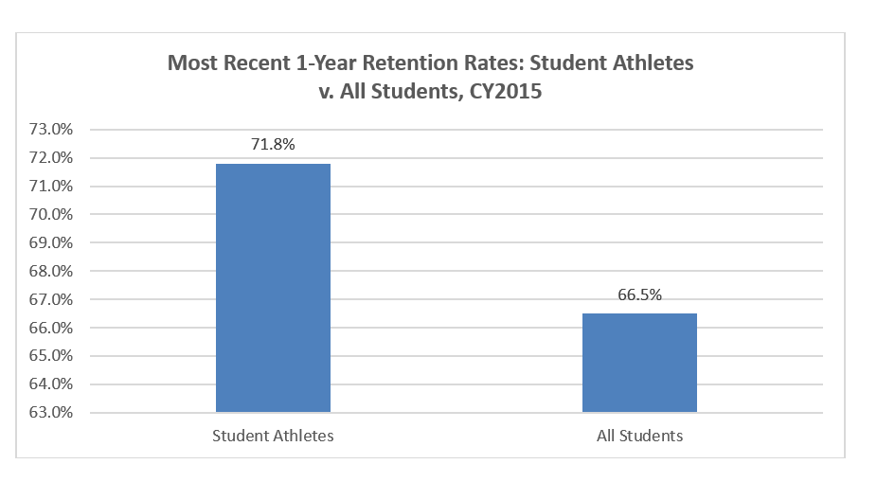
1-Year Retention Rates
The 1-year retention rate of Student Athletes is higher than All Students.

Slide 79
Graduation Rates
Athletic data is only reported to ADHE by public institutions. Ten (10) 4-Year Universities and two (2) 2-Year Colleges participate in college athletics.
The graduation rates reported herein have been re-designed. The graduation rate uses a cohort of:
first-time entering,
credential-seeking students,
from the entire academic year, not just the fall term, and
includes all full-time and part-time students.
In addition, the new graduation rates use a 100%, 150%, and 250% time rate for counting graduates. Such time rate in years is used for counting all credentials earned.
Inst. Type | 100% Rate | 150% Rate | 250% Rate
4-Year Universities | 4 Years* | 6 Years* | 10 Years*
2-Year Colleges | 2 Years* | 3 Years* | 5 Years*
Private/Independents | 4 Years* | 6 Years* | 10 Years*
*Plus the months of July and August for the next academic year.

Slide 80
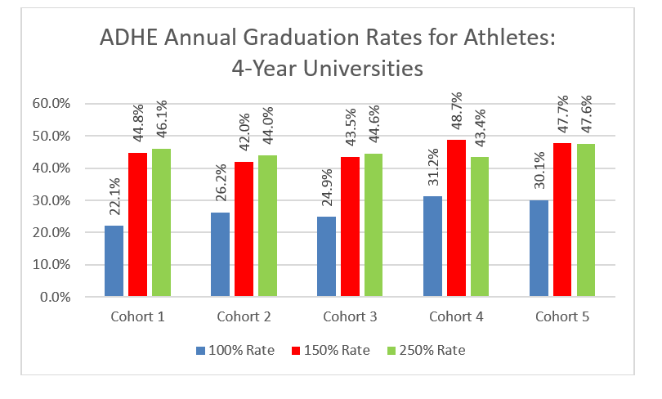
Graduation Rates: 4-Year Universities

Slide 81
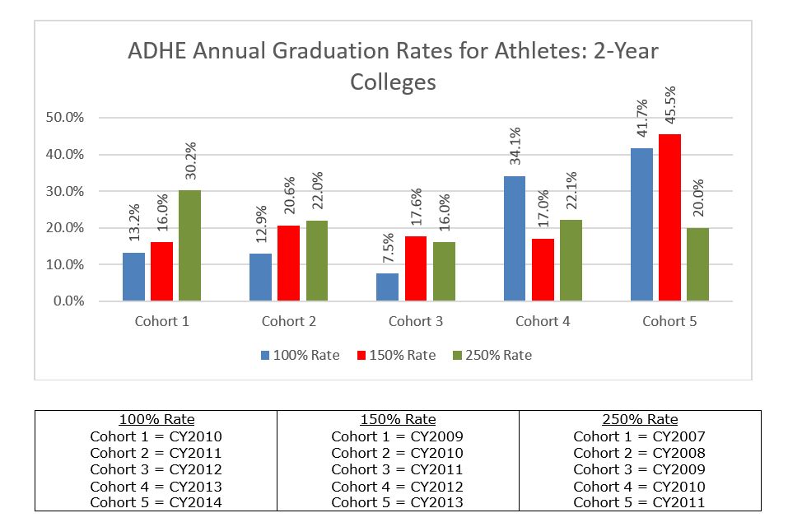
Graduation Rates: 2-Year Colleges

Slide 82
Graduation Rates by Sport
ADHE Annual Graduation Rates for Athletes by Sport
Football | 100% Rate | 150% Rate | 250% Rate | Men's Basketball | 100% Rate | 150% Rate | 250% Rate
4-Year Universities | 19.3% | 40.4% | 38.7% | 4-Year Universities | 20.8% | 36.0% | 33.3%
2-Year Colleges |  |  |  | 2-Year Colleges | 37.5% | 0.0% | 20.0%
Women's Basketball | 100% Rate | 150% Rate | 250% Rate | Baseball | 100% Rate | 150% Rate | 250% Rate
4-Year Universities | 43.2% | 34.0% | 47.1% | 4-Year Universities | 23.7% | 40.4% | 48.5%
2-Year Colleges | 42.9% | 66.7% | 33.3% | 2-Year Colleges | 30.0% | 36.0% | 13.0%
Track | 100% Rate | 150% Rate | 250% Rate | All Others | 100% Rate | 150% Rate | 250% Rate
4-Year Universities | 36.6% | 57.7% | 56.1% | 4-Year Universities | 30.0% | 56.6% | 55.5%
2-Year Colleges |  |  |  | 2-Year Colleges | 75.0% | 77.8% | 41.7%
NOTE: 2-Year Colleges did not participate in Football or Track.

Slide 83
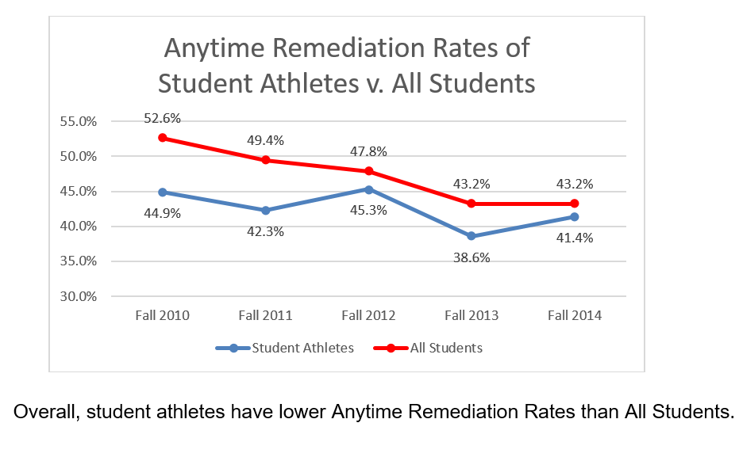
Remediation Rates

Slide 84
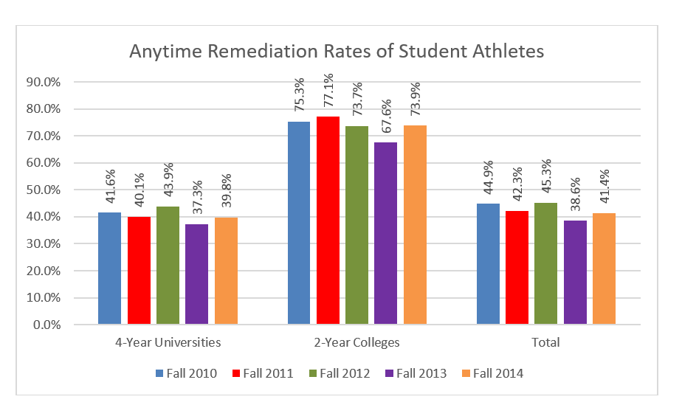
Remediation Rates

Slide 85
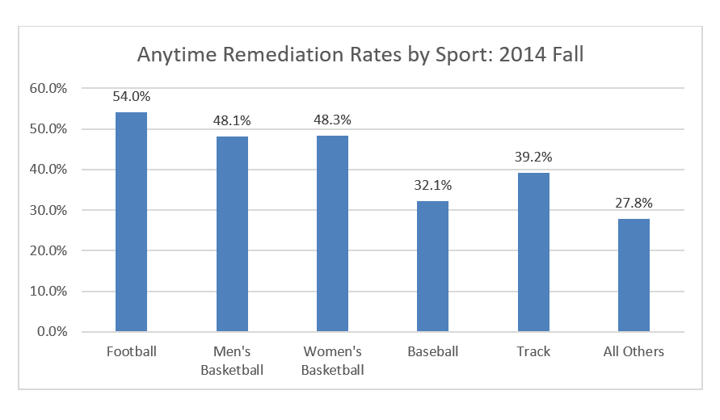
Remediation Rates by Sport
Remediation Rates cannot yet be calculated for Athletes for the 2015 Fall term as athletic data is an annual data submission.

Slide 86
Graduation Rates of Remediated Athletes
Comparison of ADHE Annual Graduation Rates between Remediated Athletes and Non-Remediated Athletes
 | 100% Rate | 150% Rate | 250% Rate
Remediated Athletes
4-Year Universities | 16.1% | 38.9% | 37.9%
2-Year Colleges | 26.1% | 28.6% | 8.5%
Non-Remediated Athletes
4-Year Universities | 40.0% | 54.1% | 56.8%
2-Year Colleges | 69.2% | 75.0% | 46.2%
Difference
4-Year Universities | 23.9% | 15.3% | 18.9%
2-Year Colleges | 43.1% | 46.4% | 37.7%
Non-Remediated Athletes graduate at higher rates than Remediated Athletes.

Slide 87
Annual Report on Productivity of Recently Approved Programs
AHECB Meeting of April 22, 2016

Slide 88
Jeanne Jones
Program Specialist, Academic Affairs

Slide 91
Number of Programs Approved by Level
20
1
11
11
4
5
1

