Slide 1
AHECB Finance Committee Meeting
April 25, 2014

Slide 2
Agenda item no. 9: Funding Formula for the 2015-17 biennium
Tara Smith
Senior Associate Director, Institutional Finance

Slide 3
Funding Formula Overview
2-YR College Need-Based Funding Formula updates
Technical Institutes Need-Based Funding Formula updates
University Need-Based Funding Formula updates
Non-Formula Funding Recommendation updates

Slide 4
Funding Formula Components
Needs-based Elements – Two-Year Colleges
Only changes for new biennium are inflationary adjustments to tuition rates, faculty salary and student services rates
Full-Time Equivalent (FTE) Faculty: Total number of FTE faculty needed is calculated by assigning each SSCH generated to one of four weighted categories.
General Education 22 students / 660 SSCH
Technical Education 16 students / 480 SSCH
Basic Skills 16 students / 480 SSCH
Allied Health 12 students / 360 SSCH

Slide 5
Funding Formula Components
Needs-based Elements – Two-Year Colleges
Faculty Salaries: The total FTE faculty is adjusted for part-time faculty.
Institutions with < 3,000 FTE students
Of the total FTE faculty, seventy (70) percent are considered full-time and thirty (30) percent are considered part-time.
Full-time salary is equal to the projected SREB average for 2015-17.
Part-time salary is equal to fifty (50) percent of the calculated full-time salary.

Slide 6
Funding Formula Components
Needs-based Elements – Two-Year Colleges
Institutions with >3,000 FTE students
Of the total FTE faculty, fifty (50) percent are considered full-time and fifty (50) percent are considered part-time.
Full-time salary is equal to the projected SREB average for 2015-17.
Part-time salary is equal to fifty (50) percent of the calculated full-time salary.

Slide 7
Funding Formula Components
Needs-based Elements – Two-Year Colleges
Student Services Rates: Student Services is calculated based on a variable rate per student using the mean of FTE students and headcount. The updated rates are:
$772/student for the first 750 students
$548/student for the next 2,250 students
$340/student for all students over 3,000

Slide 8
Funding Formula Components
Needs-based Elements – Technical Institutes
Only changes for new biennium are inflationary adjustments to tuition rates, faculty salary and student services rates
Full-Time Equivalent (FTE) Faculty: Total number of FTE faculty needed is calculated by assigning SSCH generated to one of four weighted categories.
General Education 22 students / 660 SSCH
Technical Education 16 students / 480 SSCH
Basic Skills 16 students / 480 SSCH
Allied Health 12 students / 360 SSCH
Faculty Salaries: The total FTE faculty generated above is multiplied by the average faculty salary for technical institutes in the SREB region.

Slide 9
Funding Formula Components
Needs-based Elements – Technical Institutes
Student Services Rates: Student Services is calculated based on a variable rate per FTE. The updated rates are:
$150,000 flat amount for the first 200 FTE
$536/FTE for all FTE above 200

Slide 10
Funding Formula Components
Needs-based Elements – Four-Year Universities
Changes for new biennium include inflationary adjustments to tuition rates, faculty salaries and to pursue a change in legislation to add a fringe benefits component
This formula provides equal funding for similar levels and disciplines at each university and determines the minimum level of funding needed for each university.
Full-Time Equivalent Faculty:
Faculty Load Factors (SSCH Required to Produce One FTE Faculty)
Undergraduate Graduate Doctoral
Cost Category I 645 175 130
Cost Category II 480 250 145
Cost Category III 365 160 120
Cost Category IV 230 102 70

Slide 11
Funding Formula Components
Needs-based Elements – Four-Year Universities
The total number of FTE faculty needed is determined by dividing the faculty load factors into the SSCH enrollment matrix for each institution’s latest enrollment. This determines for Arkansas the number of FTE faculty needed at each of the three levels.
Faculty Salaries: Each institution receives the same faculty salary amount per its SSCH in the four cost categories and at each level. Since the other expenditure function computations are a percentage of faculty salaries all institutions receive the same funding recommendation for the same kind of SSCH.*
* The 2012-13 SREB faculty salary for each level is inflated to the 2015-17 biennium.

Slide 12
Funding Formula Components
Needs-based Elements – Four-Year Universities
Proposed Fringe Benefit Rate:
ADHE staff in consultation with presidents & chancellors recommend pursuing a change in legislation to add a fringe benefits component to the university model.
It is proposed that fringe benefits would be calculated at 8½%
- Current matching rate for social security, Medicare, unemployment and worker’s compensation

Slide 13
Funding Formula Components
Needs-based Elements – Non-Formula
The recommendation for new funds for non-formula entities will be developed using a nominal percentage for the continuing level of programs plus programmatic justification for enhancements and/or expansions.

Slide 14
Agenda item no. 10: performance funding outcomes
Tara Smith
Senior Associate Director, Institutional Finance

Slide 15
Universities
Methodology
Total Possible Points = 10
Minimum Score Requirement = 6
Compensatory points for percentage of Pell receiving undergraduates may be added to the total points, but cannot increase the total points above 10.

Slide 16
Universities
Mandatory Measures – maximum of 4 points
Bachelor Credentials
Total Credentials
STEM Credentials
Progression
Optional Measures – maximum of 6 points
Minority Credentials
Non-Traditional Credentials
Remedial Credentials
Transfer Student Credentials
Course Completion
External Grants & Awards
Regional Economic Needs Credentials

Slide 17
Universities - Results

Slide 18
Colleges
Methodology
Total Possible Points = 10
Minimum Score Requirement = 6
Compares average of the most recent 3 years to an average of the most recent 5 years
Compensatory points for special populations (based on percentage of enrollment)

Slide 19
Colleges
Mandatory Measures – maximum of 6 points
Course Completion
Remedial
Non-Remedial
Progression
Credentials
Certificates of Proficiency
Technical Certificates
Associate Degrees
Total Credentials (rate)
Compensatory
Low-Income
Underprepared
Region/Mission Measures – maximum of 4 points
STEM Credentials
High Demand Credentials
Adult Credentials
Minority Credentials
Transfer Students
Workforce Training

Slide 20
Colleges - Results

Slide 21
Funding Impact
The implementation of the funding component shall not progress beyond 10% of an institution’s base funding until all institutions are funded at 75% of needed state funding
2 institutions did not meet the minimum required score of 6
SAUT: 5.58
UCA: 5.78
If budget cuts occur, ADHE will not further implement the funding component until such time funding is restored to the 2012-2013 fiscal year level.
ADHE will work in consultation with the Presidents & Chancellors to develop a Performance Funding Distribution policy that will be presented to the AHECB in July
Policy will include methodologies for the funding impact and distribution of performance funds

Slide 22
Agenda item no. 11: Distribution of Mineral lease funds
Callan Callaway
Program Coordinator, Institutional Finance

Slide 23
Distribution of Mineral Lease Funds
It is recommended that up to $750,000 be allocated (from the H.E. Research Development Fund) to the University of Arkansas, Fayetteville for continuing personal services and operating expenses associated with ARE-ON.
$10,103,725.79 has been distributed since May 2006, the first transfer of funds
The current balance of the Research Development Fund is $610,215.99.

Slide 24
Agenda item no. 12: Economic Feasibility of LoAn ISSUE for COLLEGE OF THE OUACHITAS
Chandra Robinson
Program Coordinator, Institutional Finance

Slide 25
Relevant Information
College Savings Bond Revolving Loan Fund
$1 million for 15 years @ a rate not to exceed 0.24%
Educational and general purposes
Revenue Funding Source: Tuition and Fee Revenue
Proceeds will be used for the purchase and renovation of a building for workforce training
Notes:
1. What is the projected date the bonds will be sold?
2. Please provide a detailed description of the new facility facilities. Please include the square feet, type of space that will make up the facility and location of the facility on the campus as well as any other relevant information.
3. Will the bond issue include furnishings?
4. What is the projected start date and completion date for facility?
5. Please list a few programs that will be housed in the facility.
6. Are there any other sources of income being used for this project? (i.e. private gifts)
7. What is the total project cost including all funding sources? Does this include all sources?

Slide 26
Agenda item no. 13: Economic Feasibility of BOND ISSUE for SOUTH ARKANSAS University
Chandra Robinson
Program Coordinator, Institutional Finance

Slide 27
Relevant Information
$10 million for 20 years @ a rate not to exceed 5.0%
Auxiliary purposes
Revenue Funding Source: Housing Revenue
Proceeds will be used to purchase the University Village apartments on the campus of Southern Arkansas University in Magnolia, Arkansas
Notes:
1. What is the projected date the bonds will be sold?
2. Please provide a detailed description of the new facility facilities. Please include the square feet, type of space that will make up the facility and location of the facility on the campus as well as any other relevant information.
3. Will the bond issue include furnishings?
4. What is the projected start date and completion date for facility?
5. Please list a few programs that will be housed in the facility.
6. Are there any other sources of income being used for this project? (i.e. private gifts)
7. What is the total project cost including all funding sources? Does this include all sources?

Slide 28
Agenda item no. 14: Economic Feasibility of BOND ISSUE for University OF Central Arkansas
Chandra Robinson
Program Coordinator, Institutional Finance

Slide 29
Relevant Information
$13.5 million for 30 years @ a rate not to exceed 5.75%
Educational and general purposes
Revenue Funding Source: Tuition and Fee Revenue
Proceeds will be used to fund the design and construction of the Lewis Science Addition including the replacement of the Lewis Science Center roof
Notes:
1. What is the projected date the bonds will be sold?
2. Please provide a detailed description of the new facility facilities. Please include the square feet, type of space that will make up the facility and location of the facility on the campus as well as any other relevant information.
3. Will the bond issue include furnishings?
4. What is the projected start date and completion date for facility?
5. Please list a few programs that will be housed in the facility.
6. Are there any other sources of income being used for this project? (i.e. private gifts)
7. What is the total project cost including all funding sources? Does this include all sources?

Slide 30
Agenda item no. 15 ASSOCIATE OF SCIENCE IN AVIATION – PROFESSIONAL PILOT OZARKA COLLEGE
Jeanne Jones
Program Specialist, Academic Affairs

Slide 31
Associate of Science in Aviation – Professional Pilot
The program will prepare students in North Central Arkansas to fly single engine plans and to qualify for a single-engine pilot license.
Provides Ozarka aviation students the opportunity for a seamless transfer to the Bachelor of Science in Aviation Henderson State University.

Slide 32
Agenda item no. 16 BACHELOR OF SCIENCE IN EDUCATION IN SPECIAL EDUCATION, K-12 University of Arkansas, Fayetteville
Jeanne Jones
Program Specialist, Academic Affairs

Slide 33
Bachelor of Science in Education in Special Education K-12
Prepares undergraduates to teach Special Education.
Leads to initial licensure in Special Education.
Arkansas Department of Education designated Special Education as an Academic Shortage area for the 2013-14 academic year.

Slide 34
Agenda item no. 17 COSMETOLOGY TECHNICAL CERTIFICATE University of Arkansas COMMUNITY COLLEGE at Batesville
Delores Logan
Program Specialist, Academic Affairs

Slide 35
Cosmetology Technical Certificate
Program graduates will qualify to take the cosmetology exam for Arkansas licensure.
Licensed cosmetology salons need for employees in the Batesville/Independence County area will be met.

Slide 36
Agenda item no. 18 Technical Certificate INDUSTRIAL Technology Cossatot COMMUNITY COLLEGE of the University of Arkansas
Delores Logan
Program Specialist, Academic Affairs

Slide 37
Technical Certificate in Industrial Technology
The Industrial Technology program will provide students with skills for entry-level maintenance and production jobs for employment.
Business and industry in the area will be provided with local employees rather than employees from out of the area.

Slide 38
Agenda item no. 19 ICAC RESOLUTIONS
Alana Boles
Program Specialist, Academic Affairs

Slide 39
Institutional Certification Advisory Committee (ICAC)
20 Colleges and Universities
74 Programs
7 New Institutions – Distance Technology
Initial Degree Certifications
American College of Healthcare Science, Portland, Oregon– 1 Degree
Concordia University Wisconsin, Mequon, Wisconsin– 7 Degrees
Johns Hopkins University, Baltimore Maryland– 8 Degrees, 1 Certificate
Mid-America Christian University, Oklahoma City, Oklahoma– 7 Degrees
University of Kansas, Lawrence, Kansas – 2 Degrees, 1 Certificate
University of Saint Mary, Leavenworth, Kansas– 2 Degrees
Vanderbilt University, Nashville, Tennessee– 4 Degrees

Slide 40
1 New Institution – Arkansas Campus
Baptist Health Schools Little Rock, Little Rock, Arkansas
Initial Degree Certifications – at Arkansas Campus
Remington College, Little Rock, Arkansas – 1 Degree
Vista College, Richardson, Texas, Fort Smith Campus – 4 Degrees

Slide 41
Previously Certified Institutions
Initial Degree Certifications – Distance Technology
Arizona State University, Scottsdale, Arizona – 2 Degrees
Franklin University, Columbus, Ohio – 2 Degrees
Missouri State University, Springfield, Missouri – 3 Degrees
National American University, Rapid City, South Dakota – 1 Degree
Norwich University, Northfield, Vermont – 1 Degree
Oregon State University, Corvallis, Oregon – 3 Degrees
University of Cincinnati, Cincinnati, Ohio – 7 Degrees
University of Nebraska-Lincoln, Lincoln, Nebraska – 13 Degrees
University of Nebraska Medical Center, Omaha, Nebraska – 2 Degrees
William Woods University, Fulton, Missouri – 2 Degrees

Slide 42
Agenda Item no. 20 Letters of Notification
Lillian Williams
Program Specialist, Academic Affairs

Slide 43
Letters of Notification
Programs approved by the ADHE Director
Programs must be included on the AHECB agenda prior to initiation
Programs are reasonable and moderate extensions of existing certificates and degrees

Slide 44
Associate of Arts Teaching (AAT)
AAT program modification required due to changes in the state standards for elementary and middle-level educator licensure effective in Fall 2015
No new students will be enrolled in the AAT program beyond Summer 2014
Current, continuously enrolled AAT students can complete the degree
PRAXIS Core exam will be required for AAT degree effective Spring 2014

Slide 45
Agenda Item no. 17 Letters of Intent
Cynthia Moten
Associate Director, Academic Affairs

Slide 46
Letters of Intent
Notification of institutional plans to offer new programs or organizational units that require Coordinating Board approval
Presidents, Chancellors and Academic Affairs Officers can comment on the proposals before consideration by AHECB

Slide 47
Agenda item no. 22 HENDERSON STATE UNIVERSITY- DOWNTOWN HOT SPRINGS EDUCATION CENTER
Cynthia Moten
Associate Director, Academic Affairs

Slide 48
Agenda item no. 23 ARKANSAS STATE UNIVERSITY- QUERETARO, MEXICO
Cynthia Moten
Associate Director, Academic Affairs

Slide 49
Agenda item no. 24 ARKANSAS TECH UNIVERSITY: Role and Scope change
Cynthia Moten
Associate Director, Academic Affairs

Slide 50
ATU Role and Scope Change (For Information and Discussion Only)
Role and Scope Change request to offer initial doctoral degree.
External team reviewed the role and scope proposal only.
Institutional concern about program duplication.
Doctoral degree proposal will be reviewed by ADHE if Board approves Role and Scope Change at the next AHECB meeting.

Slide 51
AHECB Meeting
April 25, 2014

Slide 52
Agency Overview
Shane Broadway
Director

Slide 53
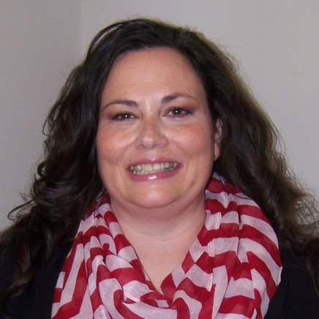
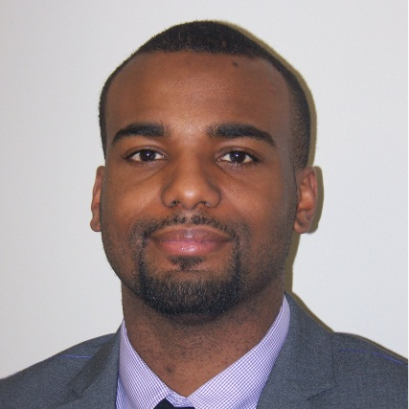
Agency Updates
New Employees
Angela Lasiter
Agency Finance & Administration
Stanley Spates
Agency Finance & Administration
Department Change
Jake Eddington
Institutional Finance, formerly Financial Aid
Resignation
Jami Fisher
Agency Finance & Administration
Retirement
June Morgan
Financial Aid
Lasiter
Spates

Slide 54
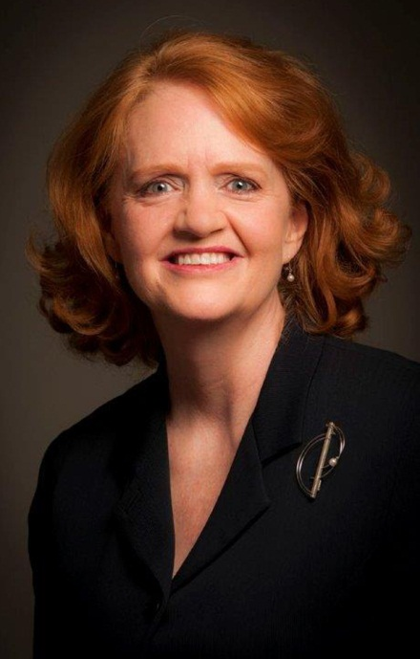
Campus Leadership Changes
Retirements
Dr. Robert Brown, June ‘14
Arkansas Tech University
Dr. Sally Carder, June ‘14
National Park Community College
Dr. Jack Lassiter, December ‘14
University of Arkansas Monticello
New President
Dr. Robin E. Bowen, July ‘14
Arkansas Tech University
Dr. Bowen

Slide 55
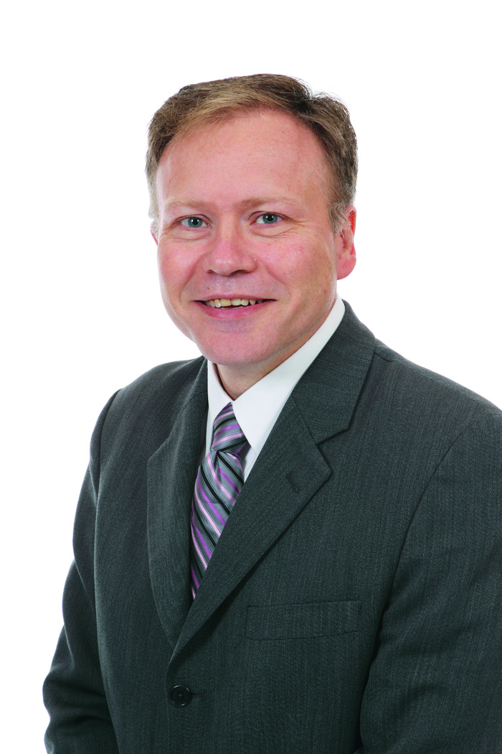
Investitures
University of Arkansas Pine Bluff
Dr. Laurence Alexander
Chancellor
Pine Bluff Convention Center 2 p.m.
University of the Ozarks
Richard L. Dunsworth, J.D.
President
Alexander
Dunsworth

Slide 56
Fast Track

Slide 57
Academic Challenge Scholarship
As of April 24, 2014:
17,410 applications received
7,300 eligibility pending
9,600 awarded
7,500 accepted

Slide 58
Governor’s Distinguished
531 students qualified for the Governor’s Distinguished Scholarship
193 were wait-listed but offered award Friday, April 18
As of Monday, April 21 more than 120 had accepted

Slide 59
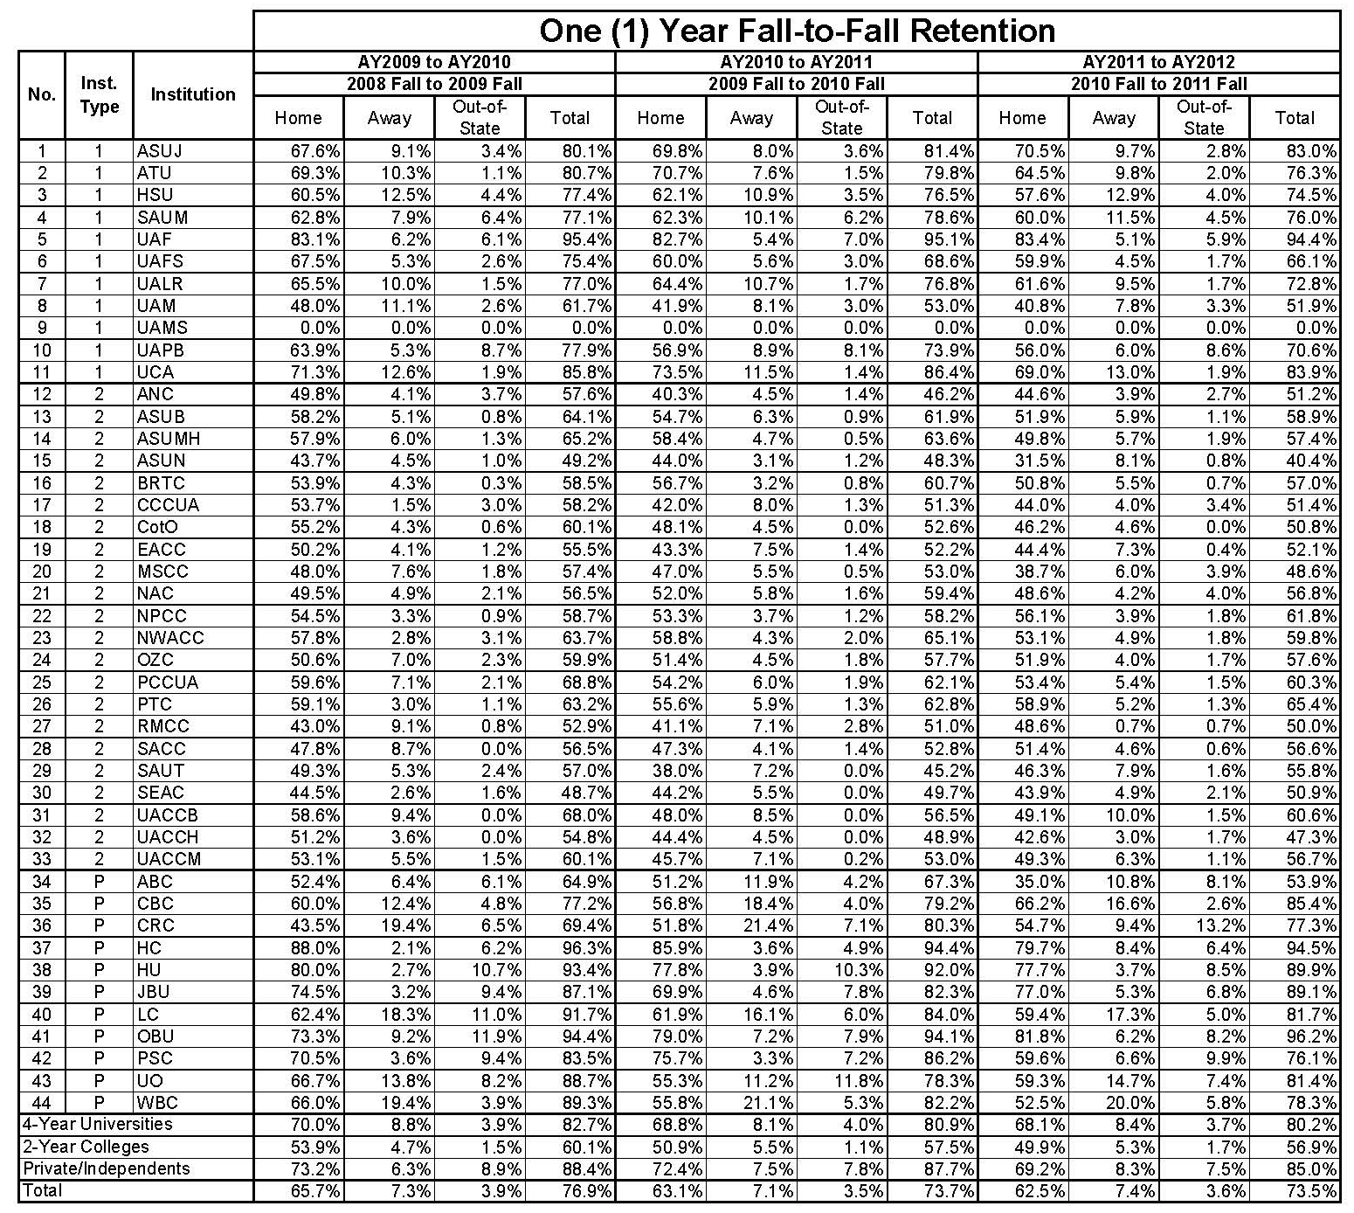
1-Year Fall-to-Fall Retention

Slide 60
Credit When It’s Due
Synopsis:
Project funded by the Kresge Foundation is a partnership between:
Arkansas Department of Higher Education
Arkansas Association of Two-Year Colleges
Arkansas Research Center
Goals:
develop an automated “reverse transfer” system
increase the number of Arkansans with Associate Degrees
promote the value of Associate Degrees.
Arkansas is one of 12 states participating in this project.

Slide 61
Credit When It’s Due cont.
Review of Phase 1 “PILOT” = 240 students (November 2013 to March 2014)
Pilot criteria: Transferred from a college to a university in the fall of 2008, still enrolled in fall 2013, no credential recorded by ADHE
Colleges and universities identified as the “majority institution” sent letters to students requesting consent to exchange transcripts and complete degree audit
17 degrees awarded to date
Challenges: varying FERPA interpretations, bad addresses, communication between campuses

Slide 62
Credit When It’s Due cont.
Phase 2 “DEGREE MATTERS”= 5,913 students (May 2014 to December 2014)
4,356 have 15 to 17 ACTS courses
1,557 have 18 or more ACTS courses
Enrolled at any Arkansas public college or university between fall 1994 and fall 2013
No credential recorded by ADHE as of Fall 2013
5,483 addresses and 2,752 phone numbers identified by LexisNexis

Slide 63
Credit When It’s Due cont.
ADHE & AATYC Responsibilities
Conduct statewide webinar for campus administrators & staff Provide campuses with information packets and frequently asked questions
Coordinate media campaign to promote the value of Associate Degrees and encourage fall enrollment (television, radio, social media)
Coordinate “DegreeMatters.org” website with two purposes:
Promote the value of Associate Degrees and link to institutions’ websites
Serve as a hub for Phase 2 students to submit online consent to share transcripts and to update contact information
Coordinate first class mail and text messages to Phase 2 students
Communicate regularly with institutional contacts to answer questions and share progress
Communicate with stakeholders (Governor’s Workforce Cabinet, STEM Coalition, Veteran’s Department, Arkansas State Chamber, Council on Postsecondary Education )

Slide 64
Credit When It’s Due cont.
Institution Responsibilities
Identify contact person(s) to receive student consent updates from web manager, process transcript requests from institutions, and communicate with ADHE and AATYC
Participate in statewide webinar
Share information packets with administrators and staff
Link to “DegreeMatters.org” website and share content via social media
After student consent is obtained, “majority institutions” will:
Send acknowledgement letter or email to student within five business days
Request transcripts
Conduct degree audits
Award degrees OR encourage completion
Report data to ADHE monthly

Slide 65
Credit When It’s Due cont.
April
Website, communication materials, and information packets in development
Institutional contacts identified (please send names, titles, and emails to Collin Callaway at ccallaway@aatyc.org by May 1st)
Early May
MOUs signed by institutions
Website finalized
Communication materials for students finalized
Information packets for institutions and stakeholders finalized
Webinar for campuses conducted on May 8th from 3 to 4 p.m.

Slide 66
Credit When It’s Due cont.
Mid-May (approximately May 21st)
Website live
Media campaign begins
Letters and text messages go out to Phase 2 students
August to December
Media campaign for fall enrollment ends mid August
Continue to follow up with Phase 2 students and report to ADHE through December
Depending on funds, a second media campaign could launch in October for spring enrollment

Slide 67
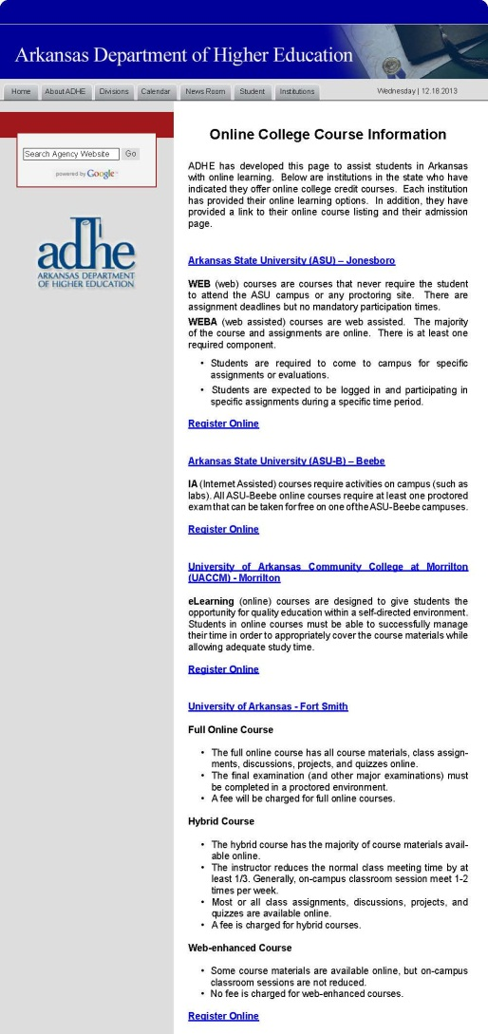
Online Programs Webpage

Slide 68
Food Truck Friday
Corner of Main Street and Capitol Avenue
11 a.m. to 1:30 p.m.
Live music this week from Kirk Anderton and Quentin May
Vendors: Southern Gourmasian, Bryant’s Barbecue, Roxie’s Hot Dogs & Loblolly Creamery

Slide 69
Kaneaster Hodges, Jr.,
Kaneaster was appointed to the Coordinating Board in 2002 and is currently serving his second term, which expires May 1, 2014.
He previously served as a Board of Trustee member of the University of Arkansas and graduated from Princeton University.
Kaneaster received his law degree from the University of Arkansas and practices in Newport.
Kaneaster was the prosecuting attorney for Newport from 1967 to 1974 and served as a U.S. Senator from 1977 to 1979. He also served as Chair of the Coordinating Board from July 2005 to July 2007.
You can find more information about Kaneaster on Wikipedia.

Slide 70
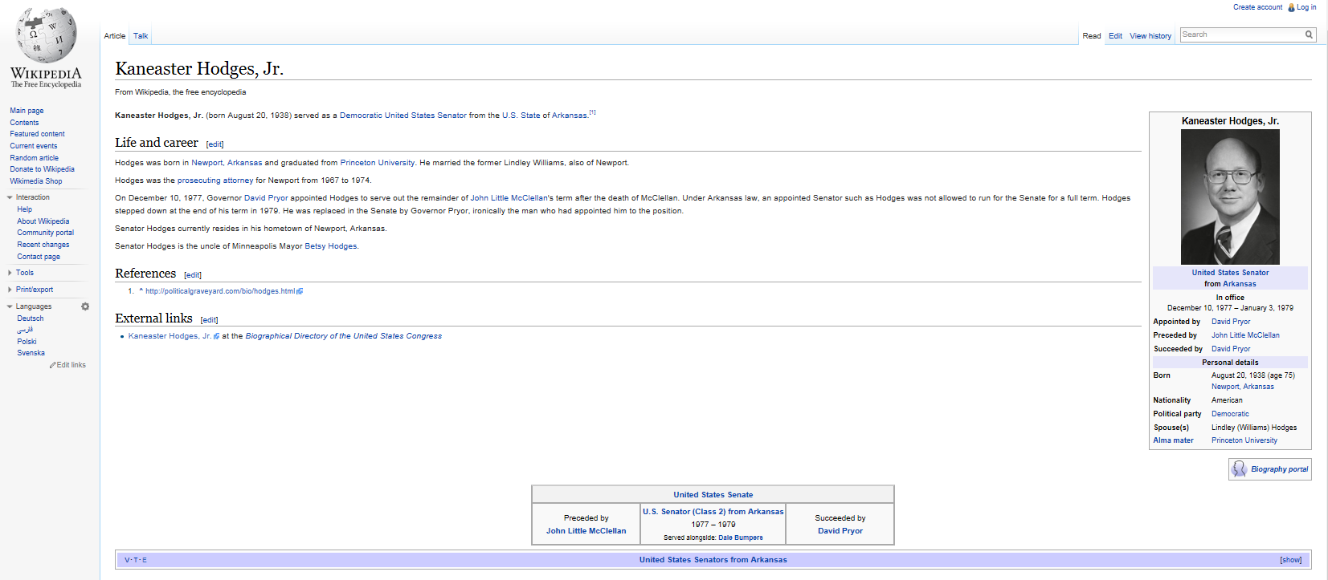

Slide 71
Credentials Awarded
AHECB Meeting of April 25, 2014
Rick Jenkins
Associate Director, Planning and Accountability

Slide 72
Credentials Awarded: AY2009-AY2013
1-Year Growth Rate = 1.4%
5-Year Growth Rate = 26.8%

Slide 73
by Institution Type
Inst. Type | 1-Year Growth | 5-Year Growth
4-Year Universities | 2.9% | 28.5%
2-Year Colleges | -0.2% | 27.8%
Private/Independents | 0.0% | 12.5%
Total | 1.4% | 26.8%

Slide 74
by Gender
 | Male | Female
1-Year Growth Rate | 2.9% | 0.5%
5-Year Growth Rate | 25.6% | 27.6%

Slide 75
by Race/Ethnicity
Race/Ethnicity | 1-Yr. Growth | 5-Yr. Growth
Asians Only | 25.4% | 33.6%
Blacks Only | 3.2% | 27.4%
Hispanics Any | 23.5% | 102.3%
Amer. Indians/Alaskans Only | -2.5% | -6.1%
Whites Only | 5.7% | 26.7%
Hawaiian/Pacific Islanders Only | -23.7% | NA

Slide 76
Retention and Graduation Rates AHECB Meeting of April 25, 2014 Rick Jenkins Associate Director, Planning and Accountability

Slide 77
1-Year Fall-to-Fall Retention
Inst. Type | 1-Year Change | 5-Year Change
4-Year Universities | 1.4% | 0.1%
2-Year Colleges | 0.2% | -5.0%
Grand Total | 1.1% | -1.6%

Slide 78
Retention Rates: Remediated v. Non-Remediated Students

Slide 79
Statewide Retention
From 11% to 18% of students are retained, but at a different institution.

Slide 80
Graduation Rates

Slide 81
Graduation Rates of Remediated Students

Slide 82
Graduation Rates: Remediated v. Non-Remediated Students
Graduation rates of non-remediated students are approximately 30% higher than remediated students at 4-Year Universities.
Graduation rates of non-remediated students are approximately 18% higher than remediated students at 2-Year Colleges.

Slide 83
Alternative Annual Graduation Rates
This supplemental graduation rate calculation is different from IPEDS graduation rate. This cohort includes: (1) first-time entering students for the entire academic year (not just the fall term); (2) both full-time and part-time students; and (3) tracks students for a full ten (10) years.
Current 4-Year University Graduation Rates (IPEDS/ADHE) are from 38.0%-40.8% and for 2-Year Colleges are from 17.9%-20.8%.

Slide 84
Athletic Retention and Graduation Rates
AHECB Meeting of April 25, 2014
Rick Jenkins
Associate Director, Planning and Accountability

Slide 85
Participation

Slide 86
Scholarship Status

Slide 87
Retention

Slide 88
Retention of Non- Remediated Student Athletes, Remediated Student Athletes, All Remediated Students, and All Non-Remediated Students

Slide 89
Graduation Rates

Slide 90
Graduation Rates by Sport

Slide 91
Graduation Rates of Remediated Student Athletes

Slide 92
Remediation Rates of Student Athletes

Slide 93
Remediation Rates of Student Athletes v. All Students

Slide 94
New Program Productivity
AHECB Meeting of April 25, 2014
Rick Jenkins
Associate Director, Planning and Accountability

Slide 95
Active and On-Track Programs
Active and On-Track Programs
New Programs | Certificate and Associate |  | Bachelor's, Graduate, Professional |  | Total
 | Number | Percent | Number | Percent | Number | Percent
All Active Programs | 71 | 77.2% | 21 | 22.8% | 92
Programs On-Track to Meet Standard | 46 | 50.0% | 21 | 22.8% | 67 | 72.8%
Baccalaureate and Graduate programs approved between July 1, 2007 and June 30, 2008 (Academic Year 2008); and
Associate and Certificate programs approved between July 1, 2009 and June 30, 2010 (Academic Year 2010).

Slide 96
Active and On-Track Programs by Institution Type and Degree Level

Slide 97
4-Year Universities

Slide 98
2-Year Colleges

Slide 99
Agenda item no. 7 POLICY AMENDMENT (5.20): Role and Scope Process
Cynthia Moten
Associate Director, Academic Affairs

Slide 100
Role and Scope Change Process
AHECB approval required for initial higher level degree only.
One external review team for the role and scope change request and the related new program proposal.
AHECB action on new institutional role and scope and new degree program.

Slide 101
Agenda item no. 8: Arkansas academic challenge scholarship rules and regulations
Janet Lawrence
General Counsel

Slide 102
Arkansas Academic Challenge
Changes due to legislative changes in the 2013 regular legislative session.
Legislative changes by Acts 234, 1106, 1173, and 1263 of 2013.
Changes affected administration and award amounts.
Due to the potential of changes to award amounts in future legislative session, the language has been changed to state such and that notification of award amounts will be placed on the ADHE website.
Administrative changes included items such as the expansion of the definition for Arkansas resident.

