Slide 1
REGULAR MEETING OF THE
ARKANSAS HIGHER EDUCATION
COORDINATING BOARD
Arkansas State University-Mountain Home
October 27, 2017

Slide 2
Agenda item no. 10: personal services recommendations for the 2018-2019 fiscal year
Tara Smith
Deputy Director

Slide 3
Summary of Recommendations
Line-item maximum salary increases were considered for the fiscal year, and all line-item maximums were adjusted by 1.4 percent per year for the biennium.
Salary recommendations for new positions were based on salaries for similar positions previously established at comparable institutions.

Slide 4
Summary of Recommendations
The following variables were used when considering requests for additional positions:
  Enrollment increases/decreases vs. position growth
  Positions directly tied to student support/success
  Keep position changes minimal for the Fiscal Session
ADHE Staff recommend a net increase of 5 positions
Increase of 0.02 percent for a total of 27,014 positions (apart from UAMS)
UAMS requested no increases and currently has 11,741 authorized positions

Slide 5
Agenda item no. 11:
REPORT ON intercollegiate ATHLETIC REVENUES & EXPENDITURES
Tara Smith
Deputy Director

Slide 6
Athletic Report
A.C.A. §6-62-106 directs AHECB to develop and establish uniform accounting standards and procedures for reporting revenues and expenditures.
The 2016-17 Athletic actual expenditures for state-supported universities was $176 million and $597,216 for two-year colleges.
This represents an increase of 6.3 percent over 2015-16

Slide 7
Revenues by Source

Slide 8
% of Athletic Revenues By Source 2016-17
Athletic Revenues by Source 2009-10

Slide 9
Expenditures by Source

Slide 10
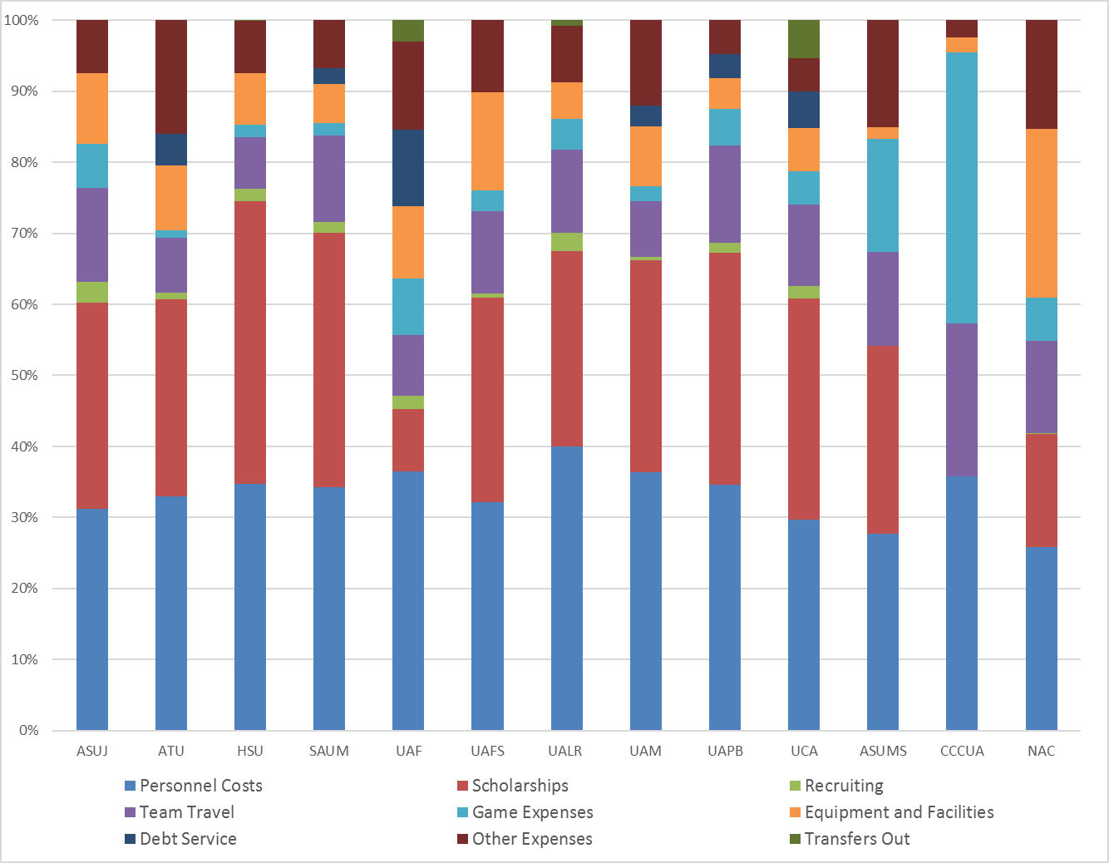
% of Athletic Expenditures By Source 2016-17
Athletic Revenues by Source 2009-10

Slide 11

Agenda item no. 12:
Economic Feasibility of a loan for
UNIVERSITY OF ARKANSAS COMMUNITY COLLEGE at rich mountain
Tara Smith
Deputy Director

Slide 12
Relevant Information
$825,000 with a term of five (5) years with the option to extend for three (3) more five (5) year terms @ a net loan rate not to exceed 1.0%
Educational and general purposes
Revenue Funding Source: Tuition and Fee Revenue
Proceeds from the loan will be used for renovation of the Abernathy Building and two (2) science labs
Notes:
1. What is the projected date the bonds will be sold?
2. Please provide a detailed description of the new facility facilities. Please include the square feet, type of space that will make up the facility and location of the facility on the campus as well as any other relevant information.
3. Will the bond issue include furnishings?
4. What is the projected start date and completion date for facility?
5. Please list a few programs that will be housed in the facility.
6. Are there any other sources of income being used for this project? (i.e. private gifts)
7. What is the total project cost including all funding sources? Does this include all sources?

Slide 13

Agenda item no. 13:
Economic Feasibility of a loan for
UNIVERSITY OF ARKANSAS For medical sciences
Tara Smith
Deputy Director

Slide 14
Relevant Information
$30 million with a term of up to ten (10) years @ a rate not to exceed 5.0%
Auxiliary purposes
Revenue Funding Source: Hospital Clinical Revenues
Proceeds from the loan will be used for capital renewal and deferred maintenance to replace electrical, mechanical, HVAC, elevators, and other equipment in buildings at the Little Rock campus
Notes:
1. What is the projected date the bonds will be sold?
2. Please provide a detailed description of the new facility facilities. Please include the square feet, type of space that will make up the facility and location of the facility on the campus as well as any other relevant information.
3. Will the bond issue include furnishings?
4. What is the projected start date and completion date for facility?
5. Please list a few programs that will be housed in the facility.
6. Are there any other sources of income being used for this project? (i.e. private gifts)
7. What is the total project cost including all funding sources? Does this include all sources?

Slide 15
ACADEMIC COMMITTEE
Consent Agenda Items
Lillian Williams Academic Affairs

Slide 16
Consent Items
*14. University of Arkansas Community College at Batesville
Certificate of Proficiency in Soil Science
Certificate of Proficiency in Plant Science
Certificate of Proficiency in Animal Science
Certificate of Proficiency in Agriculture Business
Technical Certificate in Agriculture Technology
Associate of Science in Agriculture Technology
*15. University of Central Arkansas
Master of Science in Athletic Training
*Numbers refer to main agenda

Slide 17
Agenda Item no. 16
Institutional Certification
Advisory Committee: Resolutions
Ann Clemmer
Senior Associate Director for Governmental Relations/Special Projects

Slide 18
Institutional Certification Advisory Committee (ICAC)
9 Colleges and Universities
39 Programs
Champion Christian College – Institutional Planning and Development

Slide 19
Agenda Item no. 17
Letters of Notification
Lillian Williams
Academic Affairs

Slide 20
Letters of Notification
Programs approved by the ADHE Director
Programs must be included on the AHECB agenda prior to initiation
Programs are reasonable and moderate extensions of existing certificates and degrees

Slide 21
Agenda Item no. 18
Letters of Intent
Lillian Williams
Academic Affairs

Slide 22
Letters of Intent
Notification of institutional plans to offer new programs or organizational units that require Coordinating Board approval
Chief academic officers and chief executive officers can comment on the proposals before consideration by AHECB

Slide 23
role and scope change REQUEST
Lillian Williams
Academic Affairs

Slide 24
Role And Scope Change Request
Southern Arkansas University - Magnolia
Role & Scope Change – Initial Doctoral Degree
Doctor of Education in Rural and Diverse Educational Leadership
For Information and Discussion Only

Slide 25
Approve Minutes
July 27 Special Meeting
July 28 Regular Meeting
July 31 Special Meeting
August 4 Special Meeting

Slide 26
Appointment of Nominating Committee
Chair Sherrel Johnson will appoint members of the Arkansas Higher Education Coordinating Board nominating committee. The nominating committee will recommend Board officers for 2018-19 at the January 26, 2018 meeting.

Slide 27
2017 Coordinating Board Meeting Schedule
The proposed 2018 schedule for these regular quarterly meetings follows:
January 26, 2018 Arkansas Dept. of Higher Education, Little Rock
April 20, 2018 Arkansas Dept. of Higher Education, Little Rock
July 26 - 27, 2018 University of Arkansas, Fayetteville
October 26, 2018 Arkansas Dept. of Higher Education, Little Rock

Slide 28
DR. MARIA MARKHAM
Agenda item no. 4:
REPORT OF THE DIRECTOR

Slide 29
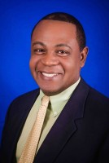
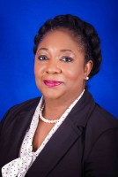
ADHE Staffing
Kevin Lewis
Career Pathways Initiative Program Specialist
  Began August 14, 2017
Willie Murdock
Career Pathways Initiative Director
  Began August 28, 2017

Slide 30
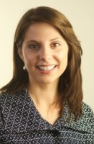
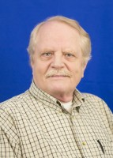
ADHE Staffing
Dr. Marla Strecker
Senior Associate Director for Academic Affairs
  Last Day was August 31, 2017
Paul Nations
Systems Specialist for Research and Analytics
  Retired on September 29, 2017

Slide 31
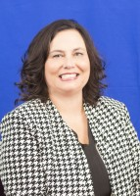
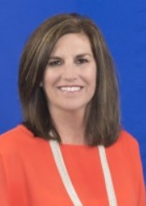
ADHE Staffing
Angela Lasiter
Program Specialist for Special Projects
  Last Day was October 12, 2017
Tracye McKeown
Program Specialist for Special Projects
  Transferred Departments

Slide 32
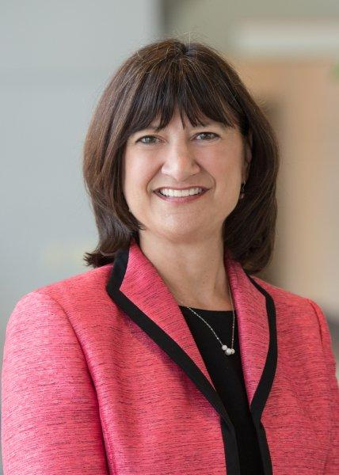
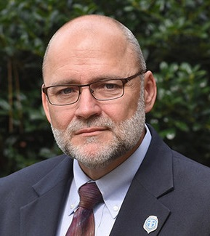
Institutional Leadership
Stephanie Gardner was named interim chancellor at the University of Arkansas for Medical Sciences, effective July 31 following the retirement of Chancellor Dan Rahn.
Gardner is senior vice chancellor for academic affairs and provost at UAMS.
Roger Moore, ASU-Beebe’s vice chancellor for finance and administration and a 19-year veteran of the institution, was appointed as interim chancellor.
Moore’s appointment was following the resignation of Dr. Karla Fisher, who plans to pursue other opportunities in higher education.

Slide 33
Agency Projects
Policy Review
Higher Ed Master Plan Implementation
Strategic Staffing Plan
ACTS Review
Arkansas Future
Statewide AP Policy
Workforce Challenge
Unplanned Pregnancy Prevention
Sexual Assault Prevention
Guided Pathways
Co-requisite Remediation
Funding Model
15 to Finish
Math Pathways
Interstate Passport
Career Pathways Initiative
Carl Perkins
Project Pipeline Repair

Slide 34
Agenda item no. 5:
Arkansas future grant
Tara Smith
Deputy Director

Slide 35
Arkansas Future Grant
No Changes from Rules presented to AHECB on April 20, 2017
Rules approved by Arkansas Legislative Council on Oct. 20, 2017

Slide 36
Agenda item no. 6:
Academic Challenge scholarship
Tara Smith
Deputy Director

Slide 37
Academic Challenge Scholarship
No Changes from Rules presented to AHECB on April 20, 2017
Rules approved by Arkansas Legislative Council on Oct. 20, 2017

Slide 38
Agenda item no. 7:
Productivity-based funding model policies
Maria Markham
Director

Slide 39
Policies for Final Adoption
University Metric Policy: No substantive changes
Two-Year College Metric Policy: Changes noted in mark-up
Funding Distribution Policy: No substantive changes
Rules approved by Arkansas Legislative Council on Oct. 20, 2017
Operating recommendations will follow in next agenda item

Slide 40
Agenda item no. 8:
Operating recommendations for the 2018-2019 fiscal year
Tara Smith
Deputy Director

Slide 41
ADHE Recommendation
Recommendation includes productivity funding for 2- & 4-year institutions and base operations & program enhancements for non-formula entities
  New Funding:
    Productivity Funding = $9,404,111
    Non-Formula Entities = $38,303,024

Slide 42
Operating Recommendations
Table A. Summary of Operating Recommendations for the 2018-19 Fiscal Year

Slide 43
Operating Recommendations
Table A. 2018-19 Productivity Index

Slide 44

Operating Recommendations
Table C. 2018-19 Four-Year Universities Recommendations

Slide 45
Operating Recommendations
Table D. 2018-19 Two-Year Colleges Recommendations

Slide 46
Operating Recommendations
Table E. 2018-19 Non-Formula Entities Recommendations

Slide 47
Agenda item no. 9:
PREVENTION OF SEXUAL ASSAULT
ON CAMPUS
Ann Clemmer
Senior Associate Director

Slide 48
Sexual Assault on Campus
Action Plan for the Prevention of Campus Sexual Assault –Act 563
The legislation requires the following elements to be a part of the campus activities:
a. Incorporation of sexual assault prevention information for students through advising and student orientation.
b. Integrate information about the prevention of sexual assault into academic courses if and when appropriate.
c. Identification of opportunities to raise awareness and provide resources for the prevention of sexual assault across the entire student population.
d. Identify private or federal grants available to address the prevention of sexual assault and promote student success, including any partnerships necessary to compete for such grants.
e. Collaboration with the Department of Health or federally qualified health centers to promote access to care.
f. Identify other topics or issues relating to the prevention and reduction of sexual assault.
Schools will be required to submit their plans to ADHE by June 30 each year. The document submitted should contain a description of both the institution’s policy and implementation activities.

