Slide 1
REGULAR MEETING OF THE ARKANSAS HIGHER EDUCATION COORDINATING BOARD
April 28, 2023

Slide 2
FINANCE COMMITTEE

Slide 3
Agenda item no. 06: Distribution of Mineral lease funds
Nick Fuller
Assistant Director for Finance

Slide 4
Distribution of Mineral Lease Funds
It is recommended that up to $475,000 be allocated (from the H.E. Research Development Fund) to the University of Arkansas, Fayetteville for continuing personal services and operating expenses associated with ARE-ON.
$13,466,058.59 has been distributed since May 2007, the first transfer of funds.
The current balance of the Research Development Fund is $370,573.85.

Slide 5
Any Questions?

Slide 6
ACADEMIC COMMITTEE

Slide 7
Mason Campbell
Assistant Director of Academic Affairs

Slide 8
New Program
Master of Arts and Graduate Certificate in Organizational Development & Learning
Academic Affairs Agenda Item #08

Slide 9
Organizational Development and Learning Master of Arts/Graduate Certificate
Sandy m. smith, r.n.; Ph.D.
Head, department of emergency management, professional studies, and student affairs administration & Professor of Emergency Management

Slide 10
Organizational Development and Learning
Core Focus: Organizational Leadership, Learning, and Development
Develops effective leaders at all organizational levels
Allows graduates to influence an organization’s culture, productivity, and team strength

Slide 11
Workforce Analysis - Arkansas
https://www.onetonline.org/link/localwages/11-3131.00?st=AR
Notes:
Many who need this advanced degree would not be coded as a training and development manager – this is a career trajectory degree.
This data is from the O*Net repository of occupational information & is sponsored by the US Department of Labor

Slide 12
Innovative, Collaborative, Efficient Design
Interdisciplinary Core Coursework
Innovative
Fully Online Delivery
Customization through Focus Areas
High Quality with Existing Resources
Notes:
An interdisciplinary program utilizing graduate courses from several graduate degree programs – specifically Business, Emergency Management and Homeland Security, Management, Student Affairs Administration, and, of course, Organizational Development and Learning courses
This is a most innovative program that addresses the needs of those in the region seeking a graduate degree for leadership positions in diverse professional settings. There is not a similar existing degree in the nation.
This is a 30-credit-hour graduate program offered fully online which best benefits the working professional who desires to gain additional instruction in training and organizational development
Flexibility: Students can package the elective credit hours to specialize in nonprofit leadership, emergency management, health informatics, student affairs administration, gerontology, research methods and assessment (for students selecting the thesis option), or interdisciplinary studies. The six credit hour block of electives allows students to customize the program to fit their personal and professional goals.
The MA-OdL was purposefully designed to utilize existing courses for the first 2 semesters. Students will not enroll in a newly designed course until their 3rd semester.

Slide 13
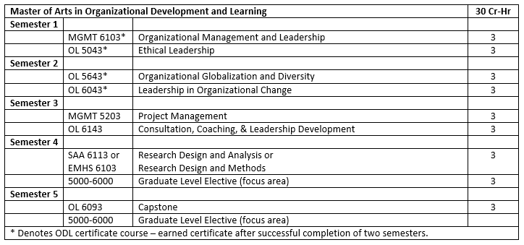
MA-ODL Interdisciplinary Curriculum
Focus Areas: Emergency Management, Gerontology, Health Informatics, Nonprofit Leadership, Student Affairs Administration, Research Methods and Assessment
Notes:
Emergency Management, Gerontology, Health Informatics, Nonprofit Leadership, Student Affairs Administration, Research Methods and Assessment

Slide 14
Graduate Certificate Curriculum
First four courses in the MA-ODL curriculum
Target audience: individuals seeking to continue their education to build skills specific to leadership and organizational development
Projected 85%+ of MA-ODL seeking students will opt-in to the graduate certificate
Projected enrollment of 15 - 20 certificate-only seeking students in the first three years of the program
Notes:
Emergency Management, Gerontology, Health Informatics, Nonprofit Leadership, Student Affairs Administration, Research Methods and Assessment

Slide 15
ATU Strategic Plan Alignment
Goal 1 Student Access and Opportunity
Goal 4 Programs and Deliveries
Goal 5 Partnerships and Innovation
Notes:
Goal 1: Item 1: Recruit and enroll first-time freshmen, transfer students, new graduate students and students who have dropped out/stopped out.
Goal 4: Item 1: Identify and implement academic and non-credit programs in response to market demand.
Item 3: Identify and implement new pathways to stackable courses and/or degree offerings.
Goal 5: Item 1: Form inter- and intra-campus/college/department academic partnerships that align with the university mission.

Slide 16
Efficient Delivery
Additional Budget Items – NONE
Developed as an interdisciplinary program to maximize efficiency and limit the need for additional resources.
Twelve credit hours of core courses in the program are existing courses within other graduate programs (MGMT 6103, MGMT 5203, SAA 6113, EMHS 6103).
Six credit hours of core courses are cross-listed with undergraduate coursework (OL 5043, OL 5643). The elective options in the MA-ODL are existing courses within other graduate programs.
Notes:
We believe this is a model that could be utilized by other programs by utilizing existing graduate courses within other graduate programs to meet the needs of professionals

Slide 17
Program Enrollment & Graduate Projections MA-ODL
Notes:
Graduation projections are based upon typical graduate retention rates and the projected enrollment is based on our best guestimate based upon undergraduate interest. We plan to recruit from active duty military installations for this degree and other business entities -

Slide 18
Program Graduates Salary Projections
Salary Projections based on salaries of Training & Development Managers:
https://www.bls.gov/ooh/management/training-and-development-managers.htm#tab-1
Notes:
Please Note: The salary projections are based solely on the occupational outlook for Training & development Managers. The MA-ODL degree is interdisciplinary by design to apply to multiple career fields.

Slide 19
New Program
Associate of Applied Science in
Occupational Therapy Assistant
Academic Affairs Agenda Item #09

Slide 20
New Program
Certificate of Proficiency and Technical Certificate in Forestry Technology
Academic Affairs Agenda Item #10

Slide 21
New Program
Master of Arts in Interdisciplinary Studies
Academic Affairs Agenda Item #11

Slide 22
New Program
Bachelor of Arts in Italian
Academic Affairs Agenda Item #12

Slide 23
New Program
Technical Certificate in
Electrical Lineworker Technology
Academic Affairs Agenda Item #13

Slide 24
AGENDA ITEM NO. 14
INSTITUTIONAL CERTICATION ADVISORY COMMITTEE: RESOLUTIONS
Alana Boles
Associate Director of Academic Affairs

Slide 25
Institutional Certification Advisory Committee (ICAC) Resolutions
5 Institutions
29 Degree and Certificate Programs

Slide 26
AGENDA ITEM NO. 15
LETTERS OF NOTIFICATION
Tracy Harrell
Academic Affairs

Slide 27
Letters of Notification
169 Letters of Notification from 23 institutions
received by February 1, 2023
n | Requested Action
10 | CIP Change
60 | Curriculum Revision
2 | Delete Option, Emphasis, Concentration or Minor
4 | Deletion of Existing Administrative Units
3 | Establishment of New Administrative Units
1 | Existing Program Offered at Off-Campus Location
13 | Existing Program Offered by Distance Education
6 | Existing Program Offered via Concurrent Education at Off-Campus Location
24 | New Certificate
13 | New Option, Emphasis, Concentration or Minor
29 | Program Deletion
9 | Program Inactivation
1 | Program Reactivation
14 | Program Reconfiguration
25 | Title Change

Slide 28
AGENDA ITEM NO. 16
LETTERS OF INTENT
Tracy Harrell
Program Specialist – Academic Affairs

Slide 29
Letters of Intent
12 Letters of Intent from 6 institutions
received by April 3, 2023
n | Reason for Intent
1 | New Organizational Unit
11 | New Programs

Slide 30
Any Questions?

Slide 31
AHECB Full Board Meeting
April 28, 2023

Slide 32
Dr. Charles Ambrose, Chancellor
Henderson State University

Slide 34
REIMAGINING HENDERSON
Henderson faced a $12.5 million projected budget shortfall for the fiscal year ending June 30, 2022, long-term debt of $78 million, and depleted financial reserves.
Henderson needed to restore financial integrity for sustainable operations. This included eliminating annual operating deficits, improving cash position, and aligning instructional spending to revenue generated by academic programs.

Slide 35
BASED ON FY22 AUDITED FINANCIAL STATEMENTS, HENDERSON MADE SIGNIFICANT PROGRESS IN RESTORING SUSTAINABLE OPERATIONS:
MODIFIED CASH BUDGET & FINANCIAL EXIGENCY
Accounts payable decreased from $6,926,687 to $1,383,746 for an improvement of $5,542,941, or 80 percent in operational savings.
Payroll decreased from $30,768,950 to $23,498,322, for a reduction of $7,270,628, or 23.4 percent, with most savings occurring between January and June 2022.
Henderson’s overall net position improved from $21,013,662 in FY21 to $31,946,526 in FY22.
Henderson improved from 7 days of cash on hand in 2019 to 50 days of cash on hand in 2022.
Henderson implemented a modified cash budget, including expense reductions and position management. Savings included furloughs and administrative salary rollbacks ($1.2 million), position management ($335,160), and academic dean salary and stipend rollbacks ($130,403).
Financial exigency included an evaluation of academic programs based on metrics such as cost of delivery and net revenue, unit-based cost of instruction, student success rates with a weighted priority for degree completion, and alignment to community-based workforce needs. Approximately 40 percent of programs were eliminated.

Slide 36
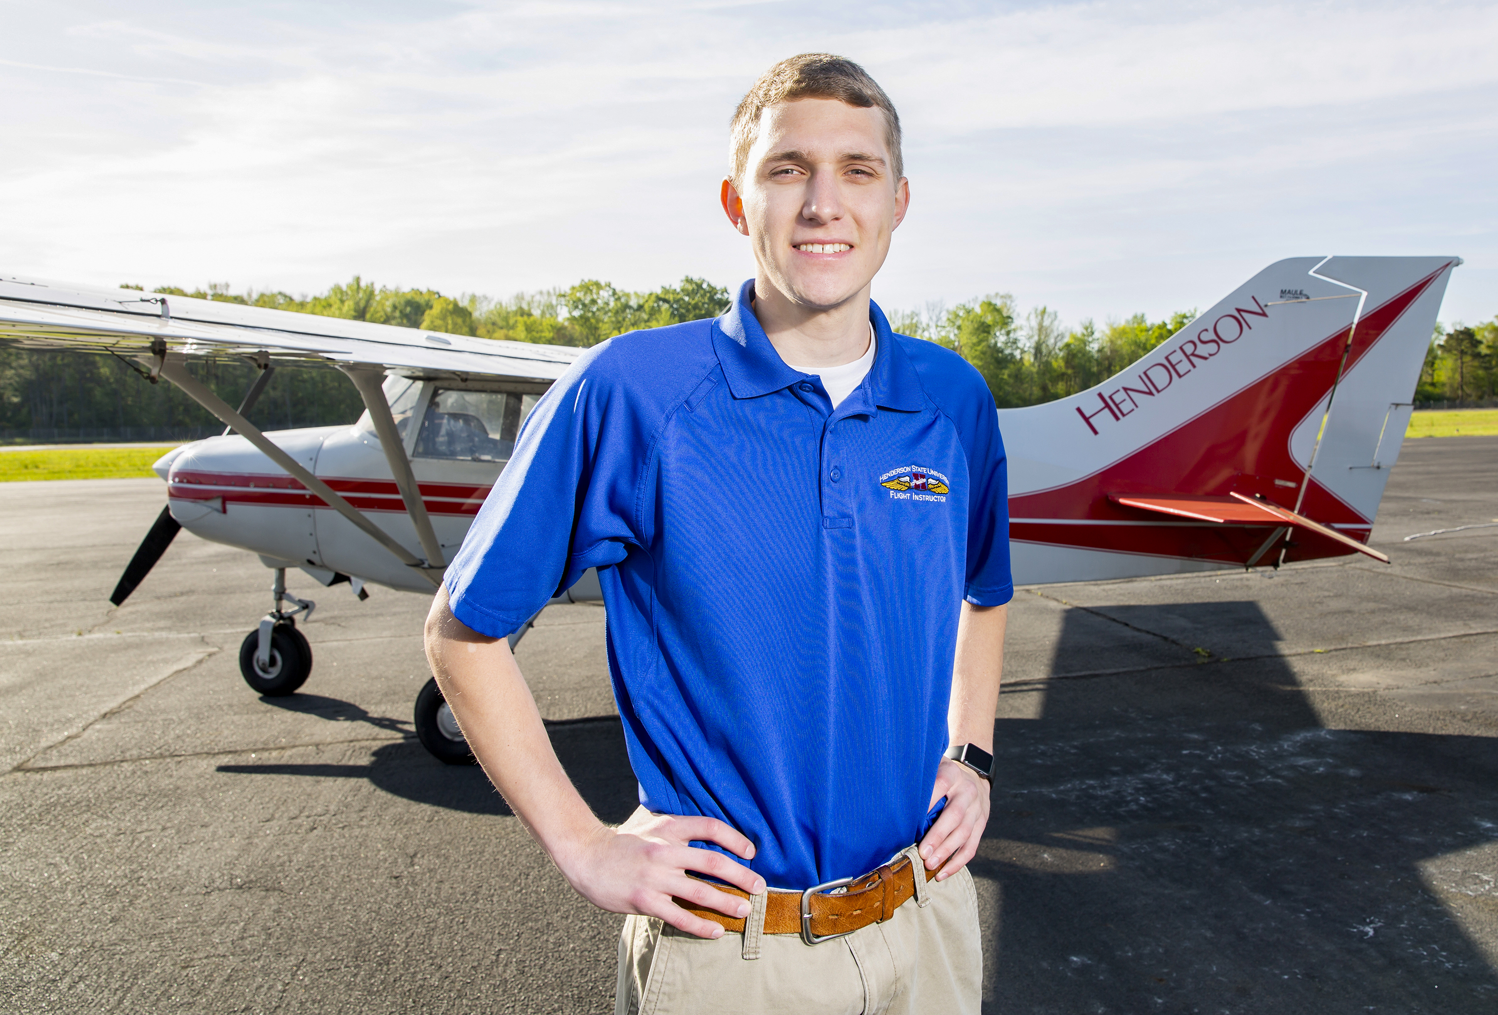
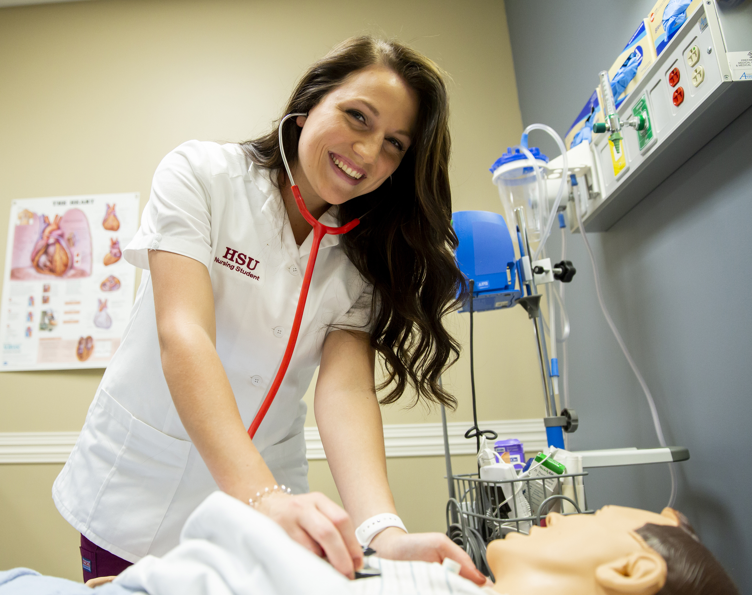
REDDIE FOR WHAT’S NEXT
With the continued support of the ASU System and State of Arkansas, Henderson will build seamless pathways from school to work while preparing students with degrees and credentials for high-demand careers. Our learning community model focuses on removing barriers to degree completion while creating a university with a Students First focus.
Open the door of opportunity and access for all students
Commitment to student completion
Degrees that matter and meet community needs
Associate plus bachelor’s degree in four years
Lower tuition cost through instructional reallocation
Navigate early intervention system
Intrusive advising and tutoring
Case management and CARES model
Less time to degrees through experiential learning opportunities and job placements

Slide 37
Approval of Minutes
January 27 Regular Meeting
February 16 Special Meeting

Slide 38
MASON CAMPBELL
Agenda item no. 2: AGENCY UPDATES

Slide 39
New DHE Staff
Dr. Tina Moore
Director of Workforce Development
Began February 20, 2023
Krystel Morgan
Program Specialist
Began April 3, 2023

Slide 40
AGENDA ITEM NO. 3
REPORT ON ACADEMIC PROGRAM VIABILITY
Mason Campbell
Chief Academic Officer

Slide 41
Academic Program Viability Standards
AHECB adopted new program viability standards in October 2008.
The 2008 viability standards, based on a 3-year average, are as follows:
Average of four (4) graduates per year for CTE degrees and certificates
Average of four (4) graduates per year for bachelor’s degrees in science, mathematics, engineering, foreign languages, and secondary education
Average of six (6) graduates per year for transfer associate degrees (AA, AS, and AAT) and bachelor’s programs;
Average of four (4) graduates per year for master’s, specialist and first-professional programs; and,
Average of two (2) graduates per year for doctoral programs

Slide 42
Non-Viable Programs Background
Since January 2023 AHECB meeting
Modified report from board recommendations
Met, via “Zoom Sessions” with each 2-Year & 4-Year institution’s Chief Academic Officer & other academic staff
The Board requested ADHE staff return to the April 2023 board meeting with a list of programs that exceed the two (2) additional years after initially being identified as non-viable.

Slide 43
Non-Viable Report Updates
ADHE Academic Affairs staff, in conjunction with ADHE Information Systems staff, developed a new report that included a total of five (5) years, which would allow for the consideration of three (3) separate three-year averages.
The report included graduation counts, individual program averages, and program cognate averages for AY18 - AY22.

Slide 44
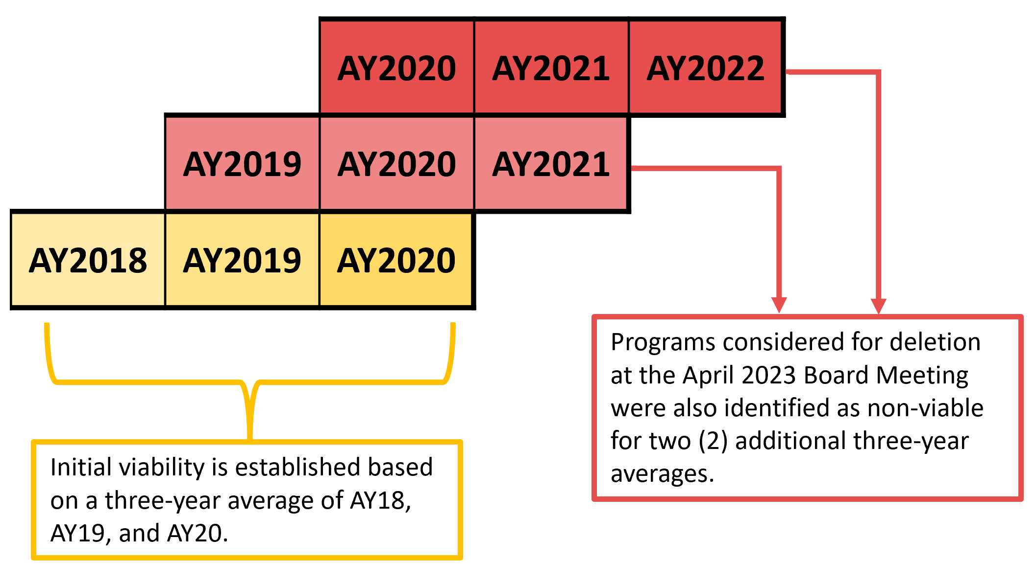
Academic Years for FY22 Non-Viable Report
The graphic below illustrates how the academic years are considered for this report:

Slide 45
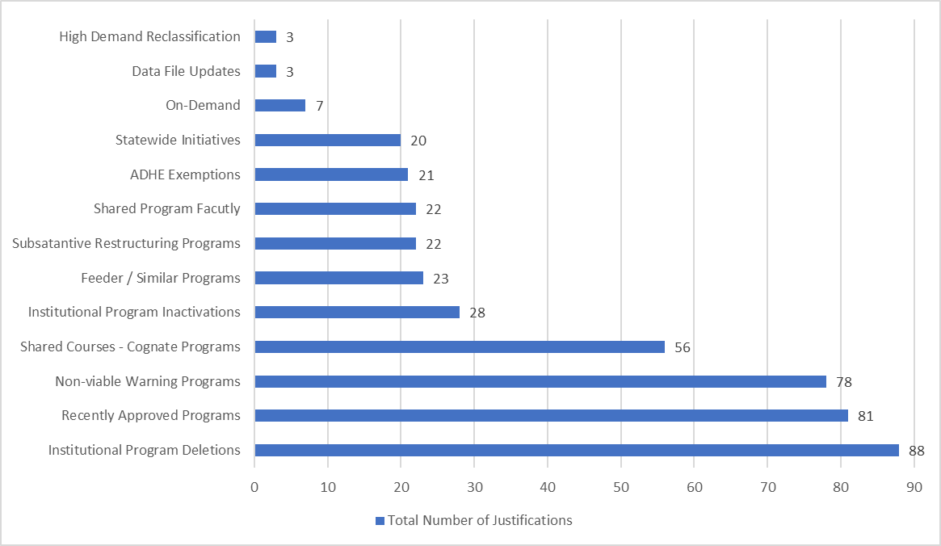
Non-Viable Program Removal Justifications

Slide 46
Non-Viable Programs by Award Type
The following table lists the sixteen (16) award types ADHE staff recommend for deletion:
Award Type | Total
Certificate of Proficiency | 5
Technical Certificate | 4
Associate Degrees | 2
Bachelor’s Degrees | 3
Master’s Degrees | 1
Graduate Certificate Degrees | 1
Total | 16

Slide 47
Non-Viable Programs Report Conclusion
ADHE staff will monitor process made on each institutional commitment.
The 16 remaining programs on the non-viable list will be removed from active status on the approved programs list effective May 1, 2023.

Slide 48
Questions?

Slide 49
Agenda item no. 04: RULES GOVERNING THE STUDENT UNDERGRADUATE RESEARCH FELLOWSHIP PROGRAM (SURF)
Alisha Lewis
Assistant Director for Operations

Slide 50
Grading Criteria Possible Points Points Awarded
Student’s performance and accomplishments (G.P.A., activities, community service, etc.). | 10
Appropriateness of courses completed for proposed research. | 10
Mentor’s letter of support. | 10
Two letters of reference. | 10
Mentor has prior experience supervising students in the discipline. (New faculty should be considered, as well as faculty recently beginning involvement in research.) | 10
Appropriateness of proposed mentor’s previous experience for the proposed project. | 10
Research/scholarly activity/productivity by the mentor. | 10
The proposed research project. * | 30
TOTAL POINTS AWARDED | 100
Selection Criteria
Student’s Academic Success: GPA, Extracurricular Activities, Leadership, etc.
Qualifications of the Mentor and Research Team (if applicable): Clear plan for support, research history, experience in the field of proposal, contributions to undergraduate research.
Innovation/Originality: Generates new ideas and/or applies existing ideas in a new context.
Significance of the Study: Outcomes are clearly proposed and Impact is anticipated. STEM – Addresses an area of importance to the discipline and shows potential to advance the science. Non-STEM - Expands knowledge of best/creative practices in the field, increases creative output.
Appropriateness of the methodology: STEM - Research design, Sampling approach, Data collection protocol/plan, Data analysis procedure/plan, Protection of human subjects and/or plan for seeking IRB approval. Non-STEM – Preliminary Research showing selection and citation of primary and secondary sources, Hermeneutic framework, analytical approach is well defined or creative process and products are well planned/described.
Merit: STEM - Utilizes established scientific principles, Demonstrates how scientific knowledge will be gained, Problem/topic being investigated is of value to the larger scientific community. Non-STEM – Uses best practices and innovative approaches in the field, betters the understanding of the human experience, benefits and engages the fields community.
Other Criteria: Reference Letters, plan for dissemination, appropriate budget, feasibility of completing the project in projected timeframe, cohesiveness and coherency, clarity of writing

Slide 51
Questions?

Slide 52
Agenda item no. 05: ARKANSAS HEALTH EDUCATION GRANT PROGRAM REQUEST FOR CONTRACT REALLOCATION
Alisha Lewis
Assistant Director for Operations

Slide 53
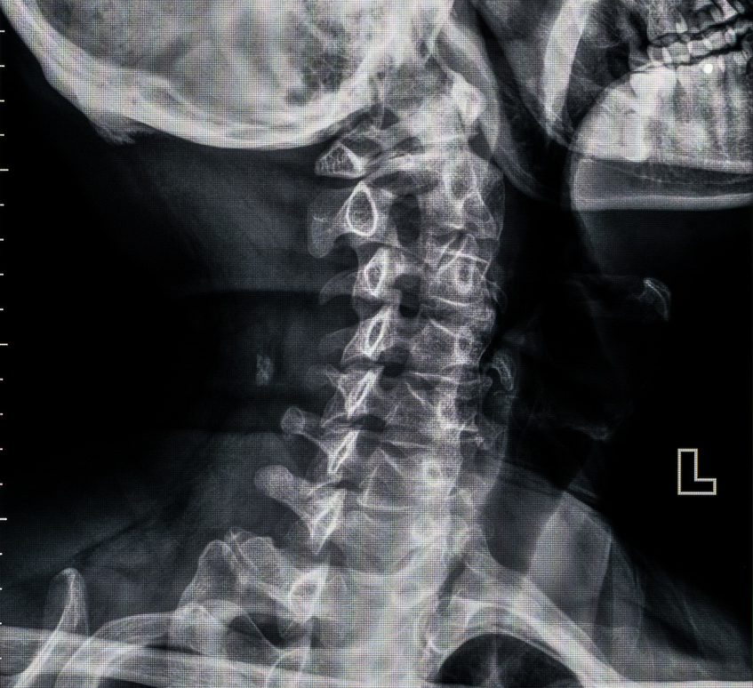
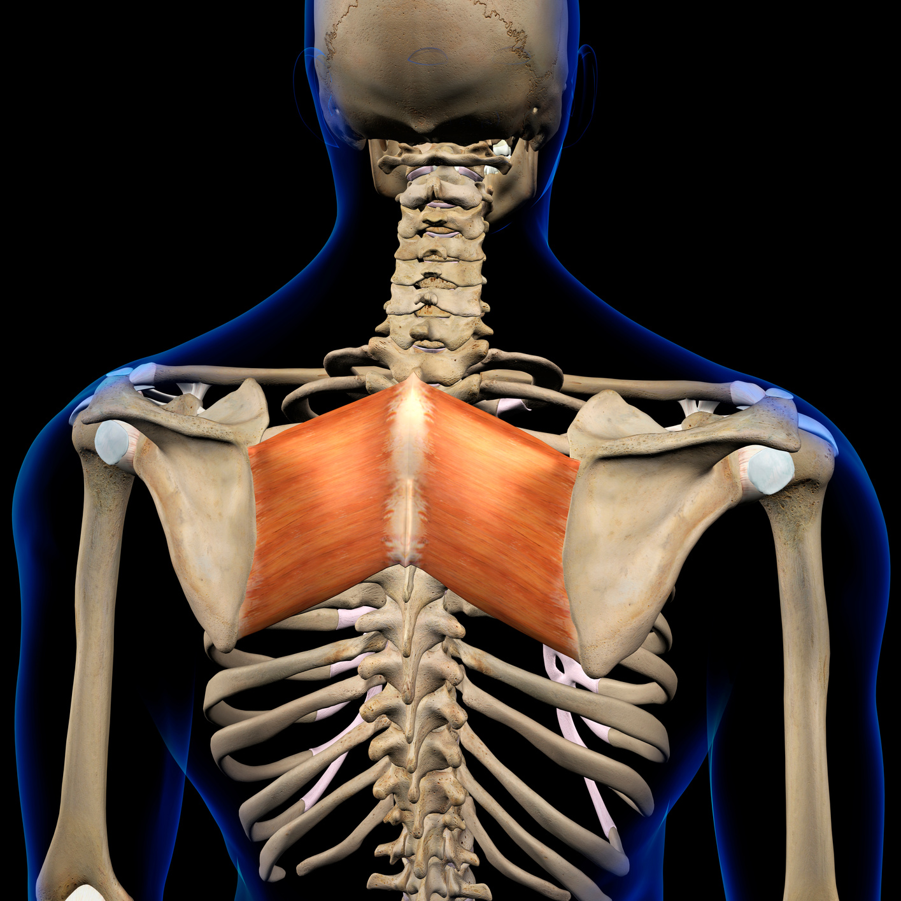
CHIROPRACTIC MEDICINE
CURRENT
13 (Total)
REQUESTED
13 (Total)
Cleveland Chiropractic College
(Kansas City, MO)
2
1
Life University (Marietta, GA)
0
2
Logan College of Chiropractic (Chesterfield, MO)
3
3
Palmer College of Chiropractic (Davenport, IA)
1
2
Parker College of Chiropractic (Irving, TX)
6
5
Texas Chiropractic College (Pasadena, TX)
1
0

Slide 54
Questions?

Slide 55
FINANCE COMMITTEE REPORT

Slide 56
ACADEMIC COMMITTEE REPORT

Slide 57
PUBLIC COMMENTS/ ANNOUNCEMENTS
Follow-up questions can be sent to: Nichole.Abernathy@adhe.edu
Presentations will be posted on the ADHE website at:
https://www.adhe.edu/about-adhe/coordinating-board/board-presentations

